Slide 1
About this resource
This slide deck accompanies “A Practical Guide to Implementing Responsible Research Assessment at Research Funding Organizations” (May 2026). It is designed to support funding agency staff in planning actionable RRA-aligned interventions in funding workflows.
The deck provides an overview of the main sections of the Guide covering: an introduction to RRA, the role of funders, and potential areas for activities and actions to embed RRA-aligned policies and practices at funding agencies.
Presenter notes are included in each slide.
This content made available under a Creative Commons Attribution License (CC BY-NC 4.0), except for supporter logos. Logos are trademarks or registered trademarks of their respective organizations and may not be reused without permission. The DORA logo may be used if its visual integrity is maintained and it is not used to suggest endorsement by DORA.
To find out more, visit https://sfdora.org/
Notes:
This slide deck is designed to accompany the “A Practical Guide to Implementing Responsible Research Assessment at Research Funding Organizations” (published in May 2026).
It is designed to support funding agency staff in planning actionable RRA-aligned interventions in funding workflows.
The deck follows the outline of the Guide covering: an introduction to RRA, the role of funders, and potential areas for activities and actions to embed RRA-aligned policies and practices at funding agencies.
Presenter notes are included in each slide.
The content is available under a Creative Commons Attribution License (CC BY-NC 4.0), except for supporter logos. Logos are trademarks or registered trademarks of their respective organizations and may not be reused without permission. The DORA logo may be used if its visual integrity is maintained and it is not used to suggest endorsement by DORA.
Please feel free to delete the slides as appropriate.
To find out more, visit https://sfdora.org/

Slide 2
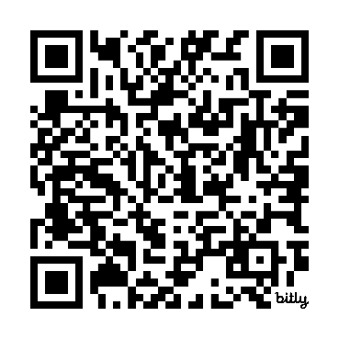
Implementing Responsible Research Assessment at Research Funding Organizations
Overview of DORA’s Practical Guide for Research Funding Organizations for funding program staff
https://bit.ly/DORA-Funder-Guide
Notes:
Please feel free to change this and other slides!

Slide 3

A collaborative effort
The Guide was created with the input of funding experts
Global Research Council Responsible Research Assessment Working Group
Science Europe
DORA’s Funders Groups
Participants at a workshop at the Conference on Reforming Research Assessment (CeRRA) (Copenhagen – Dec 2025)
Guide citation:
Allen, L., Barbour, V., Borrell-Damián, L., Cobey, K., Dube, N., Firth, C., Lawrence, R., Lima, G., McGuirk, S., Morris, J. P., Trinh, A.-K., & Uwineza, J. (2026).
A practical guide to implementing responsible research assessment at research funding organizations.
Declaration on Research Assessment (DORA). https://doi.org/10.5281/zenodo.18402271
Notes:
The Guide was created through a collaboration with the Global Research Council’s Responsible Research Assessment Working Group and Science Europe
We are also very grateful for the input and helpful contributions of a range of funding experts, notably, DORA’s Funders Groups and participants of a workshop held alongside the EU High-level Conference on Reforming Research Assessment (CeRRA) in Copenhagen in December 2025.
While the contributors' insights strengthened this work, any errors or omissions that remain are entirely our responsibility. The views expressed in the Guide are those of the authors and should not be interpreted as reflecting the positions of the contributors or their institutions.

Slide 4
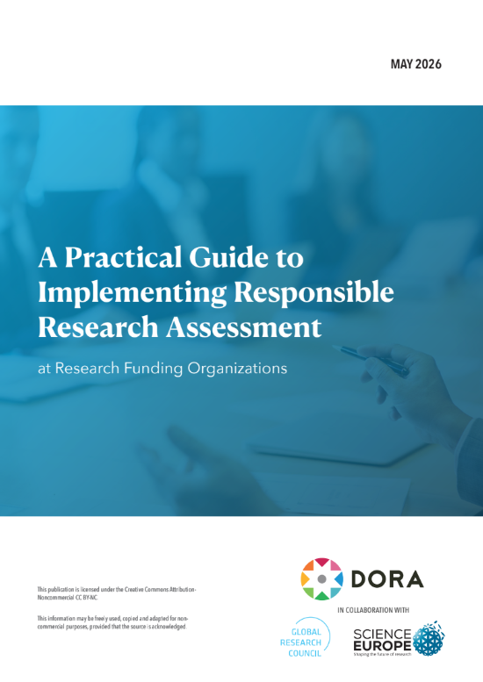
Aims of the Guide
A “one-stop-shop” for funding agencies, providing guidance and tips on how and where to get started with Responsible Research Assessment (RRA), alongside resources and real examples.
For all types of funder
Use flexibly: no ‘one-size fits all’ approach
Available free: bit.ly/DORA-Funder-Guide
Notes:
The aim of the Guide is simple: it is designed to be a “one-stop-shop” for funding agencies, providing practical tips on how and where to get started with Responsible Research Assessment (RRA), alongside with resources and real examples.
Its audience is broad and inclusive – it is intended for any research funder who want to use RRA to enhance the effectiveness and impact of their funding, and that’s from government agencies and private philanthropies to not-for-profit research charities, and commercial organizations.
It should be used flexibly –no ‘one-size fits all’ – implementing RRA involves trade-offs, with resources, costs, and benefits to consider in each context. Whether starting out or already making changes, organizations are encouraged to use the ideas, tools, and examples that best fit their needs and context.
The Guide is available free: https://bit.ly/DORA-Funder-Guide

Slide 5
Contents of the Guide
Chapter 1: Introduction to Responsible Research Assessment & its underlying principles
    Research assessment reform
    The goals and principles of RRA
    The importance of collective action on RRA
Chapter 2: Key activities for embedding RRA
Chapter 3: Key moments in funding agency assessment
Chapter 4: Relationship with components of the system
Resources & references
Notes:
The deck is organized into sections, following those of the Guide itself.
Introduction
Key activities for embedding Responsible Research Assessment
Key moments for RRA in funding agency research assessment
Responsible Research Assessment and its place in the research system
A final section provides links to some resources that have been created to complement the full Guide, including a series of Informational Briefs designed for specific staff at funding agencies (e.g. the leadership and funding program staff) and one-page summaries that provide an overview of the contents of key sections in the Guide.

Slide 6
Chapter 1. Introduction
https://bit.ly/DORA-Funder-Guide
Notes:
Please feel free to change this and other slides!

Slide 7
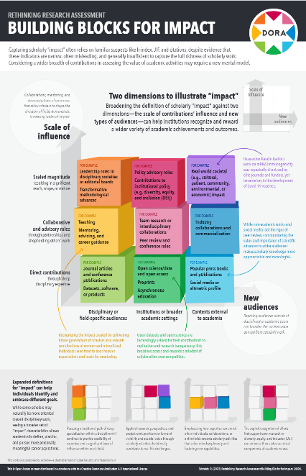
What is Responsible Research Assessment?
The goal of Responsible Research Assessment is to promote holistic, balanced, and fair approaches to evaluating research and researchers and as part of inclusive research cultures.
RRA is guided by 3 core principles:
  Encouraging a holistic view of research contributions and impact
  Think balanced and broad: valuing quality over quantity
  Promoting equity.
Schmidt, R. (2022). Building Blocks for Impact. Zenodo. https://doi.org/10.5281/zenodo.7249187
Notes:
Responsible Research Assessment (RRA) is defined as an umbrella term for approaches to assessment that incentivize, reflect, and reward the plural characteristics of high-quality research, in support of diverse and inclusive research cultures. It represents a shift from traditional assessment approaches that have often relied narrow quantitative indicators, such as publication counts and citations, as proxies for quality and performance. While useful in some contexts, these measures do not capture the full range of contributions that underpin robust, impactful research.
RRA is guided by 3 core principles:
Encouraging a holistic view of research contributions and impact – [the resource (pictured) provides a useful way to think about the types and diversity of research impact when thinking about approaches to RRA]
Think balanced and broad: valuing quality over quantity
Promoting equity
Implementing RRA involves considering how and where any existing processes are not aligned to RRA principles and where changes can be made to established practices within the funding life cycle – for example, during the design of funding calls, and in the assessment of grant applications for funding.

Slide 8

A leading role for research funders
Funders play a central role in enabling RRA
Funders influence the behaviors of researchers through their research assessment policies and practices
RRA-aligned practices can drive return on funding investment:
  Improving research quality and reliability
  Reducing research waste and duplication
  Accelerating real-world impact
Notes:
Funders play a central role in shaping RRA across the research system: their policies and requirements influence the conduct and behaviors of those they fund, and in the organizations where research is performed
(e.g. in universities and research organizations), and thereby influences research culture more broadly.
Evidence also shows that RRA-aligned practices can help drive additional value from funding investments, specifically:
By improving research quality and reliability: by incentivizing robust and rigorous methods and reporting of findings, making research more reliable and reproducible and reducing the risk of potentially unreliable findings being adopted
By reducing waste and duplication: transparency, data sharing, and the reporting of negative or null results helps to reduce wasted resources by avoiding unnecessary duplication or research that adds little new knowledge
By accelerating real-world impact: improving quality, reducing waste and encouraging collaboration, and the sharing of a wider range of research outputs ultimately helps research to move more quickly into policy and practice, delivering societal impact.
EVIDENCE references:
Ioannidis, J. P. A., Greenland, S., Hlatky, M. A., Khoury, M. J., Macleod, M. R., Moher, D., Schulz, K. F., &Tibshirani, R. (2014). Increasing value and reducing waste in research design, conduct, and analysis. The Lancet, 383(9912), 166–175. https://doi.org/10.1016/s0140-6736(13)62227-8
UK Reproducibility Network Steering Committee (2021). From grassroots to global: A blueprint for building a reproducibility network. PLOS Biology, 19(11), e3001461. https://doi.org/10.1371/journal.
pbio.3001461
Chalmers, I., & Glasziou, P. (2009). Avoidable waste in the production and reporting of research evidence. The Lancet, 374(9683), 86–89. https://doi.org/10.1016/s0140-6736(09)60329-9

Slide 9
Chapter 2. Key activities for embedding RRA in the organization
https://bit.ly/DORA-Funder-Guide
Notes:
Please feel free to change this and other slides!

Slide 10
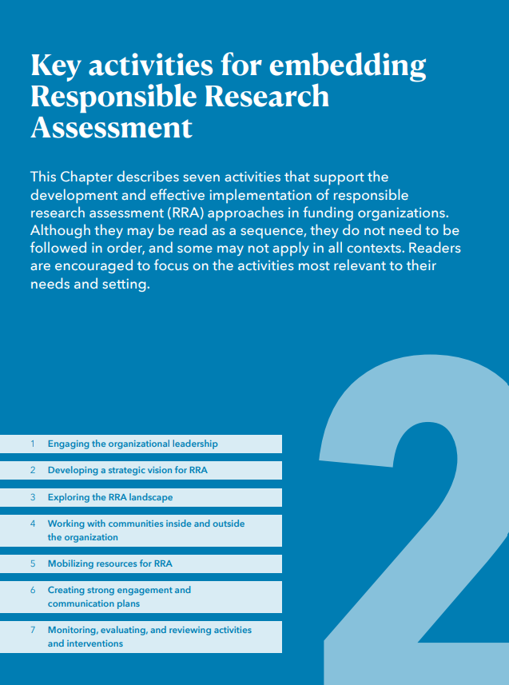
Embedding RRA in the organization
Activities to build momentum for research assessment reform
Engaging the organization leadership
Developing a strategic vision for RRA
Exploring the RRA landscape
Engaging with communities inside and outside the organization
Mobilizing resources
Creating strong engagement and communication plans
Monitoring, evaluating, and reviewing activities and interventions
Notes:
The DORA Guide outlines seven activities that, based on the DORA’s community experience, can be crucial for the successful development of RRA approaches at funding agencies.
As a reminder, the Guide aims to support all types of funders – government, not-for-profit, charity AND across geographies AND working across research disciplines. We recognize that ‘one size will not fit all’ and therefore, while the activities are numbered, they do not need to be considered (or followed) in sequence, and organizations should consider the activities that work best in their specific context and circumstance.
The seven activities described in the Guide are:
Engaging the organization leadership: Highlighting the importance of securing the support and input from senior staff and leaders to enable action and drive change.
Developing a strategic vision for RRA: Guiding organizations in defining a clear vision for RRA that aligns with their mission and values, potentially linking it to broader goals like fostering open science or promoting equity.
Exploring the landscape for RRA: Developing a comprehensive understanding of what research assessment policies and practices operate internally (and importantly, where this activity might be taking place) AND discovering approaches to research assessment at peer organizations (e.g. other funders) and other national and international initiatives that have relevance to RRA (and that might be useful to engage and/or align with).
Engaging with communities inside and outside the organization: Emphasizing the value of getting the input and involvement of various internal colleagues and teams (e.g. policy, comms) AND experts outside the organizations (e.g. engaging with potential applicants and reviewers), on the need and importance of change AND identifying priorities and practical places to make changes to policies and practices.
Mobilizing resources: to make the case and build the evidence for the importance of RRA. And resources to practically develop, test and implement what might be new approaches to RRA, updates to policies and/or a broader strategy. Considering how and where resources might be needed and identifying priorities – think people, time, materials – and funding!
Creating strong engagement and communication plans: Highlighting the necessity of clear, transparent, and consistent communication with all those impacted by changes to policies and practices, to build buy-in, and to mitigate concerns.
Monitoring, evaluating, and reviewing activities and interventions: Emphasizing the importance of being evidence-based and understanding what works and what doesn’t, regularly reviewing changes as the context may evolve, identifying unintended consequences, and essentially keeping the approaches aligned with organizational needs.
Chapter 2 also features a "Spotlight” on the SPACE Rubric – which is a tool that can help organizations to gauge their internal capacity and infrastructure to support RRA interventions and plan for success. The rubric has five dimensions (Standards for Scholarship, Process Mechanics and Policies, Accountability, Culture Within Institutions, and Evaluative and Iterative Feedback) and three stages of capability development (Foundation, Expansion, Scaling). The Guide suggests various ways the SPACE Rubric can be used to support the activities discussed in this chapter, such as structuring discussions for a task force or analyzing current practices.

Slide 11
Chapter 3. Key moments for RRA in the funding life cycle
https://bit.ly/DORA-Funder-Guide
Notes:
Please feel free to change this and other slides!

Slide 12
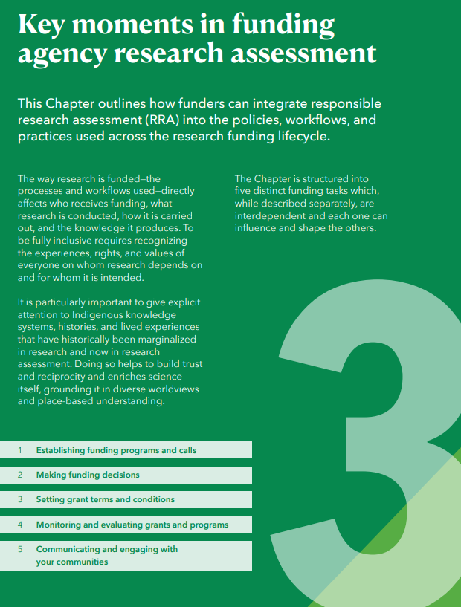
Embedding RRA in the funding lifecycle
Moments to introduce RRA-aligned processes and workflows
Establishing funding programs and calls
Making funding decisions
Setting grant terms and conditions
Monitoring and evaluating grants and programs
Communicating and engaging with your communities
Notes:
The Guide also provides guidance on how and where to potentially introduce and/or embed RRA-aligned policies practices into policies and procedures at five key places (moments) within the typical research funding cycle.
In each of these 5 moments, the Guide suggests concrete actions and provides a ‘menu of options’ approach that encourages adaptation to local contexts.
The five moments are:
Establishing funding programs and calls: This section emphasizes aligning these critical career junctures with RRA principles. This involves recognizing the diverse contributions and talents of researchers, prioritizing qualitative evaluation, moving away from inappropriate metric use, and ensuring a fair and transparent process. Suggested interventions cover creating committees, designing application materials (like transparent forms and clear criteria), writing job adverts, triaging applications, conducting interviews (using standardized protocols), providing post-hire support, and evaluating the entire process (e.g., using feedback forms). It highlights the importance of providing clarity and support throughout the application and assessment process.
Making funding decisions: The chapter offers approaches for applying RRA principles to the assessment and awarding of internal funding and prizes. Key suggestions include ensuring clear, open, and transparent criteria focused on the quality and impact of scholarship in award notices and grant calls. Nomination and application forms should request information relevant to the award/grant and be structured to allow applicants to contextualize their achievements, potentially using narrative formats alongside quantitative data. The process should involve appropriate panels and transparent communication, sensitive to both successful and unsuccessful applicants, and include mechanisms for review and feedback after the award cycle.
Setting grant terms and conditions:
Monitoring and evaluating grants and programs: This section addresses the assessment of organizational entities like university departments, research centers, and infrastructures. The goal is to align these evaluations with the organization's overall RRA principles, values, and mission. The guide suggests integrating RRA approaches through contractual components in internal budget distribution systems. Recommended actions include developing clear evaluation policies and practices, carefully composing evaluation panels (potentially including external members and providing unconscious bias training), promoting self-evaluation focused on diverse contributions, conducting the evaluation transparently, and establishing mechanisms for post-evaluation feedback and continuous improvement.
Communicating and engaging with your communities: The final key moment stresses the importance of ensuring that RRA becomes a part of the institution's internal and external narrative and identity. This involves making communication colleagues aware of the RRA strategy and enabling them to share stories and successes that highlight a broader range of contributions. Suggestions include embedding RRA in institutional policies and position statements, leadership updates and newsletters, and communications around key appointments and hires. It specifically addresses how to frame commentary around national and institutional rankings, encouraging a holistic view of the institution and clarifying the limitations of metrics-based rankings while affirming they do not dictate individual assessment criteria.
Chapter 3 also features "Spotlight" sections that delve into considerations relevant to these key moments:
Narrative CVs: Presented as an alternative to traditional CVs, allowing researchers to describe their achievements, skills, and contributions in a contextualized, descriptive format. They aim to promote diversity, equity, and inclusion by recognizing varied experiences and reducing biases, enabling researchers to "tell their story". The guide mentions evidence suggesting narrative CVs can reduce bias and highlight suboptimal practices. A possible framework for describing contributions via narrative CVs includes knowledge creation, development of individuals/collaborations, supporting the research community, and contributions to broader society.
Early Career Researchers (ECRs): This spotlight highlights the importance of aligning assessments at key moments like thesis evaluations with RRA principles. It notes ECRs' desire for assessment approaches that value diverse outputs. The Spotlight suggests RPOs can consider training for ECRs covering responsible metrics, open science, research integrity, and how to contextualize their contributions using narrative CVs.
The Chapter references tools like the SPACE Rubric and the SCOPE Framework as aids for monitoring and evaluating the effectiveness of implemented RRA strategies.

Slide 13
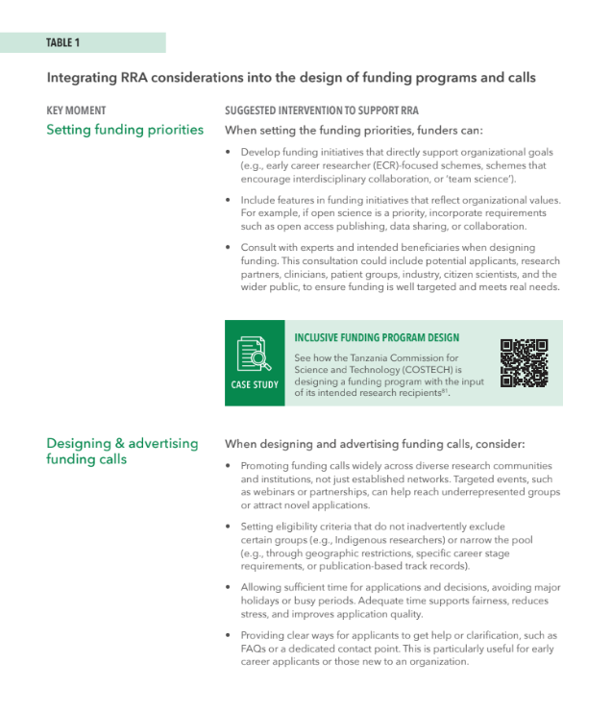

Establishing funding programs and calls
Moments to introduce RRA-aligned processes and workflows
Setting funding priorities
Designing and advertising funding calls
Designing application processes
Notes:
How research funding organizations (RFOs) design and advertise their programs sets the tone for who applies, what is proposed, and how research quality is assessed.
The Guide contains suggestions for place to embed RRA-aligned practices in the funding programs and calls. Including for example:
1. Setting funding priorities
Align funding priorities with organizational values and goals
Engage the intended funding beneficiaries in program design
2. Designing and advertising funding calls
Advertise calls widely to reach diverse communities beyond established networks
Set eligibility criteria that do not inadvertently narrow the applicant pool
Provide sufficient guidance, time and support to enable high-quality applications
3. Designing application processes
Provide guidance on the funding eligibility, assessment process, criteria for selection, and policies (e.g. AI use, data sharing, open access)
Keep application processes proportionate. Use a staged process where this can reduce administrative burden, and only ask for the information that is needed at each stage
Create application forms that provide space for applicants to share the diversity of their experience and achievements (e.g. using Narrative CVs)

Slide 14
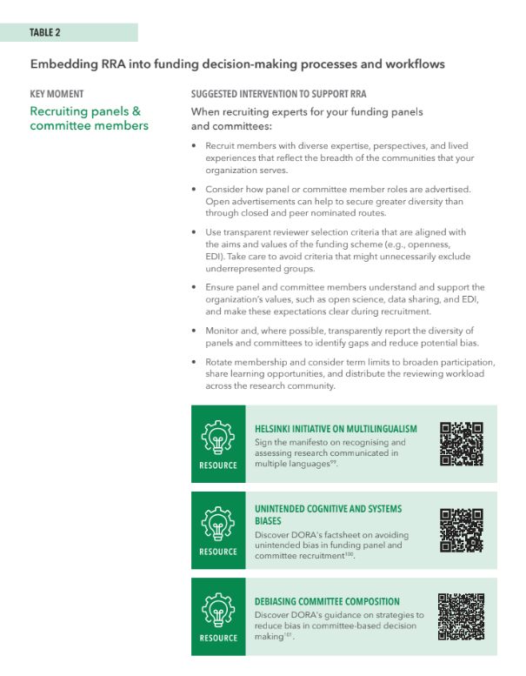

Making funding decisions
Moments to introduce RRA-aligned processes and workflows
Recruiting panel and committee members
Providing reviewers’ guidance and training
Designing RRA-aligned decision-making workflows
Sharing funding decisions with applicants
Notes:
Embedding responsible research assessment (RRA) principles in funding decision-making helps to ensure fairness and consistency, while strengthening the credibility of those decisions.
The Guide contains suggestions for place to embed RRA-aligned practices in the funding decision-making processes. Including for example:
1. Recruiting panels and committee members
Recruit members with diverse expertise and perspectives
Advertise roles openly to broaden participation beyond established networks
Use transparent selection criteria, avoiding requirements that may exclude underrepresented groups
2. Providing reviewers’ guidance and training
Clearly define reviewer roles and responsibilities
Provide guidance on how to interpret application materials (e.g. Narrative CVs)
Specify any tools or metrics that should not be used (e.g. journal prestige, H-index)
Provide training to help reviewers recognize and mitigate bias
3. Designing RRA-aligned decision-making workflows
Keep processes proportionate and transparent
Use structured approaches for consistency (e.g. scoring systems, calibration)
Test out, refine, and share the findings of any new approaches
4. Sharing funding decisions with applicants and reviewers
Provide timely and constructive feedback
Recognize reviewer contributions and inform them of decisions
Share summary data on applications and awards where possible

Slide 15
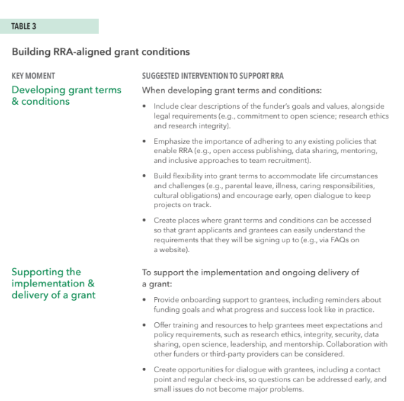

Setting grant terms and conditions
Moments to introduce RRA-aligned processes and workflows
Creating grant term and conditions
During the implementation and delivery of a grant
When setting grant reporting requirements
Notes:
Grant terms and conditions (T&Cs) reflect research funding organizations (RFO) values and define the relationship between funder and grantee. T&Cs aligned with responsible research assessment (RRA) help to forge a partnership with grantees, rather than serving as compliance documents.
The Guide contains suggestions to create RRA-aligned grant terms and conditions, including:
1. Creating grant terms and conditions
Make T&Cs easy to access and understand (e.g. via website FAQs)
Describe the organization’s expectation of grantees in your T&Cs
Enable flexibility in T&Cs to accommodate the changes to project and grantee circumstances
2. During the implementation and delivery of a grant
Provide onboarding training for new grantees
Make it easy for grantees to keep in touch and adhere to your requirements
Establish communication channels with grantees to uncover any issues early
3. When setting grant reporting requirements
Define progress reporting expectations and timelines early so grantees can plan effectively
Keep reporting proportionate: request only information that is needed and draw on existing sources where possible

Slide 16
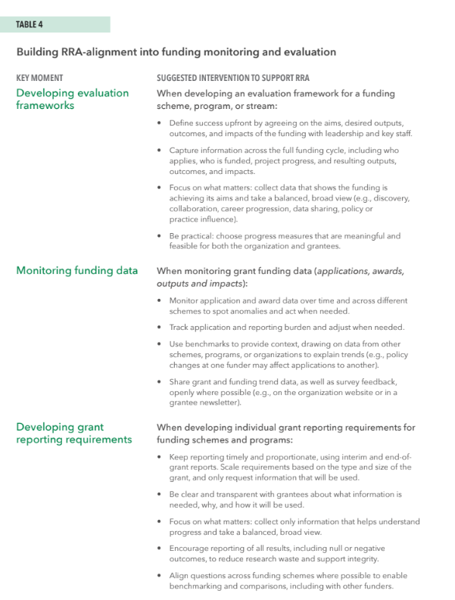

Monitoring and evaluating grants and programs
Moments to introduce RRA-aligned processes and workflows
Developing evaluation frameworks
Monitoring funding data
Developing grant reporting requirements
During grant delivery (e.g. progress reporting)
Evaluating outputs and impact
Notes:
Responsible Research Assessment (RRA)-aligned monitoring and evaluation focuses on capturing information that matters, supporting learning and improvement rather than box‑ticking.
The Guide outlines practical ways to embed RRA in monitoring and evaluation (M&E), including:
1. Developing evaluation frameworks
Define and communicate the goals and indicators of success of funding programs upfront
Be proportionate: focus on what matters and take a balanced, broad view of outputs and outcomes
Select progress and success indicators that are easy to capture and minimize the burden for both the organization and grantees
2. Monitoring funding data
Track applications, awards, outputs, and impacts over time to identify trends
Use benchmarks to provide context and interpret trends
Share funding data as openly as possible, and in formats that make the data easy to use
3. Developing grant reporting requirements
Keep reporting timely and proportionate
Be clear about what information is needed and how it will be used
Encourage reporting of all results, including null or negative findings
4. During grant delivery (progress reporting)
Alongside tracking progress and challenges, use reporting to support learning
Only request information that you intend to use
Where possible, enable flexibility in reporting timelines to accommodate changes to project and grantee circumstances
5. Evaluating outputs and impact
To support learnings, share the findings of M&E openly where possible
Show how reporting and evaluation activity informs decision-making
To support continuous improvement, gather feedback on your M&E activity

Slide 17
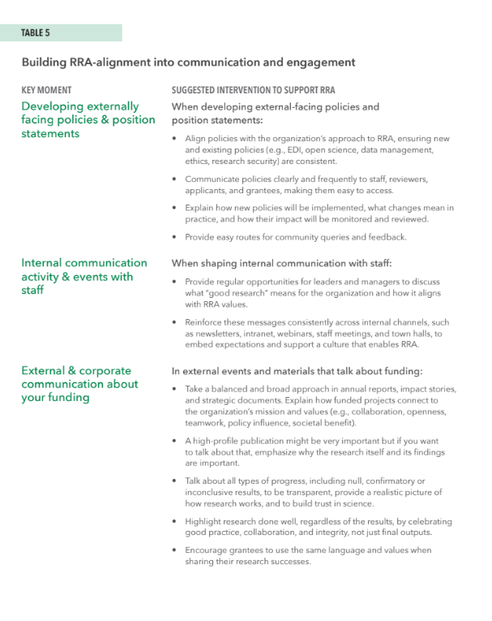
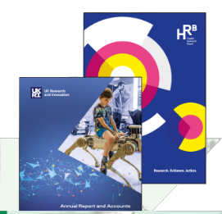
Communicating and engaging with your communities
Moments to introduce RRA-aligned processes and workflows
Developing externally facing policies and position statements
Internal communication about RRA
Communication about your funding decisions and successes
Notes:
Communicating clearly and engaging consistently with internal and external communities helps Responsible Research Assessment (RRA) become part of a research funding organization’s (RFOs) everyday practice and identity.
The Guide outlines practical ways to align community communication and engagement with RRA, including:
1. Developing externally facing policies and position statements
Develop a clear narrative about why RRA is important to your organization and its benefits
Be consistent in how you talk about RRA across media and materials
Align all policies and positions with the organization’s approach to RRA
2. Internal communication about RRA
Make opportunities for leaders to discuss the benefits of RRA with colleagues
Build familiarity with RRA across the organization to embed into organization culture
3. Communication about your funding decisions and successes
Explain how funded projects align with the organization’s mission and values
Share the diversity of grants and grantees that you have funded to provide examples and role models for others
Take a balanced and broad approach to showcasing the relevance and impact of different kinds of research

Slide 18
Chapter 4. RRA and its place in the research system
https://bit.ly/DORA-Funder-Guide
Notes:
Please feel free to change this and other slides!

Slide 19
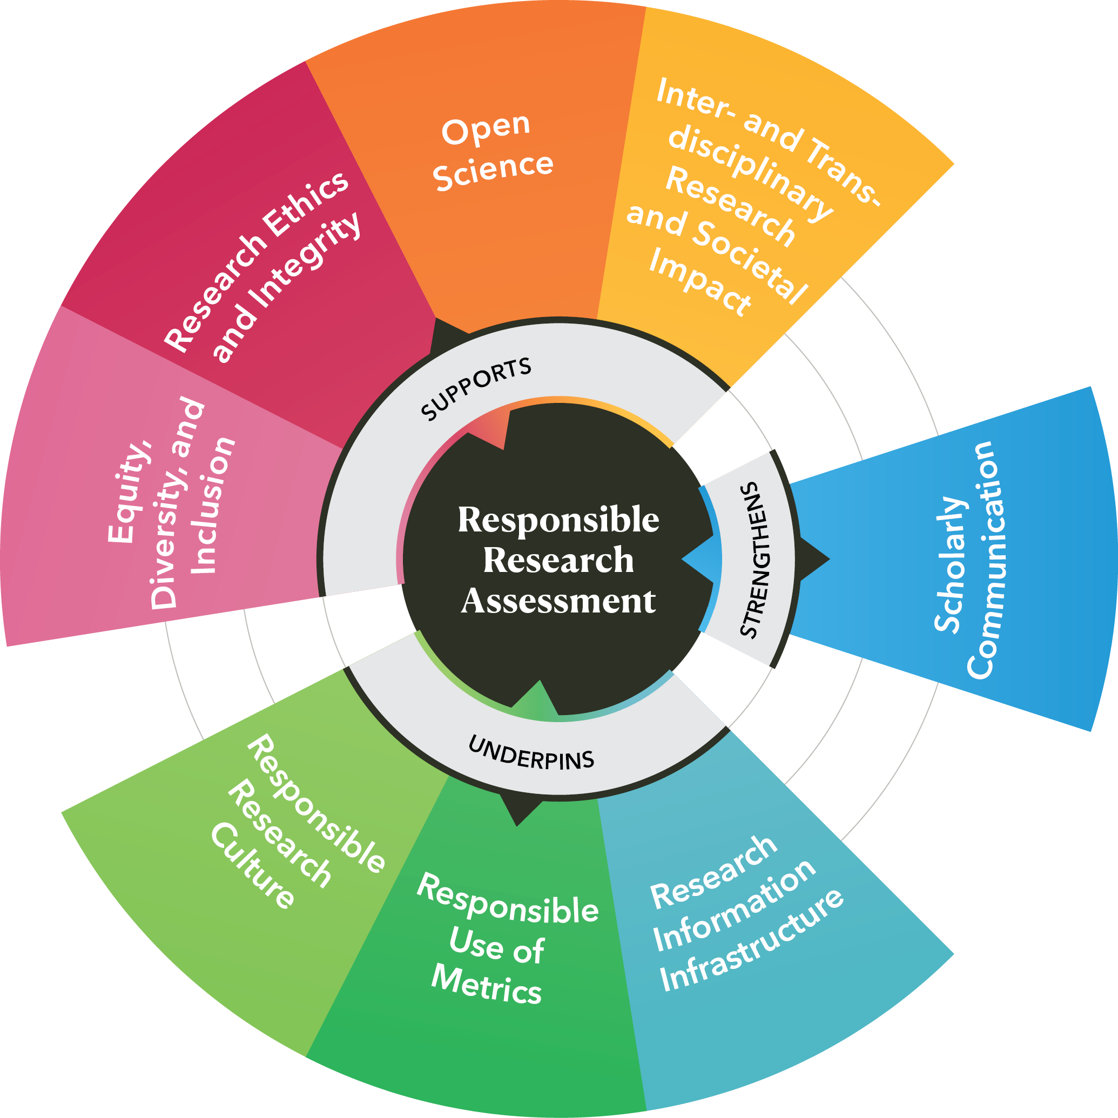
An interconnected research system
Notes:
The scholarly research and publishing system is a global, interconnected ecosystem: every part of it influences, and is influenced by, each other part.
Responsible research assessment (RRA) is inseparable from the wider system of values, practices, and change movements that shape research culture. Today, there are many initiatives and movements that, like RRA, aim to improve and enhance the context and culture of research.
In the Guide we cover 8 specific components, discussing the interactions between RRA and the component. Below, we briefly summarize how RRA influences each component.
Underpinning components
Responsible Research Culture - recognizes and incentivizes collaboration, integrity, and innovation.
Responsible Use of Metrics - balances and broadens approach to research assessment.
Research Information Infrastructure - makes contributions discoverable and usable.
Supporting components
Equity, Diversity, and Inclusion - recognizes the diversity of contributions and career paths
Research Ethics and Integrity - reduces perverse incentives, focuses on practices that deliver robust research.
Open Science - rewards transparency and the sharing of data and research outputs.
Inter- and Transdisciplinary Research and Societal Impact- values work that crosses boundaries and delivers real-world benefits
Strengthening component
Scholarly Communication - facilitates the sharing of research findings, maximizing the potential for use and reuse for use and reuse.

Slide 20
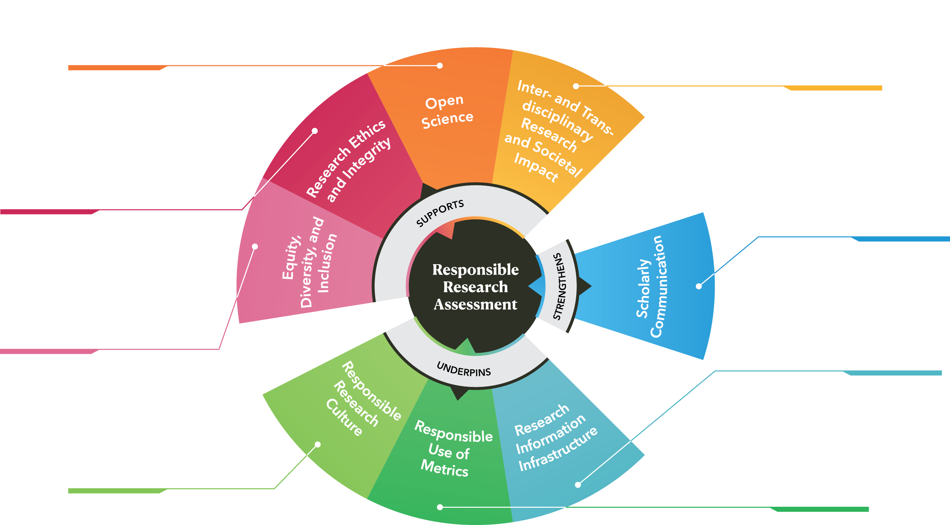
An interconnected research system
Notes:
The scholarly research and publishing system is a global, interconnected ecosystem: every part of it influences, and is influenced by, each other part.
Responsible research assessment (RRA) is inseparable from the wider system of values, practices, and change movements that shape research culture. Today, there are many initiatives and movements that, like RRA, aim to improve and enhance the context and culture of research.
In the Guide we cover 8 specific components, discussing the interactions between RRA and the component. Below, we briefly summarize how RRA influences each component.
Underpinning components
Responsible Research Culture - recognizes and incentivizes collaboration, integrity, and innovation.
Responsible Use of Metrics - balances and broadens approach to research assessment.
Research Information Infrastructure - makes contributions discoverable and usable.
Supporting components
Equity, Diversity, and Inclusion - recognizes the diversity of contributions and career paths
Research Ethics and Integrity - reduces perverse incentives, focuses on practices that deliver robust research.
Open Science - rewards transparency and the sharing of data and research outputs.
Inter- and Transdisciplinary Research and Societal Impact- values work that crosses boundaries and delivers real-world benefits
Strengthening component
Scholarly Communication - facilitates the sharing of research findings, maximizing the potential for use and reuse for use and reuse.

Slide 21
Key resources to accompany the Guide
https://bit.ly/DORA-Funder-Guide
Notes:
Please feel free to change this and other slides!

Slide 22
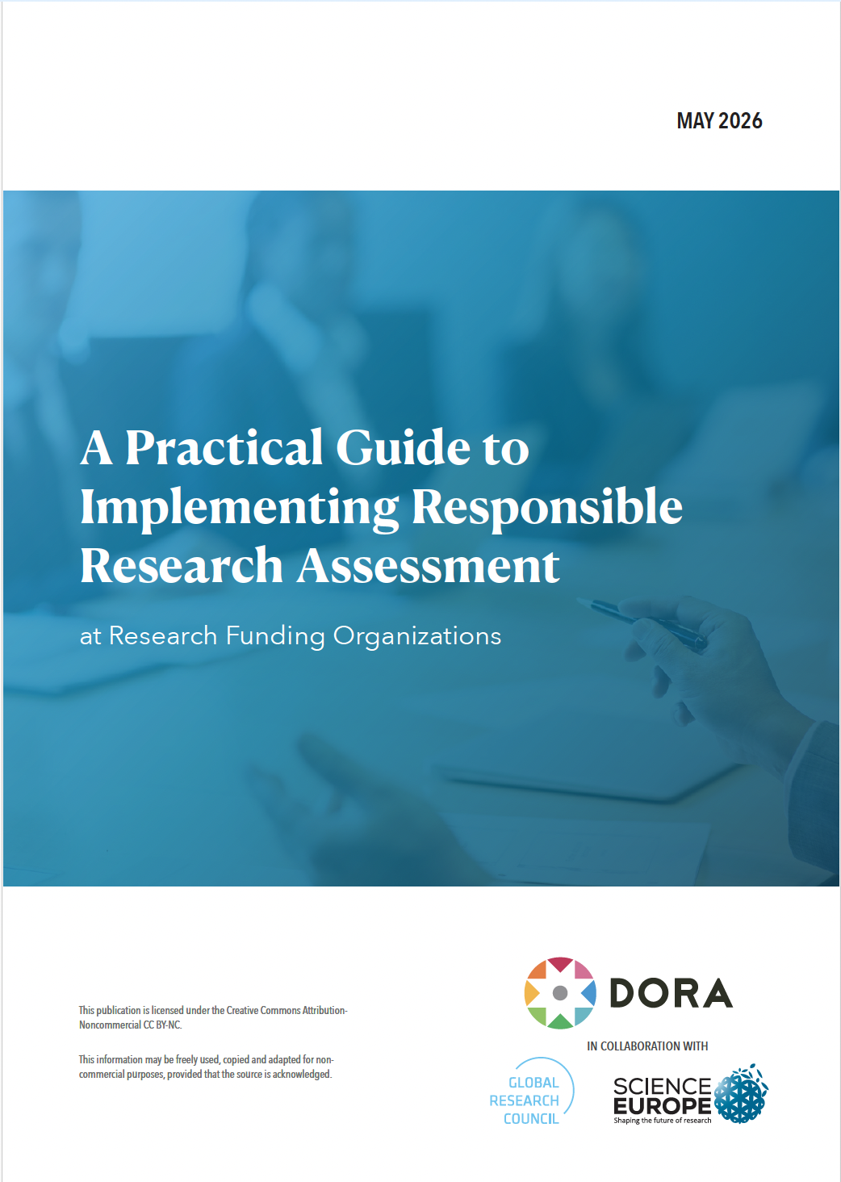
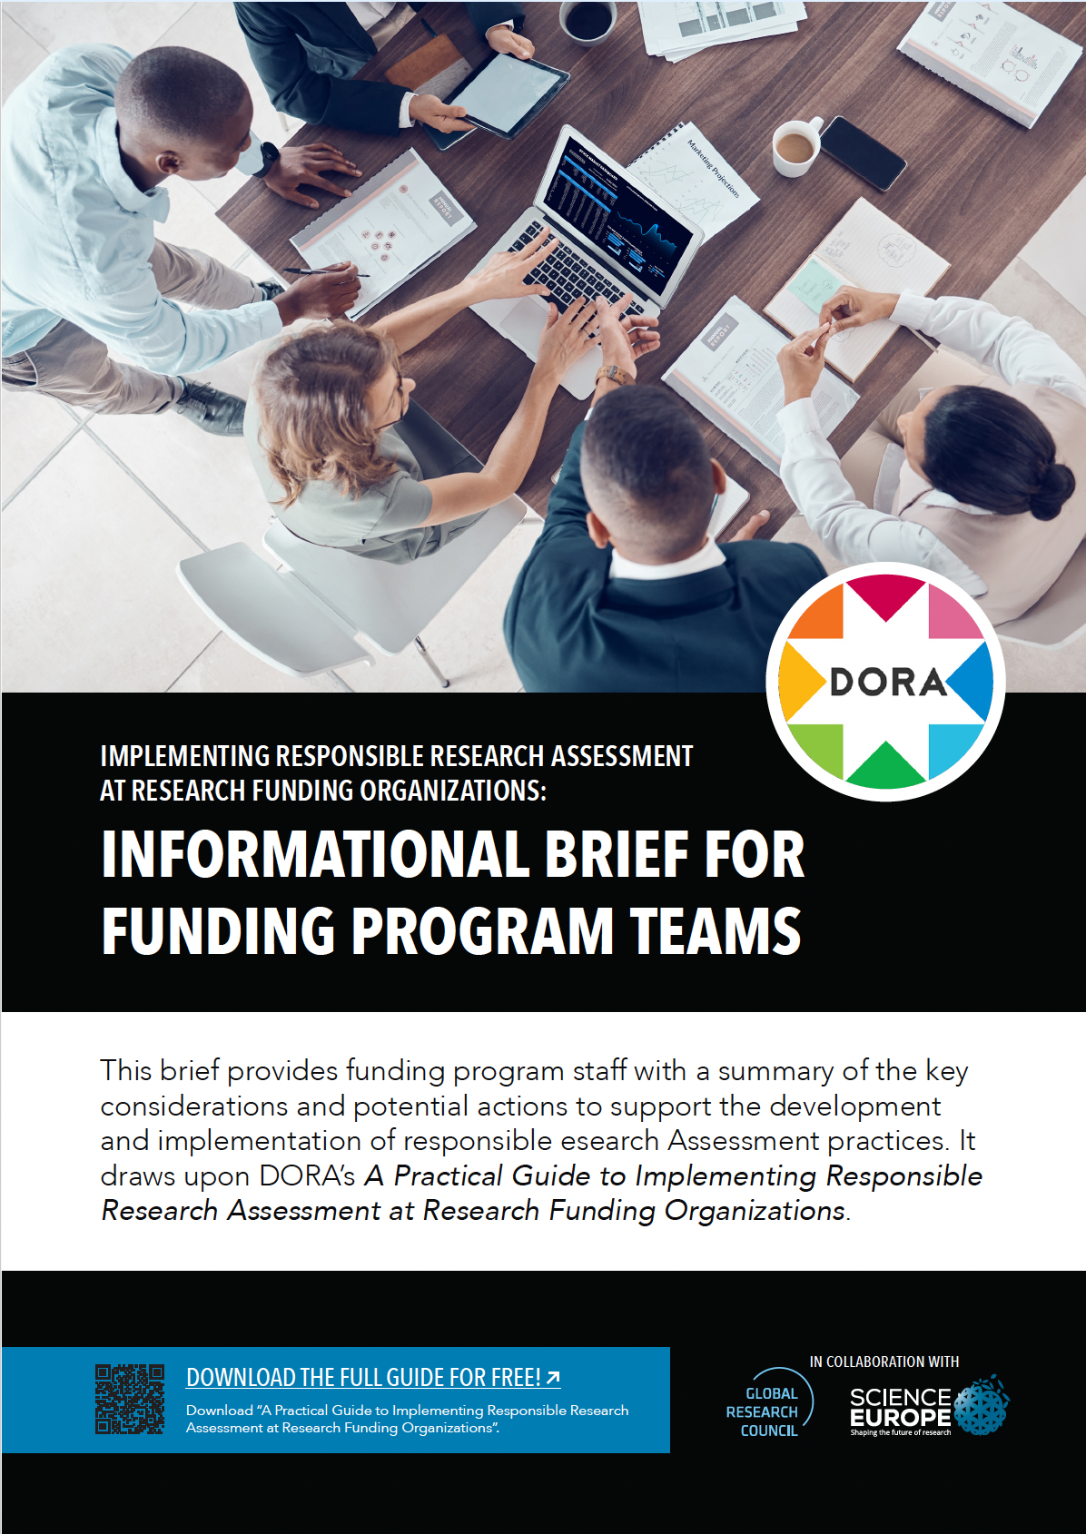
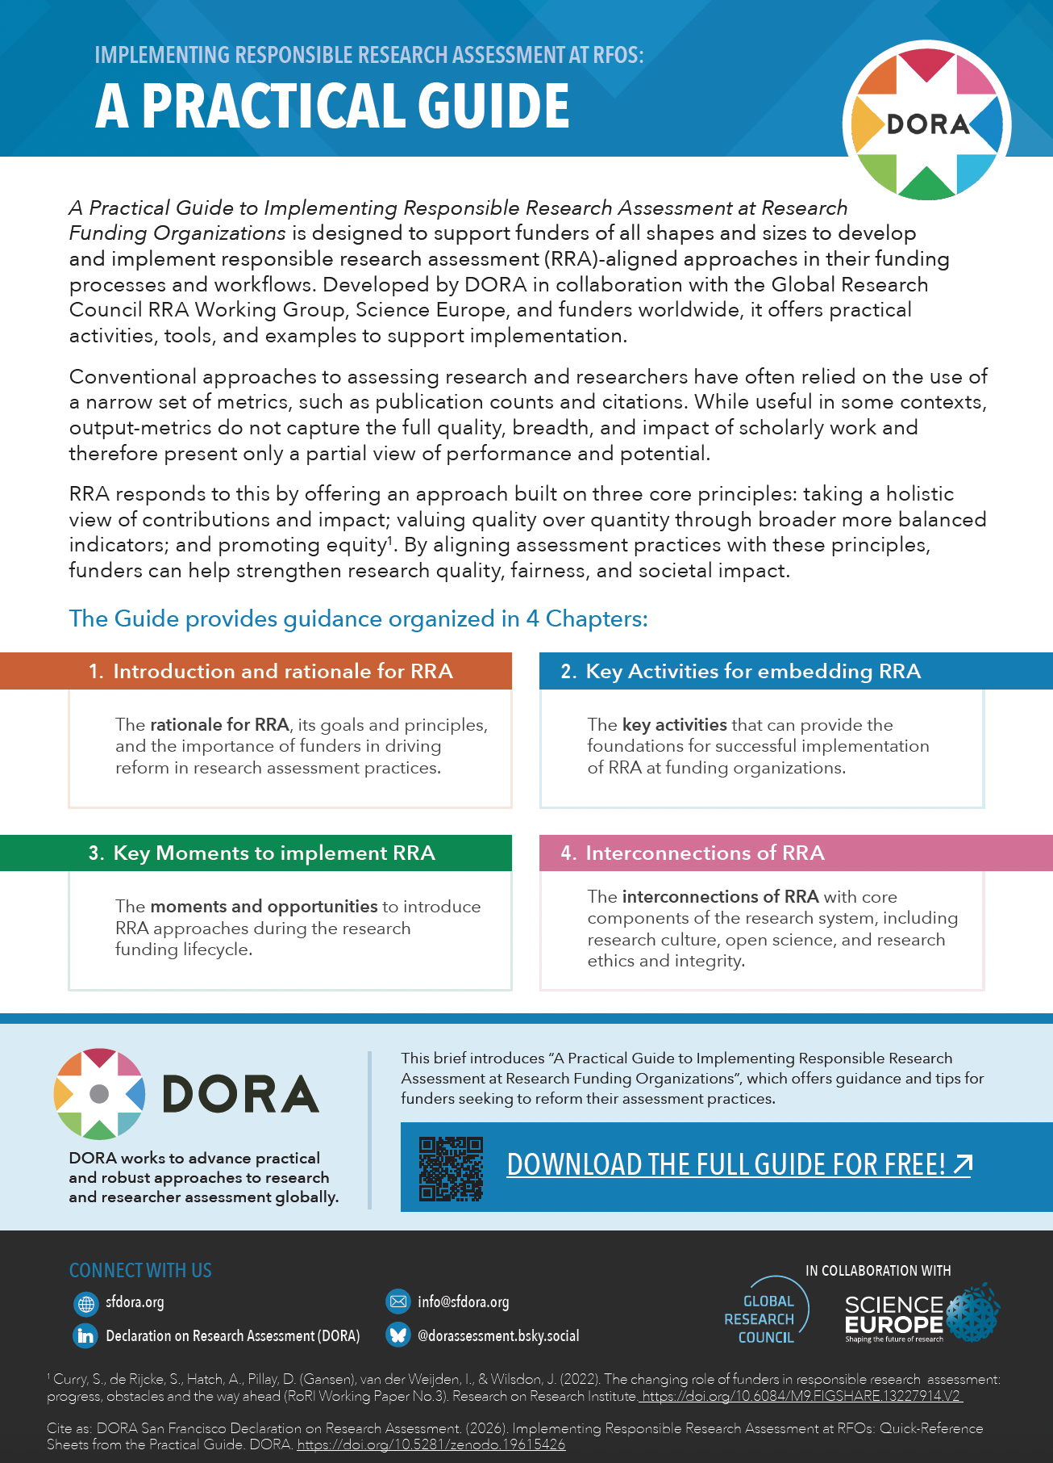
Key additional resources
Notes:
The Guide is accompanied by tailored summaries:
Informational Briefs for funding leaders and program staff, offering a distilled summary of the Guide and potential action points
Quick-Reference Sheets offering concise summaries of the key elements of the Guide
We have also created two Slides Decks: one providing an overview of the Guide, its aims, and a summary description of its content; and a second aimed at funder Program staff looking to develop RRA-aligned interventions (this one!), which delves into Chapter 3 in more detail.

Slide 23
Key resources
Practical Guide:
  Allen, L., Barbour, V., Borrell-Damián, L., Cobey, K., Dube, N., Firth, C., Lawrence, R., Lima, G., McGuirk, S., Morris, J. P., Trinh, A.-K., & Uwineza, J. (2026). A Practical Guide to Implementing Responsible Research Assessment at Research Funding Organizations. Declaration on Research Assessment (DORA). https://doi.org/10.5281/zenodo.18402271
Informational Briefs from the Practical Guide: https://doi.org/10.5281/zenodo.19615795
Quick Reference Sheets from the Practical Guide: https://doi.org/10.5281/zenodo.19615426
RRA self-assessment tool for funders:
        Global Research Council Responsible Research Assessment Working Group. (2026). A responsible research assessment self-assessment tool for funders. https://doi.org/10.6084/m9.figshare.31455505
Funding agency RRA-focused case studies:
      DORA Case Studies - https://sfdora.org/dora-case-studies/
      Global Research Council RRA Case Study Booklet - https://doi.org/10.6084/m9.figshare.31457152
      Global Research Council RRA Case Study Library - https://globalresearchcouncil.org/about/responsible-research-assessment-working-group/case-study-library/

Slide 24

Improving research assessment
sfdora.org
Notes:
More information is available on the DORA website

