Slide 1

This slide deck is for those who want to incorporate DORA’s “Introduction to RRA” course materials into training, teachings, presentations, etc. This may be particularly useful for RRA advocates who are seeking educational materials for their communities.
How to use this resource
This deck provides the most important takeaways from a lesson from the Introduction to RRA course. Notes for presenters are included in the speaker notes.
Notes:
Please feel free to delete this and any slides when using this slide deck.

Slide 2
Each course lesson has a slide deck and lesson guide. This gives you the flexibility: You can have your learners take the course and/or you can teach high-level key takeaways from each lesson.
You decide which combination of approaches is most suitable for your needs.
How to use this resource
Unless otherwise indicated, this content is available under a Creative Commons Attribution License CC BY-NC 4.0. Logos are trademarks or registered trademarks of their respective organizations and may not be reused or reproduced without permission.

Slide 3

Introduction to Responsible Research Assessment
Lesson 4: How can responsible research assessment be applied to real-world assessment scenarios?
Notes:
ADDITIONAL INFORMATION: This slide deck is for those who want to incorporate DORA’s “Introduction to RRA” course materials into training, teachings, presentations, etc. This may be particularly useful for RRA advocates who are seeking educational materials for their communities.
Please feel free to delete this and any slides when using this slide deck.
This deck provides the most important takeaways from a lesson from the Introduction to RRA course. Notes for presenters are included in the speaker notes.
Each course lesson has a slide deck and lesson guide. This gives you the flexibility: You can have your learners take the course and/or you can teach high-level key takeaways from each lesson.
You decide which combination of approaches is most suitable for your needs.
Unless otherwise indicated, this content is available under a Creative Commons Attribution License CC BY-NC-ND 4.0. Logos are trademarks or registered trademarks of their respective organizations and may not be reused or reproduced without permission.

Slide 4

Learning Objectives
By the end of this lesson, you will be able to:
  Describe basic examples of how RRA might be applied in practical scenarios.
  Analyze how you might be able to apply RRA principles to applicable scenarios.
Image Credit: Canva AI
Notes:
ADDITIONAL INFORMATION: We recommend that facilitators/presenters take Lesson 4 of the DORA Introductory Course before teaching it's content. https://sfdora.org/courses/introductory-course-to-responsible-research-assessment/
This lesson will help you understand how RRA is being implemented across some of the most well-known research assessment instances.
Suggested options for how to deliver and facilitate this lesson in a seminar, workshop, or classroom setting:
1. Have your students/audience take this course lesson before your presentation. This will support jumping more quickly into deeper discussions and focus on discussion questions.
2. Present the information from these slides. You may include some or all of the discussion questions. This is a good option if you are short on time and space, or if you are adding these slides into an existing deck.

Slide 5
Showcasing work with Narrative CVs
Traditional CVs
Traditionally, CVs have emphasized quantity and prestige.
  Publication lists
  Misuse of quantitative metrics like: Journal Impact Factors (JIF), Raw citation counts, h-index
  Lack of context
  Often long (20-30+ pages)
Narrative CVs
Incorporate qualitative and contextualized descriptions of contributions and impact.
  Selection of most significant contributions
  Role in collaborative projects
  Community engagement, mentorship, efforts to improve research integrity and workplace culture, etc
  Often have 1-2 page limit
Notes:
DISCUSSION QUESTION: How can this change be facilitated by different members of the academic system? Use the examples below if needed.
Research support staff: Create online resources and host events on the different types of CVs that staff might encounter, why adding qualitative narratives to a CV can be useful, and how to create a narrative CV. Share resources like PEP-CV can help pair experienced mentors with those new to narrative CVs.
Researchers: Experiment with creating narrative elements within your CV–try starting out with an annotated CV style, as implemented by the University of Maryland. If you manage students or more early career staff, make them aware of the different types of CVs and why they may need to use them. Discuss common pitfalls with them, like assuming quantity translates to quality and the benefits of annotating CV entries so they receive credit for their specific contributions to a project.
Leadership/Policymakers: If you are in a position to influence training, work with your library, research management, and other relevant staff to explore incorporating narrative elements into applications. Develop clear guidance on the type of information that should, and should not, be included in a CV. Create training for reviewers to support their ability to effectively review narrative-style CVs.
ADDITIONAL INFORMATION: RRA aims to modernize evaluation practices, move away from an over-reliance on quantitative indicators, and allow researchers to be assessed based on the quality and impact of their most relevant work. One way to support this is to consider reforming the academic Curriculum Vitae (CVs). Increasingly, research performing organizations and research funding organizations are experimenting with an alternative to the traditional bulleted academic CV: The narrative CV. Narrative CVs are an alternative to traditional academic CVs that allow researchers to present their achievements, skills, and contributions through a descriptive, contextualized format. Depending on the need and format, narrative CVs can be partially or fully narrative.

Slide 6
Showcasing work with Narrative CVs
Real-world examples of organizations incorporated narrative elements into applicant CVs
  The Dutch Research Council
  Luxembourg National Research Fund
  Taighde Éireann - Research Ireland
  Swiss National Science Foundation
  UK Research and Innovation
  University of Maryland
  Canda Tri-Agency
  NIH
Notes:
ADDITIONAL INFORMATION:
This is a supporting slide that you may use to include a case study example in your discussion.

Slide 7
Building and training review panels for bias mitigation
Traditional review panels
Reviewers can inadvertently perpetuate existing cognitive and systems biases, which are inherent human tendencies and systemic structures that can unconsciously influence assessment decisions. This can reinforce the status quo and potentially stymie fresh ideas and approaches.
Taking a Bias-Mitigating Approach
Taking an active approach to debiase panels can include more perspectives in the panel and reduce biases in research assessment. For example:
  Instruct panel chair
  Nominate RRA ambassador on the panel
Sources: https://sfdora.org/resource/rethinking-research-assessment-unintended-cognitive-and-systems-biases/
https://sfdora.org/resource/rethinking-research-assessment-debiasing-committee-composition-and-deliberative-processes/
Notes:
DISCUSSION QUESTION: How can this change be facilitated by different members of the academic system?
Panelists: As a panelist, you can be a voice for change from the inside. During preparatory meetings, you can ask what type of training you will receive on bias mitigation. If there are no materials, you can reach out to leadership or to the Chair to request more explicit guidance be created. During the review process itself, you can hold the line and work to keep colleagues accountable.
Leadership/Policymakers: If you are in a position to influence panel composition and training, work with your HR, Ethics, and other appropriate departments to develop clear guidance for reviewers and applicants, create training materials for reviewers, and keep in touch with reviewers to iterate training/guidance as-needed.
Applicant: As an applicant, be sure to check if the criteria for your assessment are transparently available. If not, you can help raise awareness by reaching out to inquire about the assessment criteria and whether they will be made available. It can also be useful to check if reviewer training materials are made available to applicants, and to ask if they are not.
ADDITIONAL INFORMATION: RRA aims to modernize evaluation practices to more responsible practices that foster a more equitable, inclusive, and impactful research environment.
One way to support this is to consider reforming reviewer panels: how panels are created, how reviewers are trained, and how reviewers assess applicants. Strategies to debias panels:
Where possible, diversify composition:
-Including more diverse perspectives on decision-making panels has been shown to result in better decisions, reducing bias, increasing transparency, and exposing more individuals to how decisions are made.
-Questioning norms about who is qualified to participate or contribute.
-Relying on “opt-out” rather than “opt-in” selection for committees can help boost the inclusion of individuals less comfortable with self-promotion or those not seen as “obvious” choices.
-Diversifying across multiple characteristics beyond just racial and gender representation (e.g., including first-generation academics, early career researchers, or those with cross-disciplinary experience) can bring new and valuable perspectives.
-Overcoming “two-kenism” tendencies, where committees stop seeking diversity after selecting a minimal number of underrepresented individuals.
-Connecting committee composition to outcomes by deliberately inviting perspectives from those who will be on the receiving end of policy or directly impacted by decisions.
-Broadening who is involved in assessment processes can reduce biases.
Provide training:
-Panel members should be trained in making decisions that avoid bias and are aligned with RRA principles. This includes unconscious bias or debiasing training.
Use structured approaches and rubrics:
-Employing standardized interview protocols and questions for all applicants helps to keep decision-makers focused on agreed-upon qualities, thereby reducing bias.
-Using pre-established rubrics or matrices during evaluation.
-Creating a standard set of criteria for triaging applications to ensure consistency and avoid bias in the selection process.
Implement strategies to debias deliberative processes:
-Conducting “pre-briefs”: Spending time upfront to collectively craft “rules of the road” for committee work, which creates alignment and serves as a shared reference point.
-Ensuring all votes count: Techniques like anonymous voting can help reduce tendencies to conform to others' views or confirm safe choices.
-Questioning what we think we know: Asking committee members to explicitly step through their thought processes and assumptions can surface and counteract confirmation bias.
-Identifying bias at a system level: Recognizing that systems themselves can reinforce “hidden in plain sight” biases, and not solely burdening individuals to change.
-Thinking downstream: Acknowledging new hires require investment in mentorship and retention.
-Using structure to provide consistency: Structured approaches, like interview protocols and pre-determined criteria, can increase confidence in comparison without resorting solely to quantitative measures.
-Transparency invites trust: Clearly articulated and consistently applied criteria build a foundation of credibility.
-Taking a portfolio view: Keeping the bigger picture in mind helps protect against the tendency to make individual decisions that reinforce familiar norms.
-Fostering true diversity of opinion: Creating space for non-traditional participants to voice suggestions that run counter to established views.
-Expanding a sense of what’s possible: Gaining exposure to new options by seeing what others have done can help overcome “the way things are done around here”.

Slide 8
Bias mitigating panels
Real-world examples
  The Research on Research Institute (RoRI) conducted a study on the use of narrative CVs (NCVs) by review panels at funding organizations. The study suggests:
    NCVs can provide space for applicants to expand on the impact and quality of a wide range of their scholarly contributions.
    Reviewer training and clear communication on the “why switch to NCVs” were key factors to successful uptake of NCVs.
  The Luxembourg National Research Fund (FNR) partnered with DORA to create a training video for their grant review panels that focuses on how to responsible approach review.
    Video: Balanced, broad, responsible: A practical guide for research evaluators
Notes:
ADDITIONAL INFORMATION:
This is a supporting slide that you may use to include a case study example in your discussion.

Slide 9
Traditional vs. Responsible Education on Quantitative Indicators
Traditional Education on Quantitative Indicators
  Over-reliance on quantitative indicators.
  Devalues work like community engagement, mentorship, and the rigor and transparency of research.
  Unintentionally incentivizes undesirable behaviors that hinder scientific progress.
  Fails to capture the holistic value and impact of research.
Responsible Education on Quantitative Indicators
  Critical understanding of metrics and comprehension of their limitations.
  Emphasizes the importance of recognizing and rewarding all types of work.
  Teaches alternatives to traditional use of quantitative indicators.
Notes:
DISCUSSION QUESTION: How can this change be facilitated by different members of the academic system?
Librarians: Create online resources and host events to facilitate education around the responsible use of the quantitative indicators that are most relevant to your discipline. Facilitate active dialogue with staff that engages with questions or concerns.
Staff: Staff at all levels should check with their libraries to see what training is available. Keep colleagues accountable, for example during a journal club or thesis committee meeting. Use existing resources that have been developed for the purpose of education around indicators, like the Metrics Toolkit and DORA Guidance.
Leadership/Policymakers: If you are in a position to influence training, work with your library, research management, and other relevant staff to develop clear guidance on the use of quantitative indicators that are most relevant to your discipline. Foster an active dialogue with staff that engages thoughtfully with their questions and concerns.
ADDITIONAL INFORMATION:
Changing how we educate users (e.g., reviewers, applicants, trainers, research managers) about quantitative indicators to foster a nuanced and responsible understanding when they engage in research assessment-related practices.
Traditional Education on Quantitative Indicators
Traditional education around research assessment often places a heavy focus on direct application of quantitative indicators like the Journal Impact Factor (JIF), citation counts, and the h-index. These lessons are often engrained early and taught both explicitly and implicitly, e.g. by the behaviors of mentors and peers, by guidance for applicants, by training materials for reviewers, or in communications about researchers and Lib Guides. Unfortunately, this approach can erroneously imply an equivalence between these numbers and research impact and quality.
The primary outcomes of this traditional focus can be:
-An over-reliance on quantitative indicators for assessing research and researchers.
-The fostering of a “publish or perish” culture, which can devalue important scholarly contributions like community engagement, mentorship, and the rigor and transparency of research.
-Undesirable behaviors that hinder scientific progress, such as prioritizing quantity over quality, leading to false or exaggerated reporting, aversion to negative data, and a lack of transparency.
-A failure to capture the holistic value and impact of research.
Responsible Education on Quantitative Indicators
Responsible education on quantitative indicators advocates for a critical understanding of metrics, including a clear comprehension of their strengths and, more importantly, their key limitations. It emphasizes that these indicators primarily measure journals or aggregate data, not individual article or researcher quality.
This approach is guided by five principles for responsible use of quantitative indicators:
-Be clear: Clearly define what is being measured and why.
-Be transparent: Make the methods of calculation and data sources openly available.
-Be specific: Use metrics that are appropriate for the specific context and purpose of the evaluation.
-Be contextual: Interpret metrics within their broader disciplinary, institutional, and individual contexts, recognizing that different fields have different publication and citation norms.
-Be fair: Ensure that the use of metrics does not disproportionately disadvantage certain individuals, disciplines, or types of research.
By adhering to these principles, responsible education ensures that quantitative indicators are interpreted with nuance and within their broader context, thereby promoting a more balanced evaluation practice. This includes understanding what they truly measure, what they don't, and how they can be misused.
This shift in education on quantitative indicators is a tangible change that leads to more equitable, transparent, and effective research assessment practices, ultimately fostering a more inclusive and impactful research environment.

Slide 10
Traditional vs. Responsible Education on Quantitative Indicators
Real-world examples
  Research library websites can be excellent resources to find educational materials on the responsible use of quantitative indicators.
    The University of Nottingham Libraries provide extensive guidance on responsible use of research metrics, including a guide to good practice that advises users to focus on values rather than easy-to-measure indicators, use qualitative evidence, using multiple measures of success, checking for appropriate context, and being transparent.
  The Metrics Toolkit is a free resource that outlines the uses and limitations of many different quantitative indicators.
Notes:
ADDITIONAL INFORMATION:
This is a supporting slide that you may use to include a case study example in your discussion.

Slide 11
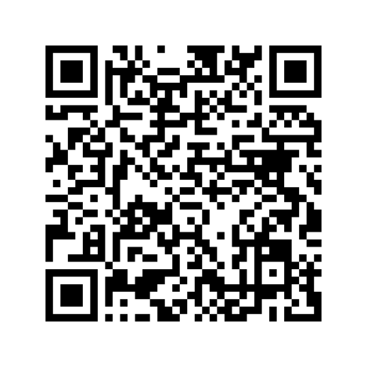
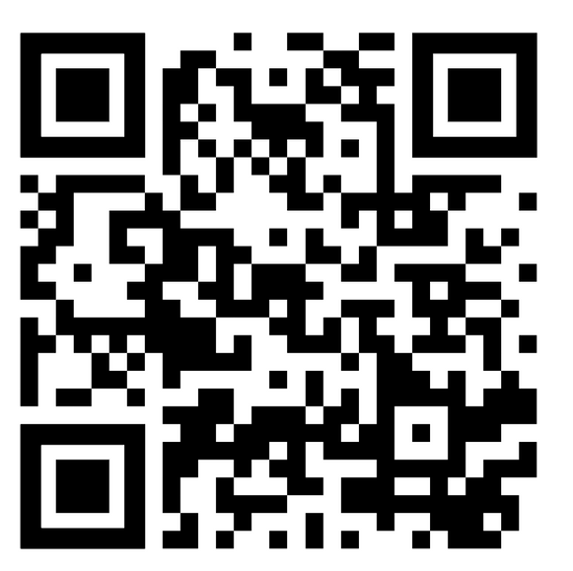
To learn more, take DORA’s Introduction to RRA Course
Glossary and suggested reading list
https://sfdora.org/courses/introductory-course-to-responsible-research-assessment/
https://sfdora.org/resource/introduction-to-rra-course-lesson-4-glossary-and-reading-list/
Notes:
Thank you for using these slides and the teaching support guide. We would love to know how you used these resources and invite you to fill out this feedback form: https://forms.gle/RXZbtoBipzVYXoX19
If you have any questions, please contact us as: info@sfdora.org.
What to do next? Consider creating a call to action for your audience to continue the conversation.

