Slide 1

This slide deck is for those who want to incorporate DORA’s “Introduction to RRA” course materials into training, teachings, presentations, etc. This may be particularly useful for RRA advocates who are seeking educational materials for their communities.
How to use this resource
This deck provides the most important takeaways from a lesson from the Introduction to RRA course. Notes for presenters are included in the speaker notes.
Notes:
Please feel free to delete this and any slides when using this slide deck.

Slide 2
Each course lesson has a slide deck and lesson guide. This gives you the flexibility: You can have your learners take the course and/or you can teach high-level key takeaways from each lesson.
You decide which combination of approaches is most suitable for your needs.
How to use this resource
Unless otherwise indicated, this content is available under a Creative Commons Attribution License CC BY-NC 4.0. Logos are trademarks or registered trademarks of their respective organizations and may not be reused or reproduced without permission.

Slide 3

Introduction to Responsible Research Assessment
Lesson 3: Limitations of Traditional Assessment Approaches and Quantitative Indicators
Notes:
ADDITIONAL INFORMATION: This slide deck is for those who want to incorporate DORA’s “Introduction to RRA” course materials into training, teachings, presentations, etc. This may be particularly useful for RRA advocates who are seeking educational materials for their communities.
Please feel free to delete this and any slides when using this slide deck.
This deck provides the most important takeaways from a lesson from the Introduction to RRA course. Notes for presenters are included in the speaker notes.
Each course lesson has a slide deck and lesson guide. This gives you the flexibility: You can have your learners take the course and/or you can teach high-level key takeaways from each lesson.
You decide which combination of approaches is most suitable for your needs.
Unless otherwise indicated, this content is available under a Creative Commons Attribution License CC BY-NC-ND 4.0. Logos are trademarks or registered trademarks of their respective organizations and may not be reused or reproduced without permission.

Slide 4

Learning Objectives
By the end of this lesson, you will be able to:
Describe traditional assessment approaches and quantitative indicators that are commonly misused during assessment.
Break down how to apply RRA principles to different assessment approaches.
Describe five guiding principles for the more responsible use of quantitative indicators.
Image Credit: Canva AI
Notes:
ADDITIONAL INFORMATION: We recommend that facilitators/presenters take Lesson 3 of the DORA Introductory Course before teaching it's content. https://sfdora.org/courses/introductory-course-to-responsible-research-assessment/
In this Lesson, you will learn more about traditional assessment approaches and their inherent flaws. You will learn about some of the quantitative indicators that are commonly misused in research assessment practices, and you will learn five guiding principles for the more responsible use of quantitative indicators.
Suggested options for how to deliver and facilitate this lesson in a seminar, workshop, or classroom setting:
1. Have your students/audience take this course lesson before your presentation. This will support jumping more quickly into deeper discussions and focus on discussion questions.
2. Present the information from these slides. You may include some or all of the discussion questions. This is a good option if you are short on time and space, or if you are adding these slides into an existing deck.

Slide 5
Pitfalls of Traditional Research Assessment
Traditional assessment approaches
Often rely on a narrow set of quantitative, publication-based criteria and metrics such as publication counts, citation rates, “laundry-list” CVs, institution prestige, and grant income as primary measures of value.
Why does it matter?
These methods can devalue work like:
“slow science”
mentorship
community engagement
service
Notes:
DISCUSSION QUESTION: Discuss your experiences with traditional assessment. Has it impacted the type of work you feel is valued?
ADDITIONAL INFORMATION: Additional context for certain types of work:
service (e.g., serving on review panels, reviewing papers, etc.)
mentorship (e.g., mentoring successful professionals and other faculty and staff)
community engagement (e.g., working with patient advocates, incorporating community input into experiment design and execution, working on research that is relevant to local communities)
"slow science” (e.g., prioritizing quality over quantity)

Slide 6


Examples of commonly misused Indicators: JIF and h-index
Journal Impact Factor (JIF) is a journal-level measure. This makes it a flawed measure of individuals because it does not provide any information about the quality of an individual article or researcher.
The h-index is flawed because it favors senior researchers, science disciplines over humanities, varies across databases, and does not account for specific author contributions in teams.
Image Credit: Canva AI
Notes:
ADDITIONAL INFORMATION: You may omit these definitions if the audience has a firm grasp of metrics or if these are not relevant to your particular field, but they are helpful for creating a shared baseline of knowledge.
Additional context for: The Journal Impact Factor (JIF) is generated by a commercial entity and is generally defined as the annual average number of citations to papers published in a given journal in the two preceding years.
Limitations: The JIF is a measure of the “average citation performance” of papers in a particular journal in the past 2 years, not a direct measure of the value or quality of an individual paper or researcher. Claims that JIF signifies the value or quality of individual papers are not supported by evidence. It provides no indication of the wide variation in the distribution of citations among articles within a journal, which can span 2-3 orders of magnitude. Despite the temptation to assume that a paper from a high JIF journal is better, JIFs are poor predictors of the citation performance of individual articles. There is no good evidence to support claims that peer review quality is higher in high JIF journals.
Examples of misuse: The JIF…
Should never be used to assess the quality of an individual research article. The JIF is a journal-level measurement that does not measure the quality of individual research articles. A paper from a high-JIF journal isn’t necessarily better than one from a low-JIF one.
Should never be used to assume citation count or impact. The JIF gives no indication of the variation in the distribution of citations between articles, which typically range over 2-3 orders of magnitude, from which it is calculated. Evidence shows that JIFs are poor predictors of citation performance of individual articles.
Should never be used to assume peer review quality. We know of no good evidence to support claims that peer review quality is significantly better in higher JIF journals.
Note that the potential misuse of the JIF applies to other journal-based indicators like the Citescore, Eigenfactor Score, and Source Normalized Impact per Paper (SNIP).
Additional context for: The h-index, for individuals, is defined as the number of their papers that have been cited at least h times; for example, an author with an h-index of 10 has ten papers, each with at least ten citations. It’s calculated using the number of publications and citations a researcher has. Learn more by watching the ScholCommLab’s educational video: https://www.youtube.com/watch?v=HSf79S3XkJw
Limitations: The h-index is commonly used to compare researchers or monitor “performance” but is difficult to interpret meaningfully and can give inconsistent or counterintuitive readings of researcher impact. Its value depends on the database used to derive it (e.g., Web of Science, Scopus, Google Scholar). It typically favors researchers at later career stages or those who have not taken career breaks, and those in disciplines with higher citation rates (e.g., medical sciences vs. mathematics or humanities). It does not account for the nature of the author’s contributions to each of their papers; in collaborative disciplines, it may reflect participation in large teams rather than individual contributions.
Examples of misuse. h-index…
Should never be used to assess early career researchers or to compare authors who are at different stages in their careers. Senior researchers have the advantage of being able to accumulate more publications and citations over time. Therefore, they usually have higher h-indexes than their junior colleagues.
Should never be used to compare researchers from different disciplines. Different fields have different publication practices and authorship protocols. The h-index does not account for field-specific differences.
May vary across databases for the same author. Each citation database has different criteria regarding which sources to index. Because of this, researchers who decide to use the h-index should indicate when and from what database the h-index was obtained.

Slide 7
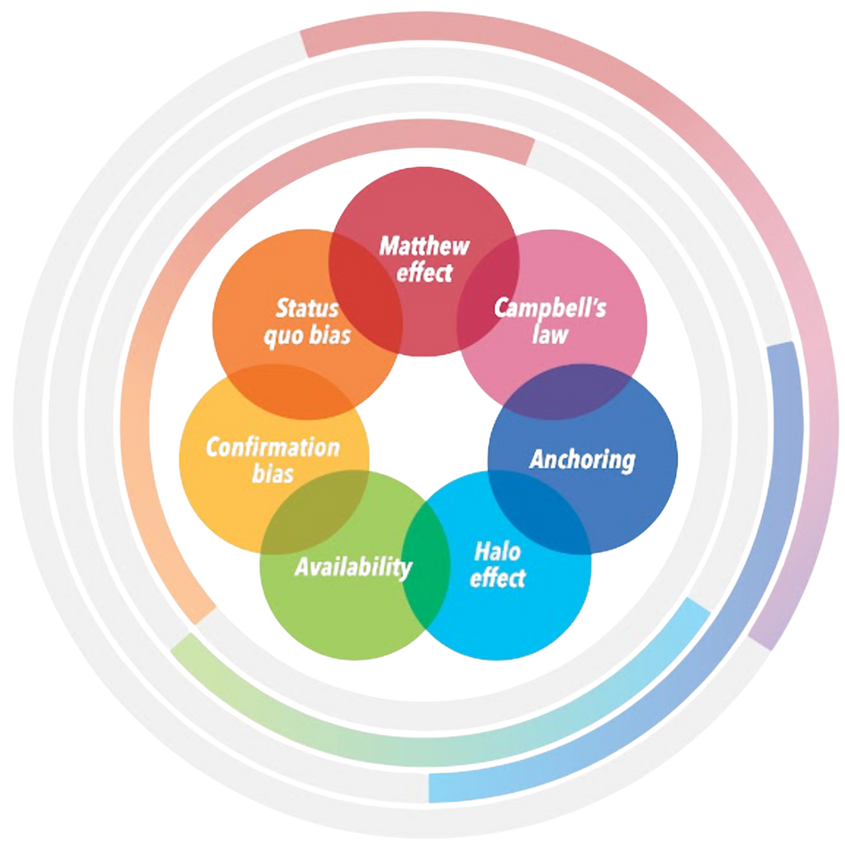
Cognitive and Systems Biases
Traditional assessment decisions can be susceptible to biases, like:
Confirmation bias
Halo effect
The Matthew effect
e
H
Image adapted from: https://sfdora.org/resource/rethinking-research-assessment-unintended-cognitive-and-systems-biases/
Notes:
ADDITIONAL INFORMATION: Definitions for the bullet points:
Confirmation bias: favoring info that fits pre-existing beliefs
Halo effect: letting one positive trait influence overall impression
The Matthew Effect: resources tend to flow to those who already have them, perpetuating inequality
It is recommended that you review DORA's one-page brief "Rethinking Research Assessment: Unintended Cognitive and Systems Biases" prior to presenting this slide. While many of the biases are applicable across different disciplines and areas of the academic system (e.g., publishers, funders, researchers/research organizations), the brief itself focuses on the context of research performing organizations. Because of this, you may need to adjust the examples to your specific context.
This resource identifies seven personal biases that can influence hiring, promotion, and tenure decisions. It also reveals four institutional and infrastructural implications of these biases and provides strategies to develop new institutional conditions that reduce bias.
Find the brief link here: https://sfdora.org/resource/rethinking-research-assessment-unintended-cognitive-and-systems-biases/
Additional context for the brief is provided in a four-part blog post series: https://theplosblog.plos.org/2020/10/rethinking-research-assessmentaddressing-institutional-biases-in-review-promotion-and-tenure-decision-making-part-iv/
Image credit: https://sfdora.org/resource/rethinking-research-assessment-unintended-cognitive-and-systems-biases/

Slide 8
Five Principles for Responsible Use
When using quantitative indicators, follow these principles
Be clear
Be transparent
Be specific
Be contextual
Be fair
These principles prioritize expert judgment over a simple reliance on numbers
Source: https://sfdora.org/wp-content/uploads/2024/05/DORA_indicators_guidance.pdf
Notes:
DISCUSSION QUESTION: How do you currently implement these principles, or how might you implement these principles in your daily work?
ADDITIONAL INFORMATION: See DORA's "Guidance on the responsible use of quantitative indicators in research assessment" for expanded information on the Five Principles. You may also find it helpful to identify more examples of commonly used quantitative indicators. Find the guide here: https://sfdora.org/wp-content/uploads/2024/05/DORA_indicators_guidance.pdf
Be Clear: What is your rationale for using particular quantitative indicators in your research or researcher assessments? Is it grounded in good evidence?
Be transparent: Ideally, rules for the use of quantitative indicators in research assessment should be developed in dialogue with your research community. They should be published so that those being evaluated understand your criteria. Make sure also that reviewers are fully aware of your approach to using quantitative information in assessment.
Be specific: How well does the indicator refer to the qualities of the person or the piece of work being assessed? Be mindful of aggregate metrics (e.g., JIF, h-index), which conceal large variations in performance, and of composite indicators (e.g., scores in university league tables, altmetrics), which are made up of arbitrarily weighted scores for very different attributes and activities and are therefore difficult to interpret meaningfully.
Be contextual: How will you take account of the proxy and reductive nature inherent in any indicator? (E.g., citations are not a direct measure of quality; the h-index takes no account of age, discipline, or career breaks.)
Be fair: How will you avoid biases inherent in quantitative indicators? Though it is often assumed that bibliometric indicators are “objective,” decisions to publish a paper or to cite it are choices that can reflect structural and personal biases. Decision makers need to be proactive and transparent in efforts to mitigate the impact of these biases in research assessment — and the same obviously applies to the qualitative aspects of assessment.

Slide 9
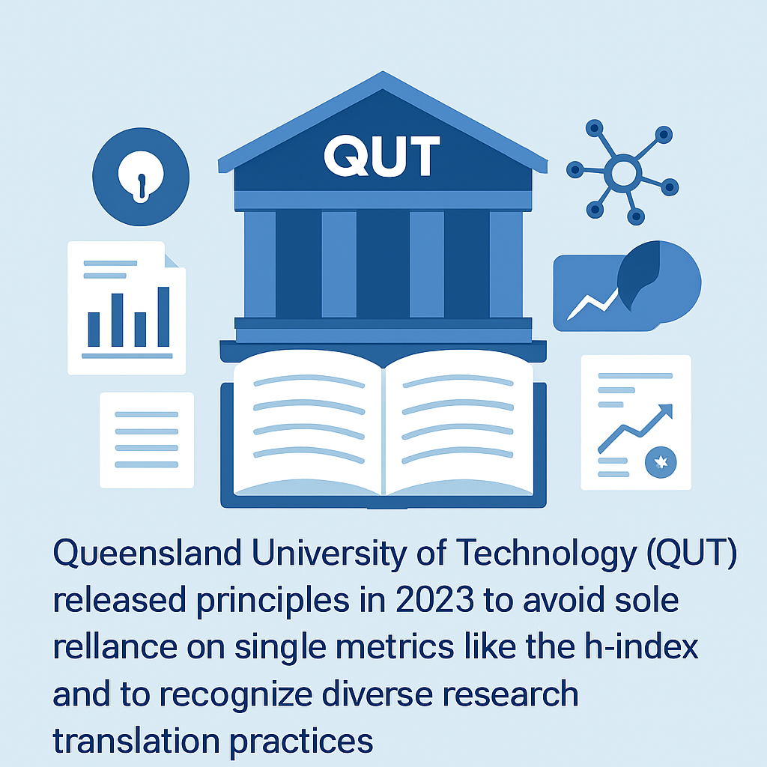
Real-world example
Traditional assessment approaches are not set in stone!
Many organizations, like QUT, are working to reform and modernize their assessment approaches.
Review the example to see what this looks like in the real world.
Image Credit: Canva AI
Source: https://sfdora.org/case-study/qut/
Notes:
DISCUSSION QUESTION: What does it look like when an organization works to reform its research assessment practices? Use this case study example to tie the lesson on traditional assessment criteria together with reforming assessment criteria to be more responsible. What would the audience do if they had the power to make change and why?
ADDITIONAL INFORMATION: You may prefer to replace this with a more context-specific case study example.
You can learn more about the work of QUT to implement RRA here: https://sfdora.org/case-study/qut/ and you can find more case study examples at: https://sfdora.org/dora-case-studies/

Slide 10
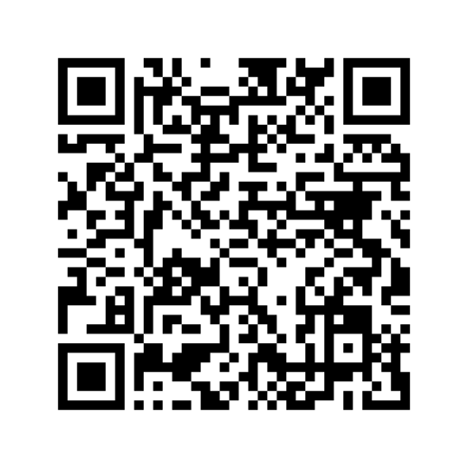
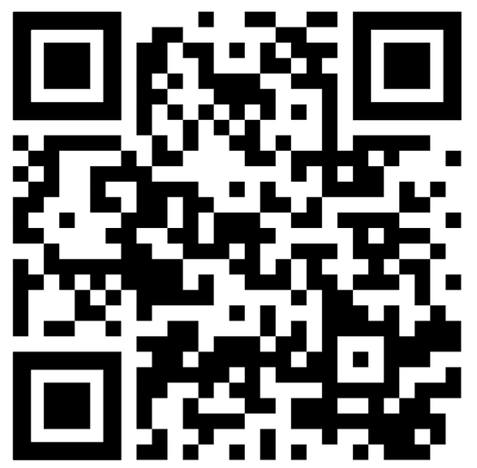
To learn more, take DORA’s Introduction to RRA Course
Glossary and suggested reading list
https://sfdora.org/courses/introductory-course-to-responsible-research-assessment/
https://sfdora.org/resource/introduction-to-rra-course-lesson-3-glossary-and-reading-list/
Notes:
Thank you for using these slides and the teaching support guide. We would love to know how you used these resources and invite you to fill out this feedback form: https://forms.gle/RXZbtoBipzVYXoX19
If you have any questions, please contact us as: info@sfdora.org.
What to do next? Consider creating a call to action for your audience to continue the conversation. As an example: If you are a librarian and you used these slides to inform a presentation on RRA to your researchers, you can ask them to create a 2-page revised version of their CV that include narrative elements, doesn't include inappropriate metrics, and focuses on their most impactful work.

