Slide 1

This slide deck is for those who want to incorporate DORA’s “Introduction to RRA” course materials into training, teachings, presentations, etc. This may be particularly useful for RRA advocates who are seeking educational materials for their communities.
How to use this resource
This deck provides the most important takeaways from a lesson from the Introduction to RRA course. Notes for presenters are included in the speaker notes.
Notes:
Please feel free to delete this and any slides when using this slide deck.

Slide 2
Each course lesson has a slide deck and lesson guide. This gives you the flexibility: You can have your learners take the course and/or you can teach high-level key takeaways from each lesson.
You decide which combination of approaches is most suitable for your needs.
How to use this resource
Unless otherwise indicated, this content is available under a Creative Commons Attribution License CC BY-NC 4.0. Logos are trademarks or registered trademarks of their respective organizations and may not be reused or reproduced without permission.

Slide 3

Introduction to Responsible Research Assessment
Lesson 2: Responsible Research Assessment Impacts Everyone in the Academic System
Notes:
ADDITIONAL INFORMATION: This slide deck is for those who want to incorporate DORA’s “Introduction to RRA” course materials into training, teachings, presentations, etc. This may be particularly useful for RRA advocates who are seeking educational materials for their communities.
Please feel free to delete this and any slides when using this slide deck.
This deck provides the most important takeaways from a lesson from the Introduction to RRA course. Notes for presenters are included in the speaker notes.
Each course lesson has a slide deck and lesson guide. This gives you the flexibility: You can have your learners take the course and/or you can teach high-level key takeaways from each lesson.
You decide which combination of approaches is most suitable for your needs.
Unless otherwise indicated, this content is available under a Creative Commons Attribution License CC BY-NC-ND 4.0. Logos are trademarks or registered trademarks of their respective organizations and may not be reused or reproduced without permission.

Slide 4

Learning Objectives
By the end of this lesson, you will be able to:
  Describe key actors within the system who influence research assessment practices.
  Describe different RRA-advocating initiatives and the types of resources they provide.
  Define the interconnectedness of the academic system and explain how this relates to the “systems problem” of research assessment.
Image Credit: Canva AI
Notes:
ADDITIONAL INFORMATION: This lesson is meant to help learners better understand their professional ecosystem. Focus on how research assessment reform is not just about a single issue (like metrics or academic assessment), but about addressing systemic issues.
We recommend that facilitators/presenters take Lesson 2 of the DORA Introductory Course before teaching it's content. https://sfdora.org/courses/introductory-course-to-responsible-research-assessment/
This lesson aims to demonstrate how responsible research assessment (RRA) profoundly impacts all the individuals and components of the academic system, emphasizing its role in addressing systemic issues, driving institutional change, and fostering more equitable and impactful career paths. This lesson will also provide a deeper dive into the diverse range of actors involved in RRA, providing an overview of their key roles within the scholarly system. By understanding how interconnected RRA is with the entire system, it becomes possible to disrupt the system and implement research assessment reform. However, it should be noted that this process of transforming the evaluation system is contentious, as there are opposing interests. For example, academic elites tend to be conservative and use arguments such as a loss of objectivity in evaluation or a future loss of quality due to the relaxation of the requirements for considering a publication of sufficient quality to oppose the changes.
Suggested options for how to deliver and facilitate this lesson in a seminar, workshop, or classroom setting:
1. Have your students/audience take this course lesson before your presentation. This will support jumping more quickly into deeper discussions and focus on discussion questions.
2. Present the information from these slides. You may include some or all of the discussion questions. This is a good option if you are short on time and space, or if you are adding these slides into an existing deck.

Slide 5
The Academic System: A Systems Approach
The academic system is a complex network including individual researchers, institutions, funders, publishers, national bodies, and scholarly societies. These systems are all embedded in national realities and are globally connected.
Why does it matter?
  Research assessment helps determine research priorities, how resources are allocated, and career advancement.
  Issues or changes in one part of the system influence all parts of the system, meaning that reform can be particularly impactful if it takes place across multiple systems.
Notes:
ADDITIONAL INFORMATION: You may omit this and other slides that contain basic definitions if you feel your audience already has a firm grasp on research assessment. However, it is also very helpful to create a shared baseline of knowledge.

Slide 6
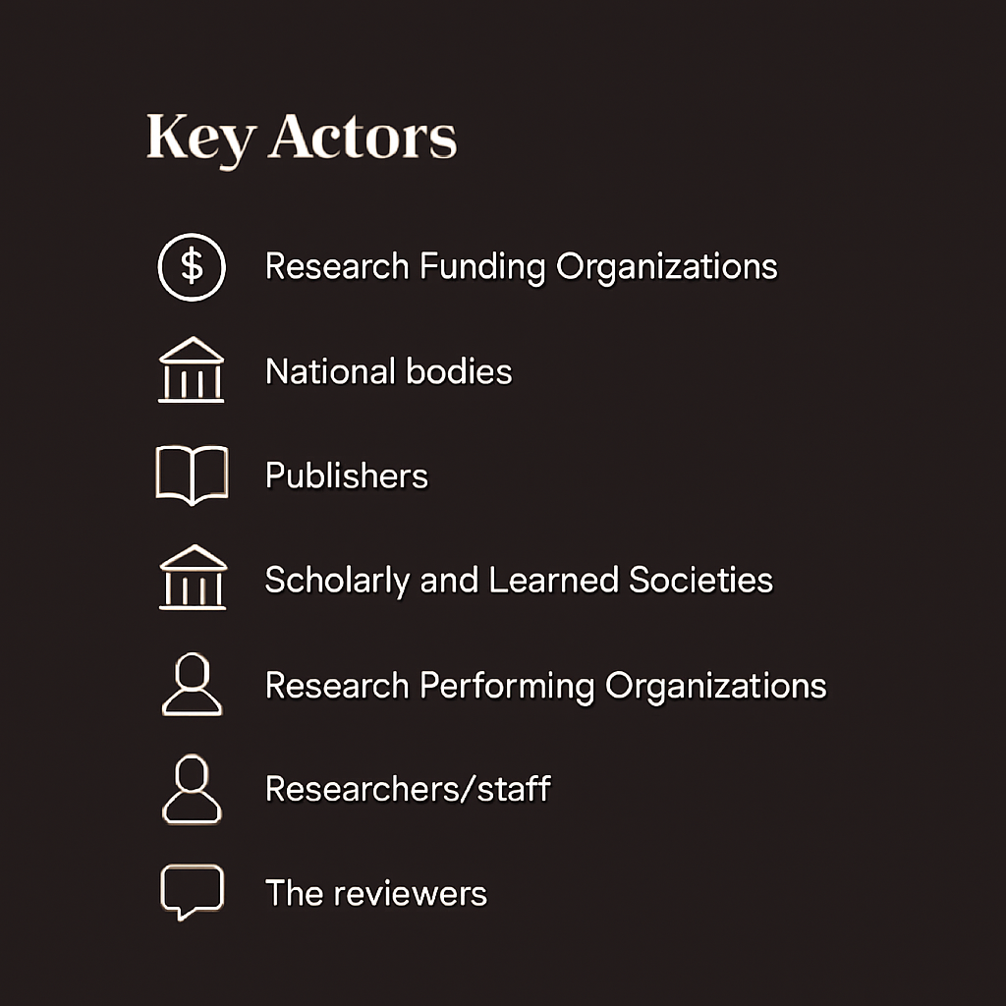
Key Actors
Research assessment is not confined to a single institution or region.
Systems problems are dynamic, involving multiple actors with diverse interests, and the actors are interconnected with each other.
Recognizing systems problems can provide a better understanding the causes of the problem and how to engage with partners and decision makers to find solutions.
Image Credit: Canva AI
Notes:
DISCUSSION QUESTION: Which actors influence your work the most? Discuss those that you might not have been aware of before and how this has changed your view of your place in the academic system.
ADDITIONAL INFORMATION: This slide provides a basic overview of who is involved in the research system. It is not exhaustive, but it does give an idea of the basic players on the field who influence and are influenced by research assessment practices.
In more detail:
Research Funding Organizations: Organizations that provide financial support for research. Their policies heavily influence what types of research are rewarded. The “changing role of funders in responsible research assessment” is a key focus for reform.
National bodies: Government agencies or consortia (e.g., AGORRA/RoRI – Research on Research Institute) that influence national research policies and funding landscapes.
Publishers: Organizations that disseminate scholarly work. They can de-emphasize the Journal Impact Factor (JIF) and promote responsible use of indicators.
Scholarly and Learned Societies: Professional organizations that represent specific disciplines or academic fields. They can set disciplinary standards for assessment.
Research Performing Organizations: Universities and research organizations where research is conducted. They are central to implementing RRA in hiring, promotion, and tenure processes.
Researchers/staff: The individuals who conduct research and are directly affected by assessment practices.
The reviewers: Individual researchers and subject matter experts who perform evaluations for research funding organizations, research performing organizations, etc.
Within organizations that do research assessment, several departments play crucial roles in providing resources, infrastructure, and training for RRA implementation. In research performing organizations, these include:
Human Resources (HR): Essential for integrating RRA principles into hiring, promotion, and tenure policies and processes.
Library Staff: Play a vital role in providing access to diverse scholarly outputs, educating on responsible metrics, and supporting open scholarship.
Funding Support: Support with funding applications, compliance, and understanding assessment criteria.
Research Managers: Coordinate institutional strategies, foster cross-departmental collaboration, and ensure alignment of assessment practices with RRA principles.
IT Departments: Provide the necessary technological infrastructure to support new assessment tools and data management.

Slide 7
How do academic systems influence one another?
The negative cycle of traditional assessment systems
Funders reward researchers based on publications in high-impact/prestigious journals
University rankings are influenced by researcher funding and publication metrics
Universities attempt to gain funding and prestige based on rankings
Implicitly or explicitly, researchers are taught what type of work is rewarded.
Researchers are not rewarded for work like mentorship, locally engages work and data stewardship
Universities narrow their recruitment and promotion criteria to avoid jeopardizing their rankings
Notes:
DISCUSSION QUESTION: How do you experience the interconnectedness and the interdependencies in your daily work?
Note: Use or adapt discussion questions depending on your audience, discipline, and unique context.
ADDITIONAL INFORMATION: You may use both of the illustrative examples slides or just one. It can often be difficult to look beyond professional silos without formal training on how the academic system functions. This illustrative scenario (slide 1 of 2) is meant to help trainers frame the discussion by illustrating what type of far-reaching ripple effects assessment decisions can have. The illustrative scenario is simplified and you are welcome to edit it to better fit your context. The text for the scenario is below, for easier editing.
Illustrative Scenario:
Funders reward researchers based on publications in high-impact/prestigious journals,
University rankings are based on researcher funding and publication metrics,
Universities gain funding and prestige based on rankings,
Universities shape recruitment and promotion criteria to avoid jeopardizing their rankings,
Researchers are not rewarded for all work they do (like mentorship, locally engaged work, data stewardship),
Researchers are trained, implicitly or explicitly, that they must “publish or perish” to obtain jobs, funding, and promotions.

Slide 8
How do academic systems influence one another?
Research Assessment Reform as a Systems Solution
Funders reward researchers based on a holistic, wide range of relevant outputs.
Universities are rewarded based on outputs that align with their values (community engagement, mentorship, rigor, etc.)
Implicitly or explicitly, researchers are taught what type of work is valued.
Universities shape recruitment and promotion criteria to reward a holistic range of outputs.
Researchers are rewarded for work like mentorship, locally engages work and data stewardship
Notes:
DISCUSSION QUESTION: How do you experience the interconnectedness and the interdependencies in your daily work?
Note: Use or adapt discussion questions depending on your audience, discipline, and unique context.
ADDITIONAL INFORMATION: You may use both of the illustrative examples slides or just one. It can often be difficult to look beyond professional silos without formal training on how the academic system functions. This illustrative scenario (slide 2 of 2) offers an example of how research assessment reform can positively influence the system. This meant to help trainers frame the discussion by illustrating what type of far-reaching ripple effects assessment decisions can have.
The illustrative scenario is simplified and you are welcome to edit it to better fit your context. The text for the scenario is below, for easier editing.

Slide 9
Who is working to change research assessment?
There are many initiatives working to reform research assessment, across disciplines and across the world. These include:
  Declaration on Research Assessment (DORA)
  Latin American Forum on Research Assessment (FOLEC-CLACSO)
  Coalition for Advancing Research Assessment (CoARA)
  More Than Our Rank (MTOR)
  SCOPE Framework
  Make Data Count
Notes:
DISCUSSION QUESTION: Does the audience know of any other examples? Have they ever engaged with these initiatives?
ADDITIONAL INFORMATION: This is not an exhaustive list of initiatives working to reform research assessment. Feel welcome to add to this based on your context.
You can find examples of initiatives and groups working to reform research assessment within DORA's "A Practical Guide to Implementing Responsible Research Assessment at Research Performing Organizations": https://doi.org/10.5281/zenodo.15000682

Slide 10
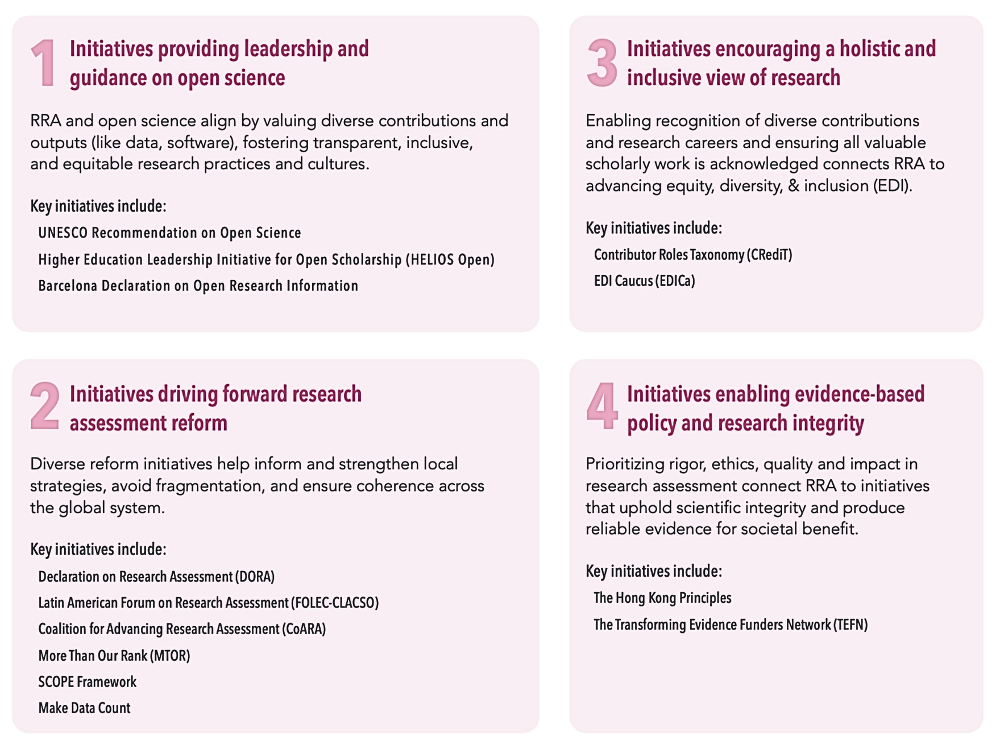

Source: http://sfdora.org/resource/practical-guide/
Notes:
ADDITIONAL INFORMATION: Additional option for discussing different initiatives in the RRA space.
This is not an exhaustive list of initiatives working to reform research assessment.
Image credit: DORA's "A Practical Guide to Implementing Responsible Research Assessment at Research Performing Organizations": https://doi.org/10.5281/zenodo.15000682

Slide 11
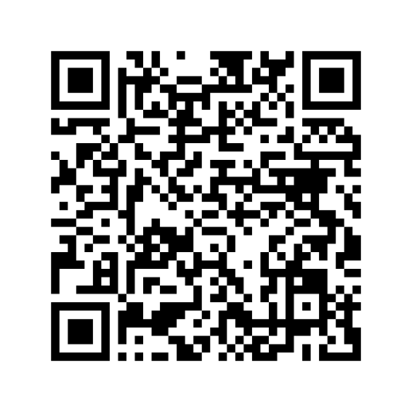
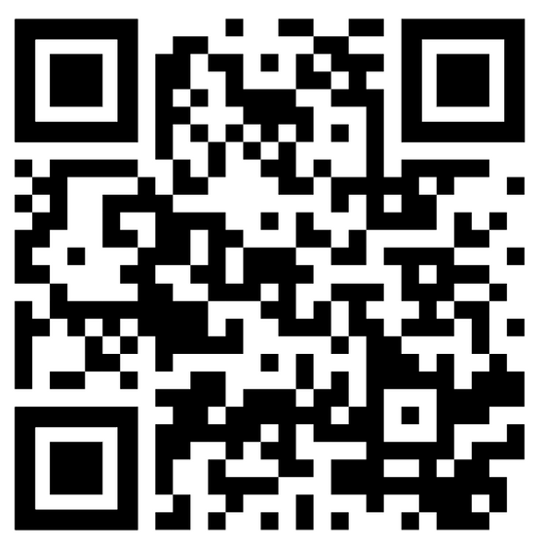
To learn more, take DORA’s Introduction to RRA Course
Glossary and suggested reading list
https://sfdora.org/courses/introductory-course-to-responsible-research-assessment/
https://sfdora.org/resource/introduction-to-rra-course-lesson-2-glossary-and-reading-list-2/
Notes:
Thank you for using these slides and the teaching support guide. We would love to know how you used these resources and invite you to fill out this feedback form: https://forms.gle/RXZbtoBipzVYXoX19
If you have any questions, please contact us as: info@sfdora.org.
What to do next? Consider creating a call to action for your audience to continue the conversation. As an example: If you are a librarian and you used these slides to inform a presentation on RRA to your researchers, you can ask them to create a 2-page revised version of their CV that include narrative elements, doesn't include inappropriate metrics, and focuses on their most impactful work.

