Slide 1

This slide deck is for those who want to incorporate DORA’s “Introduction to RRA” course materials into training, teachings, presentations, etc. This may be particularly useful for RRA advocates who are seeking educational materials for their communities.
How to use this resource
This deck provides the most important takeaways from a lesson from the Introduction to RRA course. Notes for presenters are included in the speaker notes.
Notes:
Please feel free to delete this and any slides when using this slide deck.

Slide 2
Each course lesson has a slide deck and lesson guide. This gives you the flexibility: You can have your learners take the course and/or you can teach high-level key takeaways from each lesson.
You decide which combination of approaches is most suitable for your needs.
How to use this resource
Unless otherwise indicated, this content is available under a Creative Commons Attribution License CC BY-NC 4.0. Logos are trademarks or registered trademarks of their respective organizations and may not be reused or reproduced without permission.

Slide 3

Introduction to Responsible Research Assessment
Lesson 1: What is Responsible Research Assessment?
Notes:
ADDITIONAL INFORMATION: This slide deck is for those who want to incorporate DORA’s “Introduction to RRA” course materials into training, teachings, presentations, etc. This may be particularly useful for RRA advocates who are seeking educational materials for their communities.
Please feel free to delete this and any slides when using this slide deck.
This deck provides the most important takeaways from a lesson from the Introduction to RRA course. Notes for presenters are included in the speaker notes.
Each course lesson has a slide deck and lesson guide. This gives you the flexibility: You can have your learners take the course and/or you can teach high-level key takeaways from each lesson.
You decide which combination of approaches is most suitable for your needs.
Unless otherwise indicated, this content is available under a Creative Commons Attribution License CC BY-NC-ND 4.0. Logos are trademarks or registered trademarks of their respective organizations and may not be reused or reproduced without permission.

Slide 4

Learning Objectives
By the end of this lesson, you will be able to:
Define Responsible Research Assessment (RRA) and articulate what it aims to accomplish.
Describe the intersection of RRA with other efforts to improve academic culture.
Evaluate on your own assumptions and experiences with research assessment.
Image Credit: Canva AI
Notes:
ADDITIONAL INFORMATION: We recommend that facilitators/presenters take Lesson 1 of the DORA Introductory Course before teaching it's content. https://sfdora.org/courses/introductory-course-to-responsible-research-assessment/
Suggested options for how to deliver and facilitate this lesson in a seminar, workshop, or classroom setting:
1. Have your students/audience take this course lesson before your presentation. This will support jumping more quickly into deeper discussions and focus on discussion questions.
2. Present the information from these slides. You may include some or all of the discussion questions. This is a good option if you are short on time and space, or if you are adding these slides into an existing deck.

Slide 5
Research assessment
Research assessment
The process used to review research and researchers’ contributions - or scholarly work -, reflecting on its characteristics such as quality, value, and relevance.
Why does it matter?
Research assessment shapes different aspects of academia and research system, including:
hiring, promotion, and tenure decisions
allocation of grants and awards.
Notes:
ADDITIONAL INFORMATION: You may omit this and other slides that contain basic definitions if you feel your audience already has a firm grasp on research assessment. However, it is also very helpful to create a shared baseline of knowledge.
DISCUSSION QUESTIONS: Use or adapt some or all of the below questions, depending on your audience, discipline, and unique context.
1. What factors do you think matter the most for making decisions on who to hire, who to promote, and how to allocate grant funding? Here, we are trying to get audience to think through their assumptions around quality and merit.
2. What do you think “research assessment” is? You can ask this question before you define research assessment or after you define it and before you outline why research assessment matters.
3. Who do you think makes the decisions about hiring, promotion, tenure, and grant funding?
You can use these prompts to get the audience thinking: Who creates the job listings, interviews candidates, and decides what a “good” candidate is? How do they decide? Here are some important roles that also influence research assessment at different organizations: research managers, human resources, library staff, department leadership, ethics officers, policy officers from national agencies, and grant program officers/managers. In some countries, national agencies manage research assessment standards.

Slide 6
The pitfalls of traditional research assessment
Traditional approaches frequently fall short in capturing the full richness and societal value of research, leading to unintended consequences and a skewed view of quality and impact.
Some common approaches:
Use of “laundry-list” CVs
Overreliance on prestige
Inadvertently perpetuate biases
Lack of clear evaluation guidance
Grant income as an important or sole measure of impact or value
Use of rankings
Notes:
DISCUSSION QUESTIONS: Discuss your experiences with traditional assessment. Has it impacted you and/or your work? How do you think it has impacted the type of work that is valued in research?
ADDITIONAL INFORMATION: For many years, academic culture has been heavily influenced by a narrow set of “traditional” assessment approaches and metrics. The following assessment approaches often influence what types of scholarly work are valued in critical decisions like hiring, promotion, tenure, funding, awards, and publication:
Use of “laundry-list” CVs
The traditional “laundry-list” CV can be upwards of twenty pages long and consists of lists of publications and achievements, often without providing context about the person’s specific contributions, the work's significance, or its broader impact. This approach incentivizes assessment based on “quantity over quality” and devalues things like slow science and diverse achievements.
Overreliance on prestige
Often, unintended biases lead to judging individuals based on the reputation of the institutions they attended or worked at, or the prestige of the journals or publishers where they publish, rather than assessing their individual merits, contributions, or the actual content of their work. This can perpetuate existing inequities and limit opportunities for talented individuals from less prominent institutions or those who publish in less “prestigious” venues.
Review panels
Reviewers can inadvertently perpetuate existing cognitive and systems biases. Cognitive and systems biases are inherent human tendencies and systemic structures that can unconsciously influence assessment decisions, which can reinforce the status quo and potentially stymie fresh ideas and approaches.
Lack of clear guidance
If the criteria and guidelines used to evaluate a candidate or applicant are not clear or structured, it can create space for more variable and subjective review. Along the same lines, lack of transparency around how applicants will be assessed creates uncertainty and can erode trust in the system.
Grant income as an important measure of impact or value
Assuming that the amount of grant funding received directly equates to a researcher’s competence or the quality of their ideas, without considering the varying funding needs across disciplines. Resources often flow to those who already have them, and overreliance on a track record of funding awards can create the potential for biases in funding allocation and career assessment.
Use of rankings
It can be easy to use rankings, like those for “most cited researchers” or university rankings, which are often based on narrow, easily quantifiable indicators that fail to reflect a holistic view of contributions, mission, or value.

Slide 7

Why does research assessment matter?
Researcher: “I’ve worked for many years to be a supportive mentor and I’ve spearheaded a project that has had positive impacts in my community. But all anyone seems to care about is whether I’ve published in a high-impact journal and how much grant money I’ve brought into the university. I was passed over for promotion, again. I’m considering leaving academia for another sector.”
Librarian: “As a librarian, I struggle to reconcile guiding researchers how to correctly use metrics like JIF and h-index while my university keeps using them for promotions. JIF and h-index are harmful when used incorrectly! I don’t want to rock the boat, but I’m frustrated by these conflicting interests. I wish something would change.”
Note: These examples are fictitious
Image Credit: Canva AI
Notes:
ADDITIONAL INFORMATION: You may find that it is helpful to ground your discussion about research assessment in real-world examples.
This slide (1 of 2) contains quotes from fictitious characters about how research assessment impacts them. It is recommended to pick a quote that is most appropriate for your context and use that to illustrate the potential impact of research assessment practices that are not responsible. Remove the unused quotes/slide.

Slide 8
Why does research assessment matter?
Research Funder: “We want to invest in more risky, big ideas, but our current assessment system focuses too much on rewarding the status quo, the same people over and over again get funded even when we changed the criteria of our high risk high gain grants. I don’t know what else to do to change it.”
Publisher: “We think we publish great science, but it’s becoming much harder with AI: we have increasing pressure from more submissions while also struggling with having fewer reviewers who can peer review them!”
Note: These examples are fictitious
Image Credit: Canva AI
Notes:
ADDITIONAL INFORMATION: You may find that it is helpful to ground your discussion about research assessment in real-world examples.
This slide (2 of 2) contains quotes from fictitious characters about how research assessment impacts them. It is recommended to pick a quote that is most appropriate for your context and use that to illustrate the potential impact of research assessment practices that are not responsible. Remove the unused quotes/slide.

Slide 9
What does RRA mean in practice?
Responsible research assessment (RRA)
A modern approach to evaluating research and researchers. It moves beyond counting publications or relying on journal popularity and aims for a complete and balanced picture of quality and impact across all research contributions.
RRA is about choosing assessment approaches that:
Focus on the quality and impact over quantity of contributions
Recognize diverse contributions like collaboration, mentorship, and societal contributions
Prioritize qualitative evaluation, like peer review, while avoiding inappropriate metrics or rankings (like JIF and h-index).
Promote fairness and transparency in evaluation processes.
Notes:
DISCUSSION QUESTION: How would you go about changing assessment systems so that they are better at rewarding work that you think is valuable? Make sure to carefully consider what “value” means in your own context!

Slide 10
Real world example: RRA in practice
Research performing organizations (RPOs) set the tone for research assessment: RPOs assess researchers for hiring, promotion, and tenure using specific criteria to judge research quality and impact.
University Medical Center (UMC) Utrecht has an evaluation framework for hiring and promotion that requires applicants to outline qualitative indicators and a narrative portfolio of achievements, including those relating to how they engage with society. The way that institutions ask their staff to share their achievements and contributions shape the culture and work priorities of its staff.
Notes:
ADDITIONAL INFORMATION: You may find that it is helpful to ground your discussion about research assessment in real-world examples.
This slide contains a real-life example of why assessment matters. You will also find two different examples below, for use as appropriate for your context:
Example: How national agencies set the tone for research assessment: In Italy, there is a national-level agency called Agenzia Nazionale Di Valutazione Del Sistema Universitario E Della Ricerca (ANVUR) that sets standards for “research quality”, organizes reviewer panels to perform evaluations of Italian universities and research performing organizations (RPOs) and informs public funding policy. The type of work that ANVUR considers to be “high quality” directly influences how RPOs are funded and the type of work that RPOs incentivize their staff.
Example: How research funders set the tone for research assessment: In Canada, major research funding agencies like Canadian Institutes of Health Research (CIHR), the Natural Sciences and Engineering Research Council of Canada (NSERC), and the Social Sciences and Humanities Research Council of Canada (SSHRC) work together create policies for researchers who apply for funding. The types of scholarly work that funding agencies choose to receive funding influence the work that RPOs reward and the work that researchers choose to highlight and focus their energy on.

Slide 11
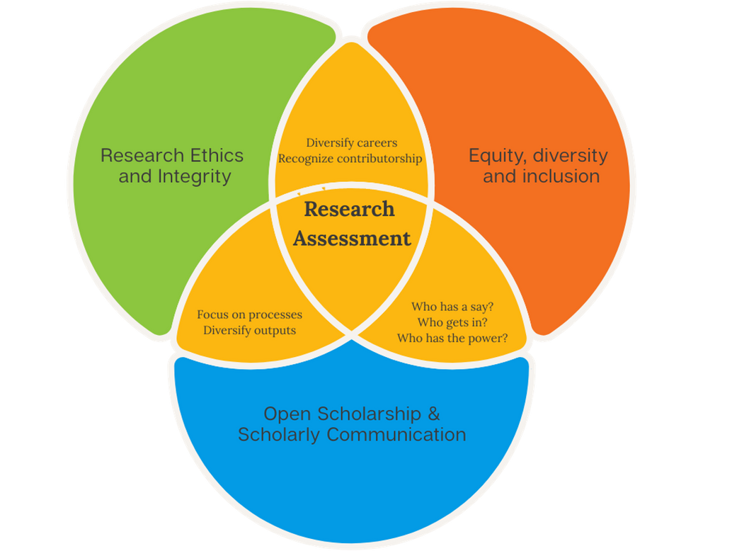
Intersection with other movements
RRA is deeply interconnected with and supports broader efforts to improve academic culture! This includes:
Research integrity and reproducibility
Fostering open scholarship (which makes scientific knowledge openly available and accessible)
Addressing biases in evaluation processes.
Notes:
DISCUSSION QUESTION: To help address questionable research practices, how would you change the way that researchers are evaluated?
RRA is interconnected with many other initiatives that are aimed at improving academic culture and quality. Let’s walk through a real-world example of this: In traditional assessment practices, researchers are usually incentivized to take a “quantity over quality” approach in order to get hired, promoted, or to be awarded funding. This approach deprioritizes slower, more rigorous research and creates pressure on researchers, resulting in a range of negative behaviors, like: false or erroneous reporting of results, publication chasing, citation chasing, an aversion to including negative data, and a lack of transparency.
ADDITIONAL INFORMATION: RRA is deeply interconnected with and supports other initiatives aimed at improving academic culture. Two examples are:
1. The integrity and reproducibility movement: This is a movement that advocates for 1) rigor in designing and performing research, 2) transparent and interoperable sharing of methods and results, and 3) the ability to reproduce research findings.
How does RRA fit in to this movement? When we responsibly assess scholarly work, we focus on its own merits, including how it is rigorous, ethical, transparent, and reproducible. By applying RRA principles, people can be recognized and rewarded for a broader range of contributions, opening space for publishing null results, conducting replication studies, and truthfully reporting results.
2. The open scholarship movement: Open science, also known as open scholarship or open research, can broadly be defined as: an inclusive movement to “make multilingual scientific knowledge openly available, accessible and reusable for everyone, to increase scientific collaborations and sharing of information for the benefits of science and society, and to open the processes of scientific knowledge creation, evaluation and communication to societal actors beyond the traditional scientific community.”
How does RRA fit in? Because engaging in openness practices requires time and effort not always captured by traditional metrics, adoption of responsible assessment practices enables more diverse contributions to be recognized and rewarded, including datasets, software and educational materials. By moving away from quantitative metrics, RRA allows for increased comprehensive and contextualized understanding of the research process.
3. Addressing biases to include a greater diversity of perspectives: There are a wide range of biases that can negatively influence how someone is assessed for a hiring, promotion, or for funding.
How does RRA fit in with these different movements? RRA advocates for the unbiased assessment of scholarly work based on its own merits. By valuing contributions to team science (e.g., research projects conducted by groups of individual experts each contributing knowledge and effort), interdisciplinary efforts, and the development and training of other researchers, which often disproportionately falls on women and minoritized individuals, RRA seeks to foster a more equitable, inclusive, and impactful research environment.

Slide 12
What does RRA look like in practice?
For facilitator to fill in based on their context:
Choose a case study example that you feel is most relevant to your specific context. You can present this to your audience to tie together the lesson and discussions.
Sources for a case study example:
Your own experience or knowledge
DORA Course Lesson 1
DORA Case Study repository
Reformscape
Notes:
ADDITIONAL INFORMATION: We recommend including a practical example of RRA in a real-world context that is relevant to you. This helps drive home the idea that traditional assessment practices are not as concrete and unchangeable as they might seem, and that RRA is being implemented actively.
You can find examples linked in this slide and also in Lesson 1.
Some examples from Lesson 1:
Example 1: How national agencies set the tone for research assessment: In Italy, there is a national-level agency called Agenzia Nazionale Di Valutazione Del Sistema Universitario E Della Ricerca (ANVUR) that sets standards for “research quality”, organizes reviewer panels to perform evaluations of Italian universities and research performing organizations (RPOs) and informs public funding policy. The type of work that ANVUR considers to be “high quality” directly influences how RPOs are funded and the type of work that RPOs incentivize their staff.
Example 2: How research funders set the tone for research assessment: Research funding organizations decide what type of work they want to fund, and they decide who to award that funding to. This implicitly and explicitly influences standards for “quality” research. For example: The Aotearoa New Zealand Ministry of Business, Innovation and Employment (MBIE) worked with Indigenous peoples to create the He aka ka toro investment fund for projects that advance iwi, hapū, hapori, and Māori research.
Example 3: How research performing organizations set the tone for research assessment: RPOs assess researchers for hiring, promotion, and tenure using specific criteria to judge research quality and impact. University Medical Center (UMC) Utrecht has an evaluation framework for hiring and promotion that requires applicants to outline qualitative indicators and a narrative portfolio of achievements, including those relating to how they engage with society. The way that institutions ask their staff to share their achievements and contributions shape the culture and work priorities of its staff. In this sense, RRA (i) stimulates originality and contributes to taking risks in research by not prioritizing the number of results obtained in the short term; (ii) reduces the influence of fashions or dominant ways of thinking by valuing the intrinsic contributions of research; and (iii) pluralizes the types of problems whose study is considered valuable, as well as the approaches to addressing them.

Slide 13
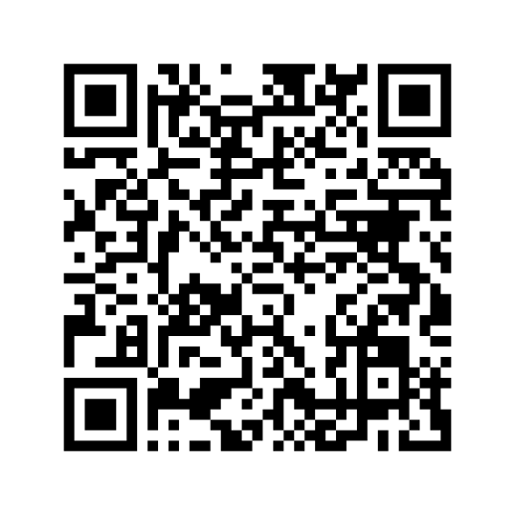
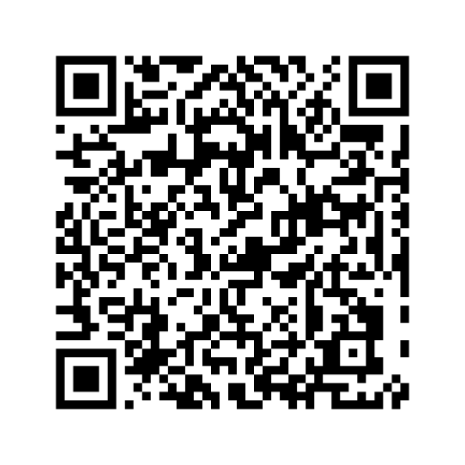
To learn more, take DORA’s Introduction to RRA Course
Glossary and suggested reading list
https://sfdora.org/courses/introductory-course-to-responsible-research-assessment/
https://sfdora.org/resource/introduction-to-rra-course-lesson-2-glossary-and-reading-list-2/
Notes:
Thank you for using these slides and the teaching support guide. We would love to know how you used these resources and invite you to fill out this feedback form: https://forms.gle/RXZbtoBipzVYXoX19
If you have any questions, please contact us as: info@sfdora.org.
What to do next? Consider creating a call to action for your audience to continue the conversation. As an example: If you are a librarian and you used these slides to inform a presentation on RRA to your researchers, you can ask them to create a 2-page revised version of their CV that include narrative elements, doesn't include inappropriate metrics, and focuses on their most impactful work.

