Slide 1

How to use this resource
This slide deck has been developed for those who are advancing responsible research assessment initiatives and can benefit from using the “A Practical Guide to Implementing Responsible Research Assessment at Research Performing Organizations”.
This deck may be particularly useful for RRA advocates in presenting their initiatives to their communities, for which the Guide can be a supporting tool.
It briefly introduces RRA and then introduces potential areas of action based on the DORA Practical Guide, launched in May 2025. Notes for presenters are included in the notes section of each slide.
Please feel free to use what needed and edit the slides as suitable for your institutional needs.
This content is available under a Creative Commons Attribution License (CC BY-SA 4.0), except supporter logos. Logos are trademarks or registered trademarks of their respective organizations and may not be reused or reproduced without permission. The DORA logo may be used provided its visual integrity is maintained and it is not used in any way to suggest endorsement by DORA.

Slide 2
Implementing Responsible Research Assessment
Reflections based on DORA’s Practical Guide for Research Performing Organizations
Notes:
Please feel free to change this and other slides!

Slide 3
What is Responsible Research Assessment?
An umbrella term for approaches to assessment that incentivize, reflect, and reward the plural characteristics of high-quality research, in support of diverse and inclusive research cultures.
It represents a shift in how research and researchers are evaluated, moving beyond traditional methods that often rely on narrow quantitative metrics.
The goal of RRA is to support and encourage assessment practices that focus on a holistic view of researchers, as well as the research processes, outputs, outcomes, and impacts of research.
Notes:
Responsible Research Assessment (RRA) is defined as an umbrella term for approaches to assessment that incentivize, reflect, and reward the plural characteristics of high-quality research, in support of diverse and inclusive research cultures. It represents a shift in how research and researchers are evaluated, moving beyond traditional methods that often rely on narrow quantitative metrics.
The goal of RRA is to support and encourage assessment practices that focus on a holistic view of researchers, as well as the research processes, outputs, outcomes, and impacts of research.
Implementing RRA involves making changes to established practices in various key moments of assessment, such as recruitment, hiring, promotion, awards, grants, and evaluation of research units.

Slide 4
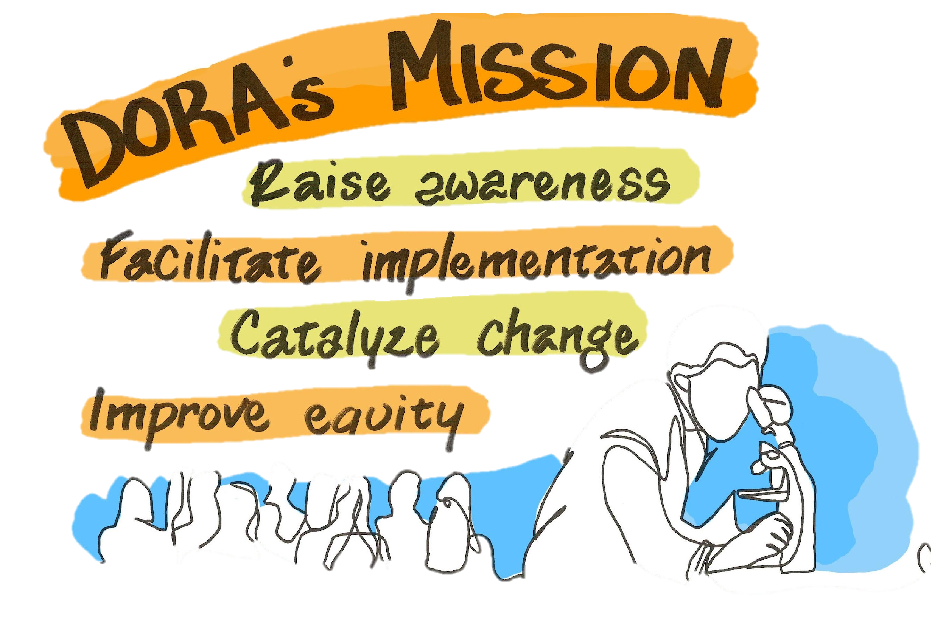
DORA (Declaration on Research Assessment)
Draws attention to potential problems of journal-based metrics in hiring, promotion, and funding decisions and the need to recognize a broader range of scholarly contributions
A set of 18 recommendations for funders, institutions, publishers, metrics suppliers and researchers
Demonstrates community support for change
  Currently signed by over 26,000 individuals and organizations
Notes:
The San Francisco Declaration on Research Assessment (DORA) emerged from concerns about the inappropriate use of journal-based metrics in evaluating scholarly outputs. A core principle driving DORA's existence is the belief that research should be assessed on its own intrinsic merit, not on the journal title or Impact Factor where it is published. DORA advocates for recognizing and valuing a broad range of scholarly activities and contributions beyond traditional publications. It seeks to move away from journal-based performance indicators and promote the use of effective alternative tools and processes.
DORA acknowledges that reforming research assessment is a complex systems challenge that requires collective action from various stakeholders, including researchers, academic institutions, and funders. It emphasizes that evaluation practices should align with core academic values, promote consistency and transparency in decision-making, and address structural inequalities in academia to improve equity. Ultimately, DORA exists to support the development of a research culture that is centered on people and values.
Signing the San Francisco Declaration on Research Assessment (DORA) is considered a first step towards RRA, with the more challenging steps involving changes in processes to reflect these principles in practice.

Slide 5
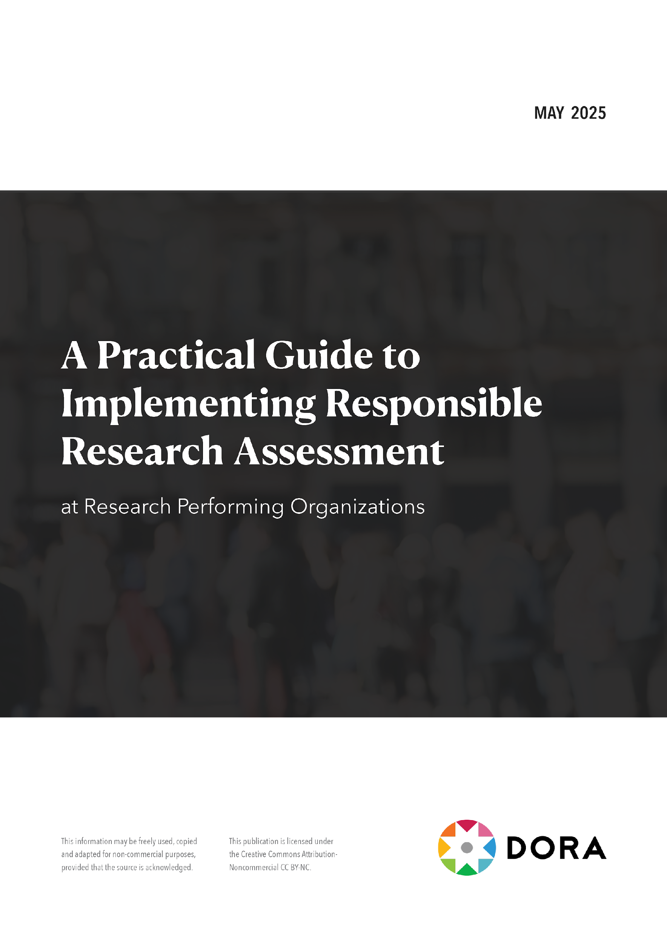

Download from Zenodo bit.ly/DORA-Guide
A “one-stop-shop” for research performing organizations: practical tips, reflective questions, real life examples.
Flexible: no size fits all choose your own adventure approach.
Notes:
The publication titled "A Practical Guide to Implementing Responsible Research Assessment at Research Performing Organizations" was launched in May 2025 with three launch events (https://youtube.com/playlist?list=PLOnCDgZmlVHfsufDusj1RwscvzjXs4UlV&si=xdcvo433rysEMMO5), coinciding with DORA's 12th anniversary celebration. This Guide is a key output of Project TARA (Tools to Advance Research Assessment), which is supported by the Arcadia Fund.
The primary goal of the Guide is to provide practical guidance and tips for Research Performing Organizations (RPOs) that are seeking to review or reform how they assess research and researchers. It aims to help institutions build capacity and support the implementation of responsible research assessment (RRA) practices.
The Guide is designed for a broad audience within RPOs, including research leadership, faculty, administrative staff, and researchers at all career stages. It draws upon the learnings DORA has gained over a decade of working with its community.
It covers key areas for implementing RRA, including:
• Nine key activities for developing an RRA strategy (such as engaging leadership, convening working groups, exploring the landscape, reviewing practices, developing a vision, and monitoring the strategy).
• Guidance on integrating RRA practices into key moments in assessment, such as recruitment, hiring, and promotion decisions; institutional awards and internal grants; evaluation of internal research units; and corporate communications.
• An introduction to relevant global initiatives and frameworks that align with RRA.

Slide 6
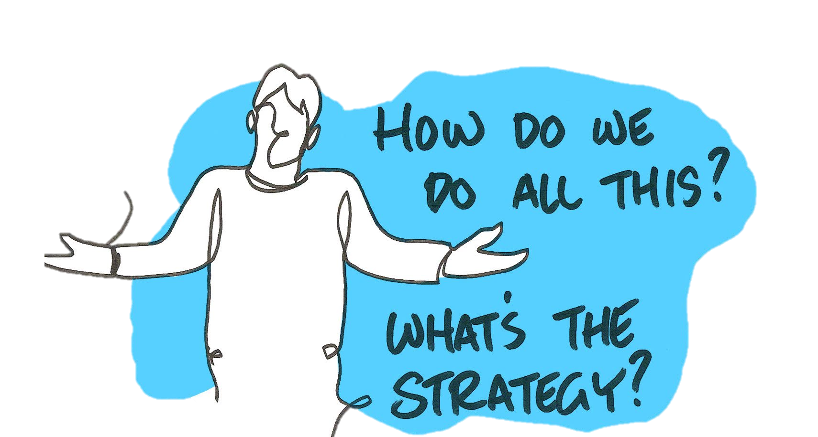
What are potential change strategy activities?
How do we get started /advance with research assessment reform?
Engaging the organization leadership
Working with the community at your organization
Mobilizing resources
Convening a working group
Exploring the RRA landscape
Reviewing current assessment practices
Developing a strategic vision for RRA
Developing engagement and communication plans
Monitoring and updating your strategy
Notes:
The DORA Guide outlines nine key activities that, based on DORA’s community experience, can be crucial for the successful development of RRA approaches. These activities are presented as distinct steps that can be considered in sequence, in parallel, or selected based on an organization's specific needs and context, recognizing that "one size rarely fits all in RRA".
The nine activities covered are:
1 Engaging the organization leadership: Highlighting the importance of securing support from senior figures to drive change.
2 Working with the community at your organization: Emphasizing the value of involving various stakeholders like faculty, Early Career Researchers, librarians, and administrators to build support and gather perspectives.
3 Mobilizing resources to develop and implement an RRA strategy: Addressing the need for sufficient people, time, and materials for effective implementation, suggesting pilot testing as a way to understand resource implications and build evidence.
4 Convening a working group/task force: Recommending the formation of a group with expertise and broad representation to drive the process, ideally with support from organizational leadership.
5 Exploring the landscape for RRA: Encouraging organizations to look at national and international initiatives and the practices of other RPOs and funders to inform their own strategy.
6 Reviewing current assessment practices: Stressing the importance of understanding existing processes, criteria, and any past reform efforts within the organization to identify areas for change.
7 Developing a strategic vision for RRA: Guiding organizations in defining a clear vision for RRA that aligns with their mission and values, potentially linking it to broader goals like fostering open science or promoting equity.
8 Developing effective engagement and communication plans: Highlighting the necessity of clear, transparent, and consistent communication with all affected parties about the RRA agenda to build buy-in and mitigate concerns.
9 Monitoring and updating your strategy: Emphasizing the importance of establishing mechanisms for regular review, using evidence to track progress, identify unintended consequences, and keep the strategy aligned with organizational needs.
Chapter 2 also features a "Spotlight” on the SPACE Rubric. Developed in collaboration with Ruth Schmidt, this rubric is a tool designed to help institutions gauge their internal capacity and infrastructure to support RRA interventions and plan for success. The rubric has five dimensions (Standards for Scholarship, Process Mechanics and Policies, Accountability, Culture Within Institutions, and Evaluative and Iterative Feedback) and three stages of capability development (Foundation, Expansion, Scaling). The Guide suggests various ways the SPACE Rubric can be used to support the activities discussed in this chapter, such as structuring discussions for a task force or analyzing current practices.

Slide 7
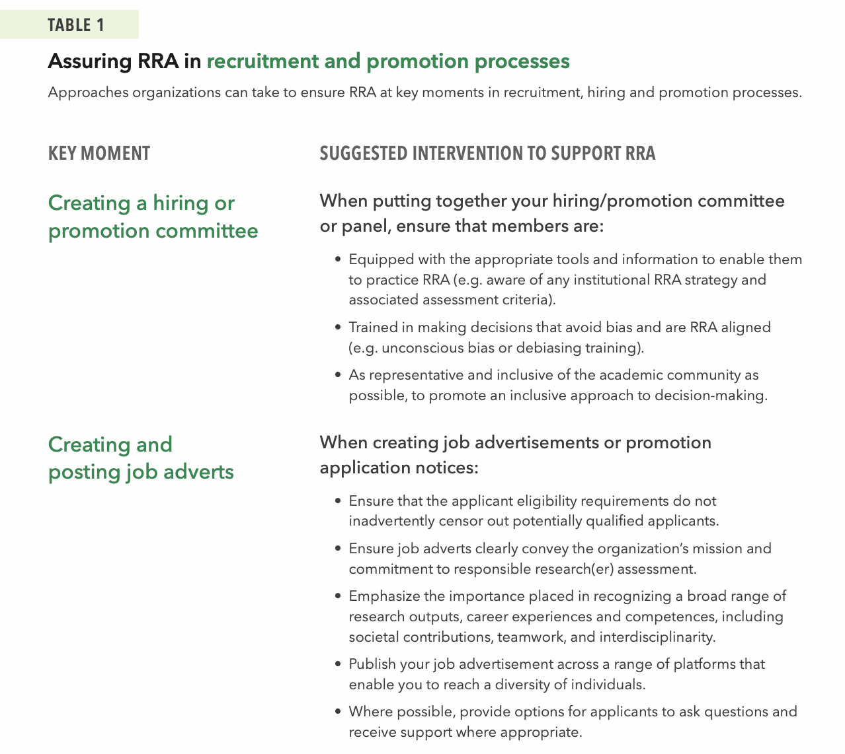
What could we change?
Points in time when RRA considerations are important
Recruitment, hiring and promotion
Institutional awards and internal grants
Evaluation of internal research units
Developing corporate communications
Notes:
The Guide also provides practical guidance on embedding Responsible Research Assessment (RRA) practices into policies and procedures that significantly impact researchers' careers based in four key moments of research(er) assessment. In each of these 4 moments, the Guide offers potential actions from Research Performing Organizations (RPOs), facilitating a ‘choose your own adventure’ or a ‘menu of options’ approach that encourages adaptation to local contexts. The chapter focuses on four crucial points where research and researchers are assessed:
1. Recruitment, hiring, and promotion decisions: This section emphasizes aligning these critical career junctures with RRA principles. This involves recognizing the diverse contributions and talents of researchers, prioritizing qualitative evaluation, moving away from inappropriate metric use, and ensuring a fair and transparent process. Suggested interventions cover creating committees, designing application materials (like transparent forms and clear criteria), writing job adverts, triaging applications, conducting interviews (using standardized protocols), providing post-hire support, and evaluating the entire process (e.g., using feedback forms). It highlights the importance of providing clarity and support throughout the application and assessment process.
2. Institutional awards and internal grants: The chapter offers approaches for applying RRA principles to the assessment and awarding of internal funding and prizes. Key suggestions include ensuring clear, open, and transparent criteria focused on the quality and impact of scholarship in award notices and grant calls. Nomination and application forms should request information relevant to the award/grant and be structured to allow applicants to contextualize their achievements, potentially using narrative formats alongside quantitative data. The process should involve appropriate panels and transparent communication, sensitive to both successful and unsuccessful applicants, and include mechanisms for review and feedback after the award cycle.
3. Evaluating internal research units: This section addresses the assessment of organizational entities like university departments, research centers, and infrastructures. The goal is to align these evaluations with the organization's overall RRA principles, values, and mission. The guide suggests integrating RRA approaches through contractual components in internal budget distribution systems. Recommended actions include developing clear evaluation policies and practices, carefully composing evaluation panels (potentially including external members and providing unconscious bias training), promoting self-evaluation focused on diverse contributions, conducting the evaluation transparently, and establishing mechanisms for post-evaluation feedback and continuous improvement.
4. Developing corporate communications: The final key moment stresses the importance of ensuring that RRA becomes a part of the institution's internal and external narrative and identity. This involves making communication colleagues aware of the RRA strategy and enabling them to share stories and successes that highlight a broader range of contributions. Suggestions include embedding RRA in institutional policies and position statements, leadership updates and newsletters, and communications around key appointments and hires. It specifically addresses how to frame commentary around national and institutional rankings, encouraging a holistic view of the institution and clarifying the limitations of metrics-based rankings while affirming they do not dictate individual assessment criteria.
Chapter 3 also features "Spotlight" sections that delve into considerations relevant to these key moments:
• Narrative CVs: Presented as an alternative to traditional CVs, allowing researchers to describe their achievements, skills, and contributions in a contextualized, descriptive format. They aim to promote diversity, equity, and inclusion by recognizing varied experiences and reducing biases, enabling researchers to "tell their story". The guide mentions evidence suggesting narrative CVs can reduce bias and highlight suboptimal practices. A possible framework for describing contributions via narrative CVs includes knowledge creation, development of individuals/collaborations, supporting the research community, and contributions to broader society.
• Early Career Researchers (ECRs): This spotlight highlights the importance of aligning assessments at key moments like thesis evaluations with RRA principles. It notes ECRs' desire for assessment approaches that value diverse outputs. The Spotlight suggests RPOs can consider training for ECRs covering responsible metrics, open science, research integrity, and how to contextualize their contributions using narrative CVs.
The Chapter references tools like the SPACE Rubric and the SCOPE Framework as aids for monitoring and evaluating the effectiveness of implemented RRA strategies.

Slide 8
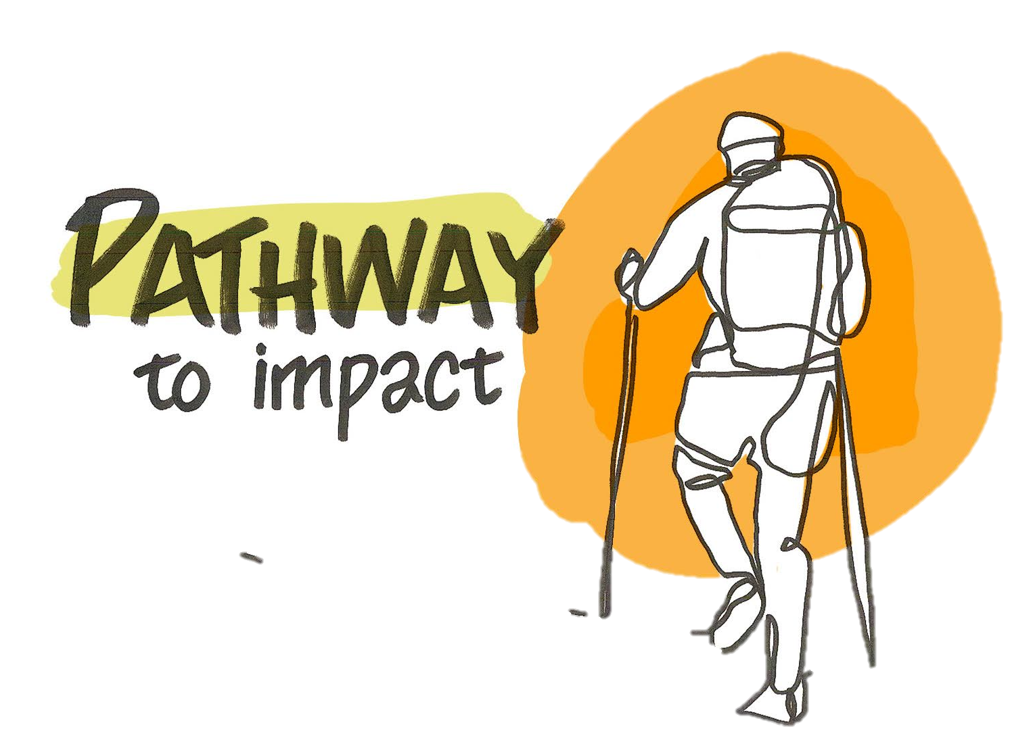
How can we connect our RRA strategy with other institutional changes?
Strategically alignment across trajectories, policies and practices
Research integrity
Research quality
Open science
Societal impact
Interdisciplinarity
Team science
Institutional assessment
Notes:
All RPOs are undergoing multiple changes at the same time. How can you connect these major changes in a way that reinforces and creates synergies to move forward your institutional missions? The Guide’s final chapter introduces a range of global initiatives and frameworks that align with Responsible Research Assessment (RRA) practices and related topics. We suggest that being knowledgeable about and integrating related topics such as open science, societal impact, research integrity, community engagement, interdisciplinarity, and reproducibility – along with others relevant to an organization's context – could be beneficial, as there may be many ongoing efforts to support change in an organization and they can mutually reinforce each other. The list of initiatives is not exhaustive but hopefully provides a helpful starting point. They are grouped by:
1. Initiatives aiming to provide leadership and guidance on aspects of open science. This section includes initiatives like the UNESCO Recommendation on Open Science, the Higher Education Leadership Initiative for Open Scholarship (HELIOS Open), and the Barcelona Declaration on Open Research Information.
2. Initiatives that focus on driving research assessment reform. Examples covered here include the San Francisco Declaration on Research Assessment (DORA), Foro Latinoamericano sobre Evaluación Científica (FOLEC-CLACSO), the 'More Than Our Rank' (MTOR) initiative, Make Data Count, the Coalition for Advancing Research Assessment (CoARA), and the SCOPE Framework.
3. Initiatives that aim to encourage a holistic and inclusive view of research. This section discusses the Contributor Roles Taxonomy (CRediT) and the EDI Caucus (EDICa).
4. Initiatives that focus on enabling evidence-based policy and research integrity. Initiatives mentioned are The Hong Kong Principles and The Transforming Evidence Funders Network (TEFN).

Slide 9

Improving research assessment
sfdora.org
Notes:
More information is on our website sfdora.org

