Slide 1

How to use this resource
This slide deck has been developed to introduce “A Practical Guide to Implementing Responsible Research Assessment at Research Performing Organizations”.
This slide deck may be particularly useful for DORA partners and friends in presenting the Guide to their communities.
It briefly introduces DORA and then introduces the Guide, launched in May 2025. Notes for presenters are included in the notes section of each slide.
Please feel free to use what needed and edit the slides as suitable for your institutional needs.
This content is available under a Creative Commons Attribution License (CC BY-SA 4.0), except supporter logos. Logos are trademarks or registered trademarks of their respective organizations and may not be reused or reproduced without permission. The DORA logo may be used provided its visual integrity is maintained and it is not used in any way to suggest endorsement by DORA.

Slide 2
Implementing Responsible Research Assessment
A Practical Guide for Research Performing Organizations
Notes:
Please feel free to change this and other slides!

Slide 3
Why DORA exists
Research needs to be assessed and people want to use quantitative evidence to do so
But many measures now used are flawed or inappropriate
DORA fosters better ways to assess research
Notes:
The San Francisco Declaration on Research Assessment (DORA) emerged from concerns about the inappropriate use of journal-based metrics in evaluating scholarly outputs. Specifically, there was a significant issue with the misapplication of the Journal Impact Factor (JIF). The JIF was being used incorrectly as a surrogate measure for the quality of individual research articles or to assess an individual scientist's contributions, particularly in key decisions related to hiring, promotion, tenure, and funding. Recognizing this problematic reliance on narrow metrics, DORA was released with the goal of improving the ways in which scholarly research is evaluated. It aims to advance practical and robust approaches to research assessment globally and across all scholarly disciplines.

Slide 4
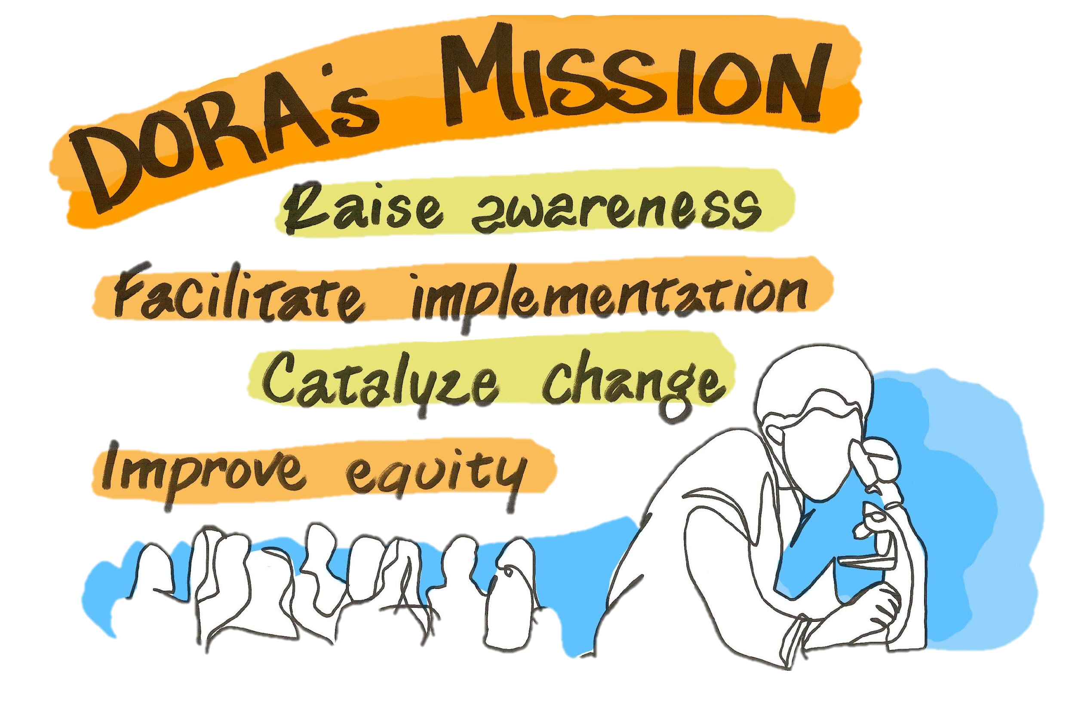
DORA (Declaration on Research Assessment)
Draws attention to potential problems of journal-based metrics in hiring, promotion, and funding decisions and the need to recognize a broader range of scholarly contributions
A set of 18 recommendations for funders, institutions, publishers, metrics suppliers and researchers
Demonstrates community support for change
  Currently signed by over 26,000 individuals and organizations
Notes:
A core principle driving DORA's existence is the belief that research should be assessed on its own intrinsic merit, not on the journal title or Impact Factor where it is published. DORA advocates for recognizing and valuing a broad range of scholarly activities and contributions beyond traditional publications. It seeks to move away from journal-based performance indicators and promote the use of effective alternative tools and processes.
DORA acknowledges that reforming research assessment is a complex systems challenge that requires collective action from various stakeholders, including researchers, academic institutions, and funders. It emphasizes that evaluation practices should align with core academic values, promote consistency and transparency in decision-making, and address structural inequalities in academia to improve equity. Ultimately, DORA exists to support the development of a research culture that is centered on people and values.

Slide 5
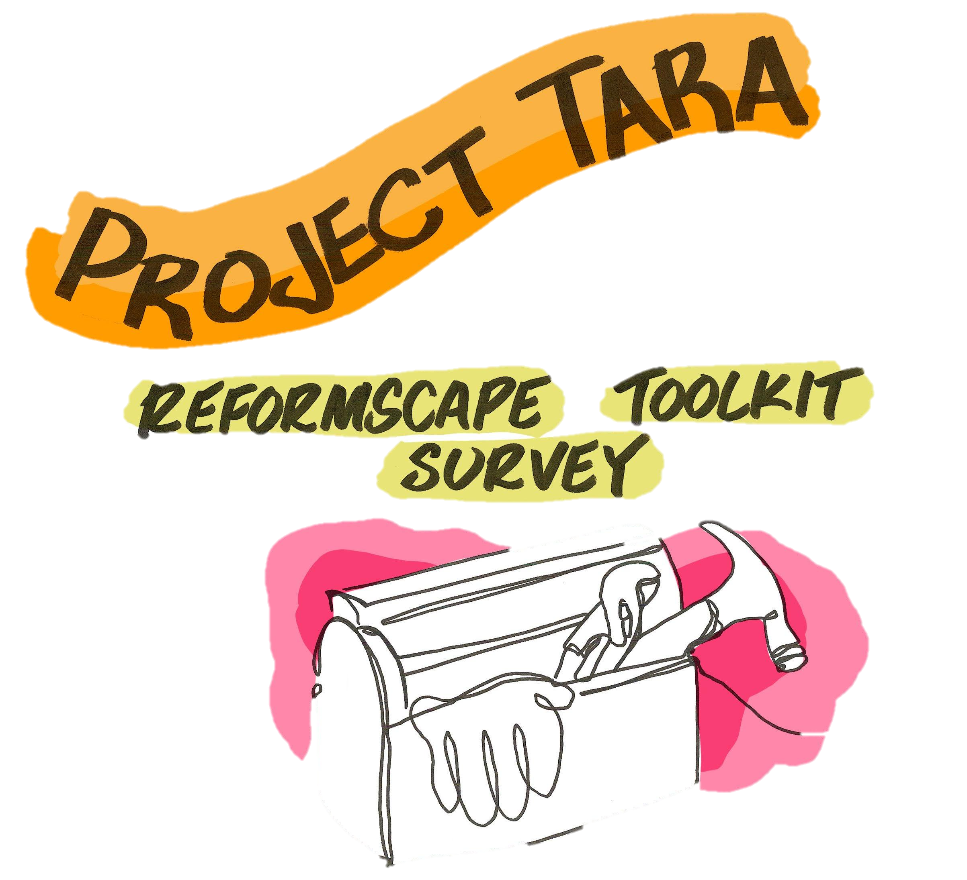
Project TARA
Project TARA is supported by a grant from Arcadia Foundation.
Its aim is to create resources to help support responsible research assessment approaches (RRA) within academic and scholarly institutions.
Notes:
Project TARA (Tools to Advance Research Assessment) is a major project undertaken by DORA aimed at advancing and accelerating research assessment reform. Specifically, its goal is to identify, understand, and make visible the criteria and standards that academic institutions use for decisions regarding hiring, promotion, and tenure. Project TARA is supported by a significant $1.2 million grant from the Arcadia Foundation. The project started in June 2021and it is a highly collaborative effort.
The project has three main outputs:
• An interactive online dashboard named Reformscape. This tool showcases good practices, examples and advances on criteria and standards used by academic institutions globally for hiring, review, promotion, and tenure. Reformscape was fully launched in January 2024.
• A survey of U.S. academic institutions. This survey was conducted to gain a broad understanding of institutional attitudes and approaches to research assessment reform within the American context. The results of this survey were published as a preprint in May 2023 and later as an open access article in Research Evaluation in March 2024 (https://doi.org/10.1093/reseval/rvae007).
• A toolkit of resources. This toolkit aims to support institutions as they work to improve their policies and practices. Resources include tools like "Building Blocks for Impact" and guidance on "Debiasing Committee Composition and Deliberative Processes," developed in collaboration with Ruth Schmidt. A key output is "A Practical Guide to Implementing Responsible Research Assessment at Research Performing Organizations," intended to provide actionable steps and examples. The Practical Guide is part of this toolkit of resources.

Slide 6
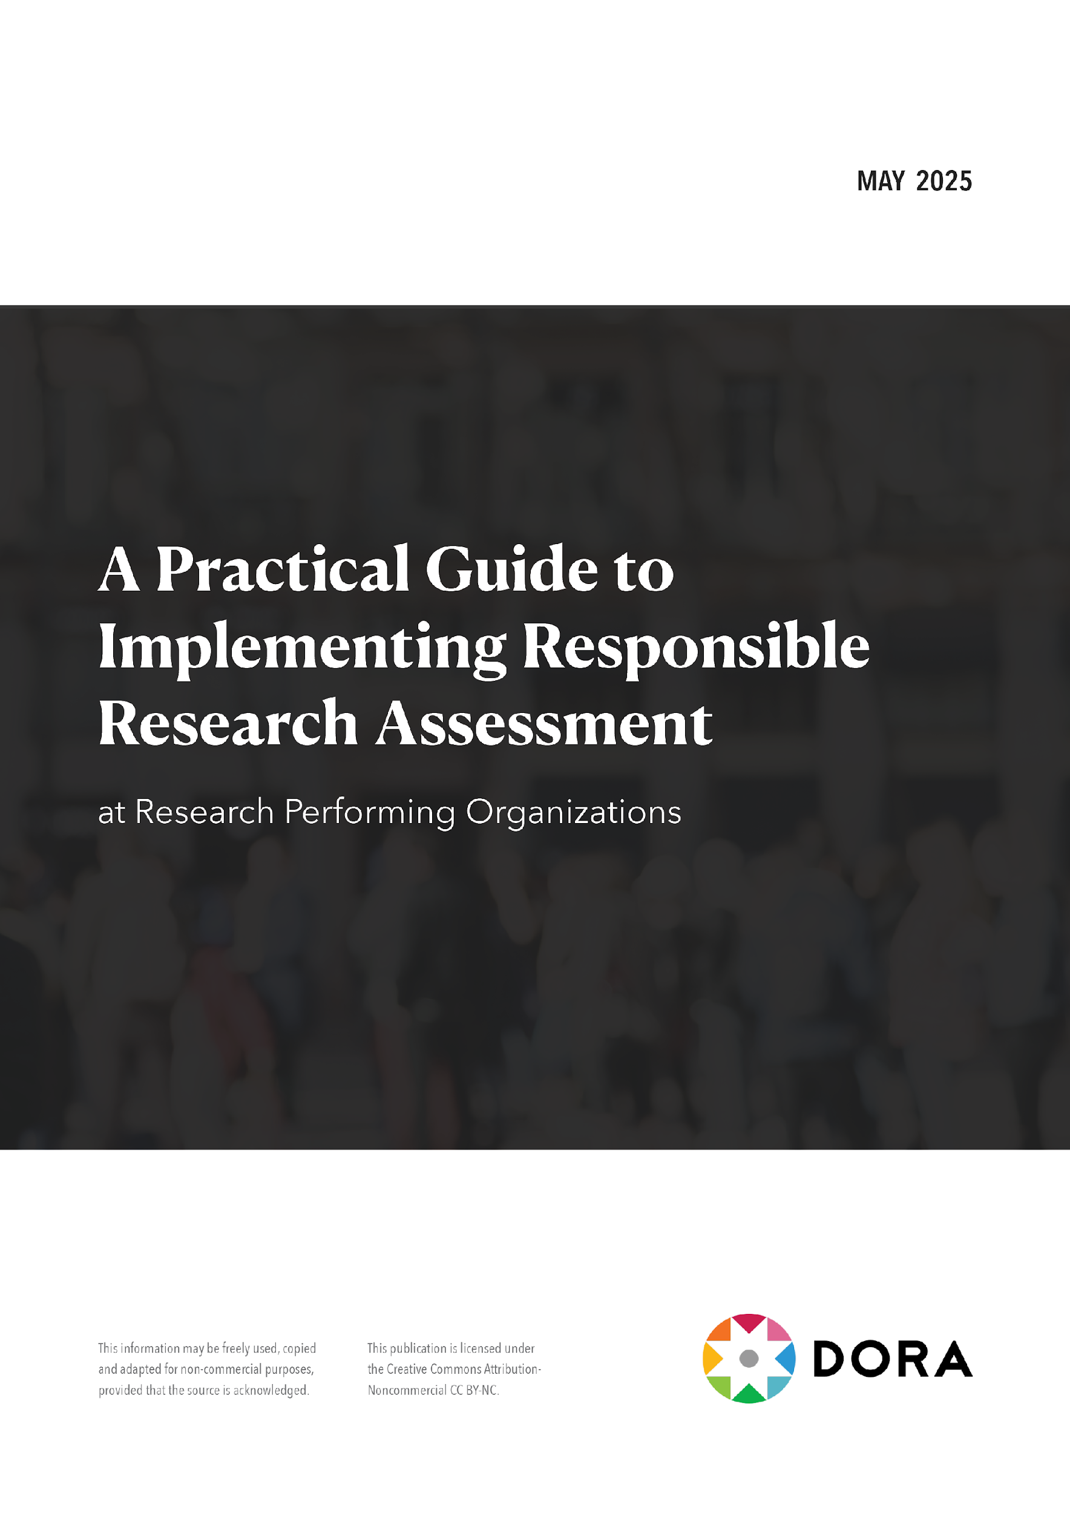
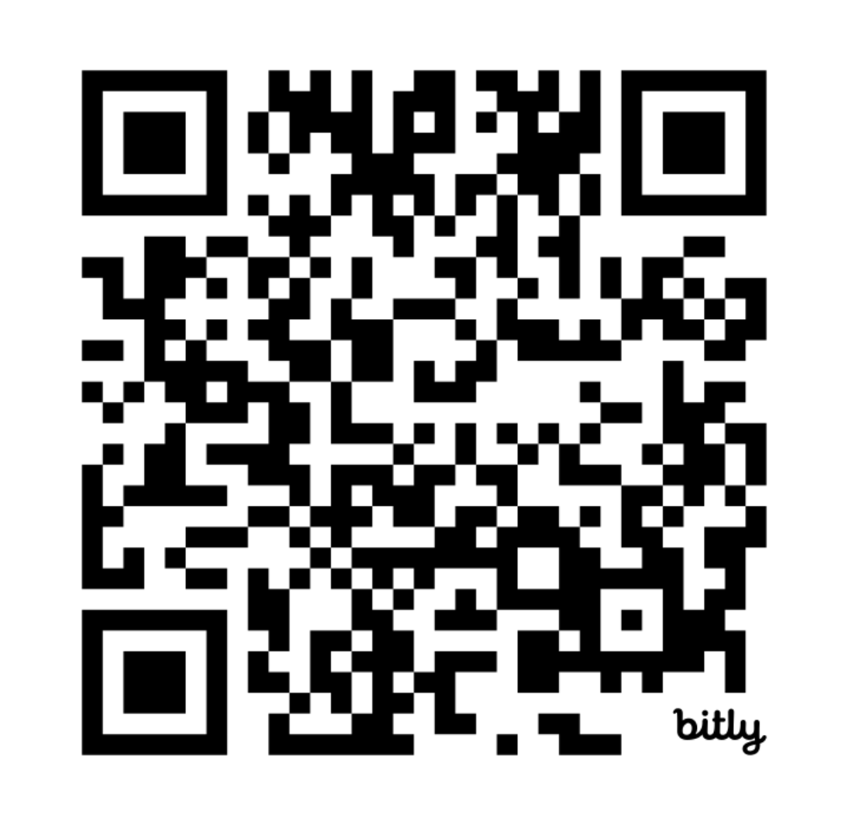
Download from Zenodo bit.ly/DORA-Guide
Notes:
The publication titled "A Practical Guide to Implementing Responsible Research Assessment at Research Performing Organizations" was launched in May 2025 with three launch events (https://youtube.com/playlist?list=PLOnCDgZmlVHfsufDusj1RwscvzjXs4UlV&si=xdcvo433rysEMMO5), coinciding with DORA's 12th anniversary celebration. This Guide is a key output of Project TARA (Tools to Advance Research Assessment), which is supported by the Arcadia Fund.

Slide 7
Aims of the Guide
How do I get started with research assessment reform?
Practical tips
Outline of activities and intervention points that are proven to help in achieving reform
Real examples and case studies
Links to resources
A “one-stop-shop” for research performing organizations to take them from the recognition the RRA needs to happen towards implementing and monitoring a strategy.
Notes:
The primary goal of the Guide is to provide practical guidance and tips for Research Performing Organizations (RPOs) that are seeking to review or reform how they assess research and researchers. It aims to help institutions build capacity and support the implementation of responsible research assessment (RRA) practices.
The Guide is designed for a broad audience within RPOs, including research leadership, faculty, administrative staff, and researchers at all career stages. It draws upon the learnings DORA has gained over a decade of working with its community.
It covers key areas for implementing RRA, including:
• Nine key activities for developing an RRA strategy (such as engaging leadership, convening working groups, exploring the landscape, reviewing practices, developing a vision, and monitoring the strategy).
• Guidance on integrating RRA practices into key moments in assessment, such as recruitment, hiring, and promotion decisions; institutional awards and internal grants; evaluation of internal research units; and corporate communications.
• An introduction to relevant global initiatives and frameworks that align with RRA.

Slide 8
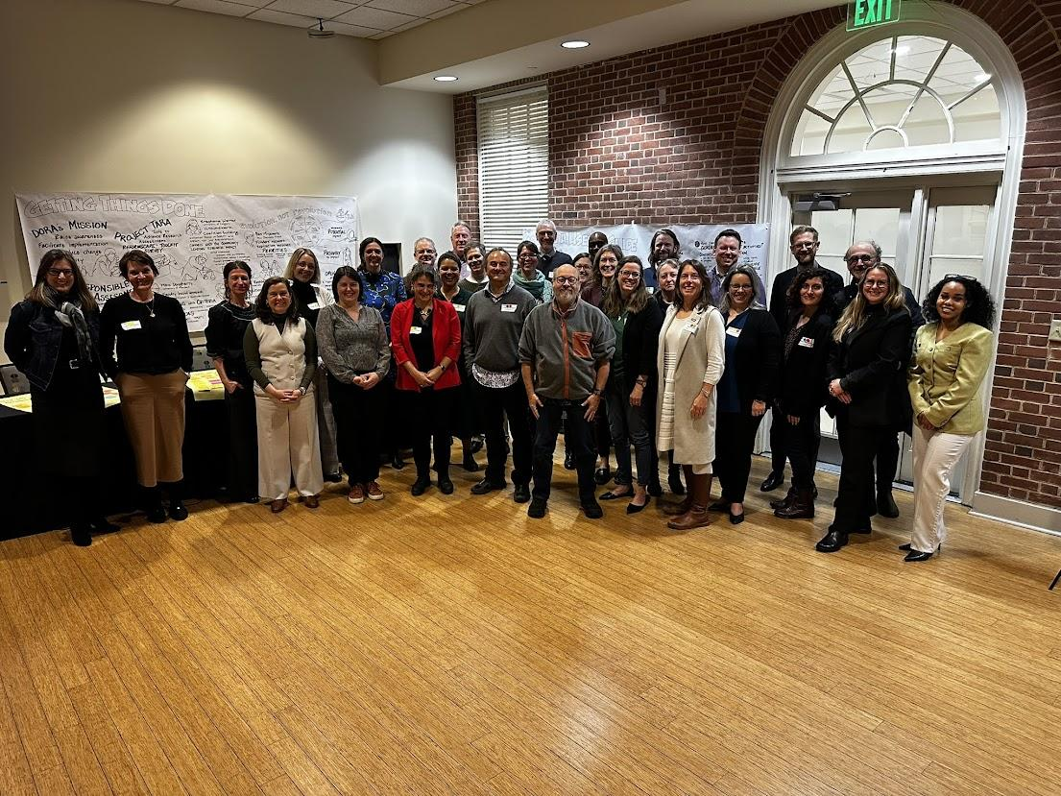
Co-developed via a workshop
Bringing together a group (n=35) of engaged RPOs, funders, research policy makers ….
Getting things done - reflections
on RRA at academic institutions and research funders
Creating a useful Guide - reflections on the content and ingredients of the Guide
Making the Guide accessible - reflections on the audience, formats and discoverability
Notes:
The Guide was co-developed with DORA’s Steering Committee and input from a working meeting held in Washington, DC, USA in January 2025, involving participants who provided valuable reflections and input. This workshop included over 35 attendees from various interest groups, and many contributors are acknowledged by name and affiliation in the end of the Guide.

Slide 9


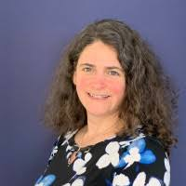
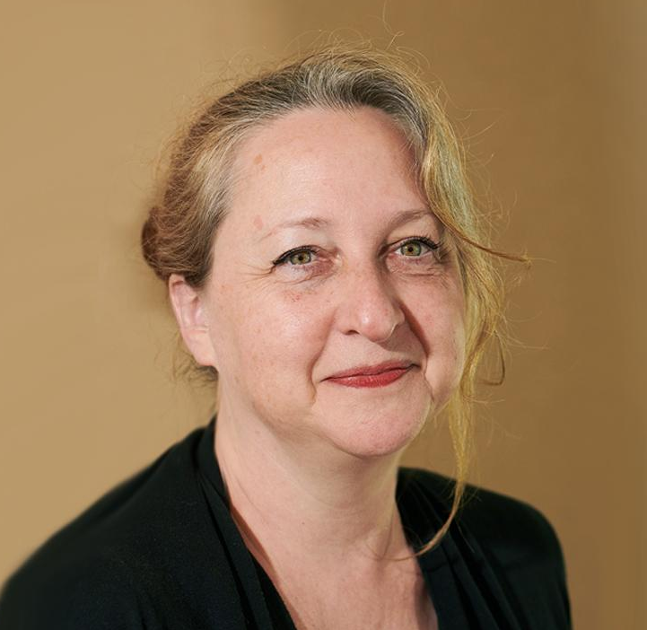
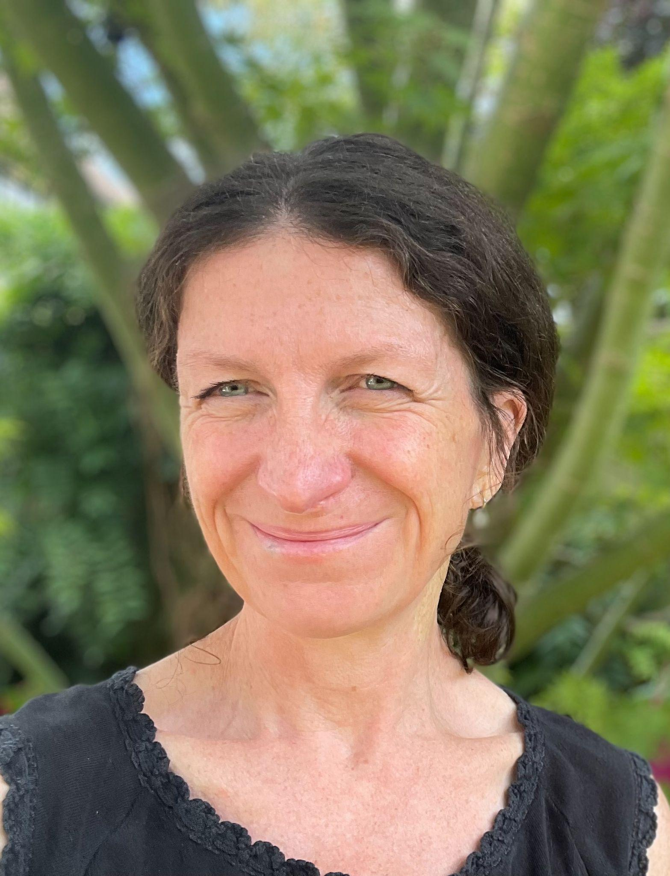


The Guide team
Kelly Cobey
(DORA Co-Chair)
Ginny Barbour
(DORA Co-Chair)
Rebecca Lawrence
(DORA Vice-Chair)
Ruth Schmidt
(Project TARA)
Liz Allen
(Project TARA)
Flora Massah
(Project TARA)
Giovanna Lima
(DORA Program Manager)
Notes:
The Guide was the result of a collective effort and reflects the hard work of many contributors. It draws upon learnings from the DORA community.
The DORA staff team and leadership were central to its creation, especially DORA Co-Chairs Ginny Barbour and Kelly Cobey, vice-chair Rebecca Lawrence. Specific DORA staff members highlighted for their roles in the internal leadership, coordination, design, and implementation included Liz Allen and Giovana Lima. Flora Massah and Ruth Schmidt provided their behavioural science and user-centred experience.

Slide 10
What’s in the Guide
Principles, activities, key moments, resources, references – threaded with examples
Chapter 1: Introduction to Responsible Research Assessment & its underlying principles
    Holistic view of impact
    Balanced and broad : quality over quantity
    Equitable opportunities for researchers
Chapter 2: Key activities in developing a Responsible Research Assessment Strategy
Chapter 3: Key moments in research and researcher assessment
Chapter 4: Global initiatives and exemplars relevant to RRA
References & resources
Notes:
The Guide is intended to be used flexibly and adapted to the specific context of each organization. It is seen as a first version that will evolve over time, enriched by real examples and feedback from the RRA community. The Chapters are color coded and sit independently from each other to make it easier for use for whatever the needs of each organization are.

Slide 11
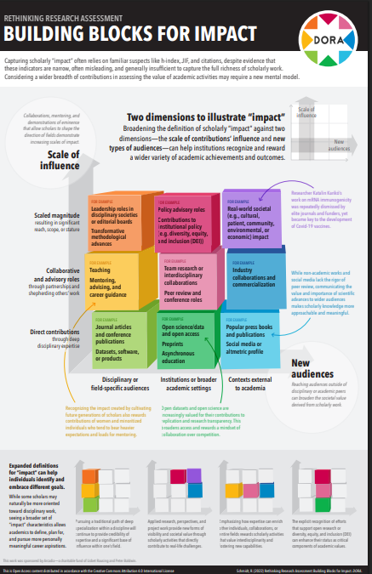
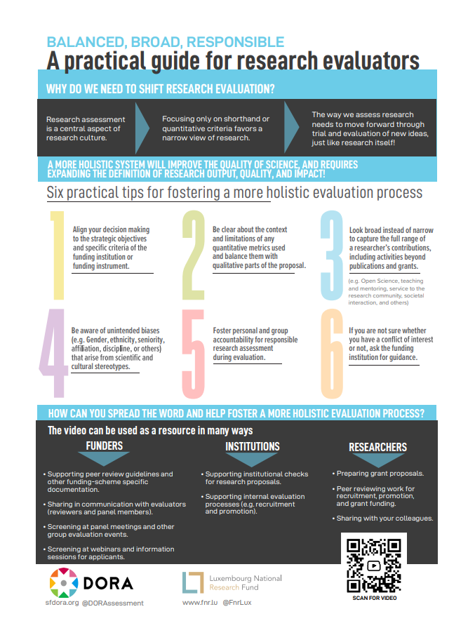
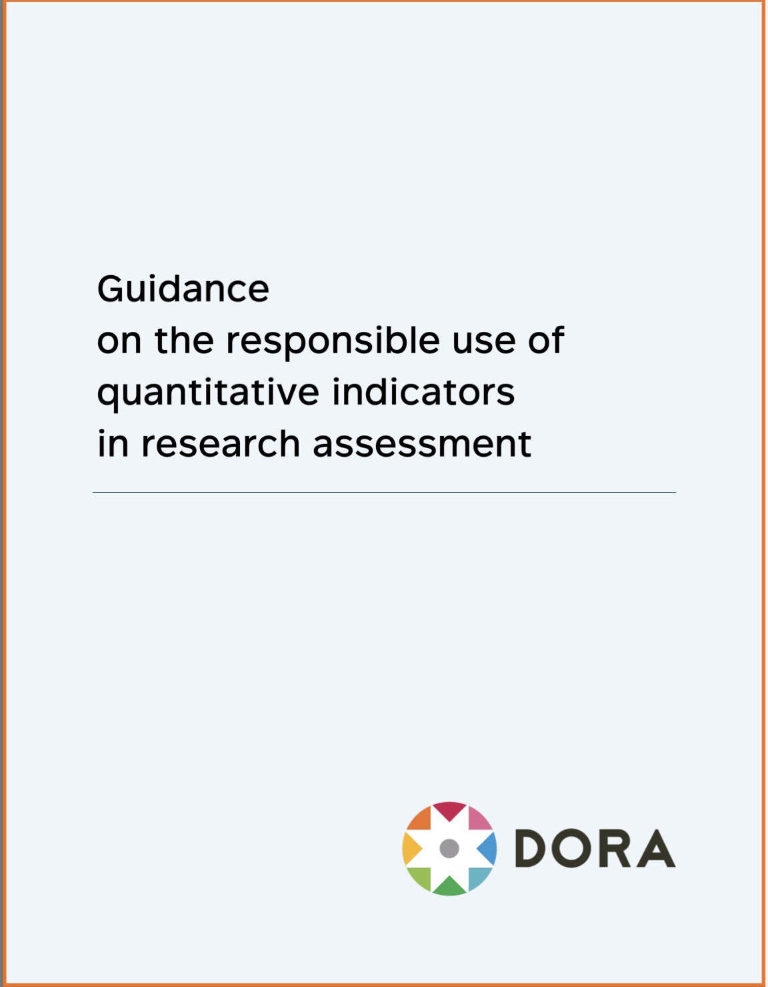
Chapter 1: Introduction to RRA
Background, principles and resources
A holistic view of research impact
Value quality over quantity
Equitable opportunities
Notes:
Chapter 1 sets the stage for the entire Guide by providing the context, goals, and underpinning principles of Responsible Research Assessment (RRA). Chapter 1 serves as the foundational part, preceding the detailed activities for developing a strategy (Chapter 2), embedding practices in key moments (Chapter 3), and exploring relevant global initiatives (Chapter 4).
A core element of Chapter 1 is defining RRA and its purpose. "Responsible Research Assessment" is described as an umbrella term for approaches that incentivize, reflect, and reward the plural characteristics of high-quality research, fostering diverse and inclusive research cultures. It is considered "responsible" because it encourages research behaviors that benefit both RPOs and the broader research system.
The central goal of RRA is to support approaches that take a holistic view of researchers, the research processes, outputs, outcomes, and impacts. It is fundamentally a values-driven approach that should align with an organization's mission and values, promoting clear, transparent, open, and fair criteria, and ensuring non-discriminatory practices.

Slide 12
Chapter 2: Key activities to get started
Activities that can help research performing organization to progress RRA
Engaging the organization leadership
Working with the community at your organization
Mobilizing resources
Convening a working group
Exploring the RRA landscape
Reviewing current assessment practices
Developing a strategic vision for RRA
Developing engagement and communication plans
Monitoring and updating your strategy
Practical tips
Reflective questions and things to think about
Link out to relevant examples and case studies
Links to relevant resources
Notes:
Chapter 2 of the Guide focuses on providing practical steps and ideas for Research Performing Organizations (RPOs) that are looking to create or enhance their strategy for implementing Responsible Research Assessment (RRA) practices. The chapter outlines nine key activities that, based on DORA’s community experience, can be crucial for the successful development of RRA approaches. These activities are presented as distinct steps that can be considered in sequence, in parallel, or selected based on an organization's specific needs and context, recognizing that "one size rarely fits all in RRA".
The nine activities covered are:
1 Engaging the organization leadership: Highlighting the importance of securing support from senior figures to drive change.
2 Working with the community at your organization: Emphasizing the value of involving various stakeholders like faculty, Early Career Researchers, librarians, and administrators to build support and gather perspectives.
3 Mobilizing resources to develop and implement an RRA strategy: Addressing the need for sufficient people, time, and materials for effective implementation, suggesting pilot testing as a way to understand resource implications and build evidence.
4 Convening a working group/task force: Recommending the formation of a group with expertise and broad representation to drive the process, ideally with support from organizational leadership.
5 Exploring the landscape for RRA: Encouraging organizations to look at national and international initiatives and the practices of other RPOs and funders to inform their own strategy.
6 Reviewing current assessment practices: Stressing the importance of understanding existing processes, criteria, and any past reform efforts within the organization to identify areas for change.
7 Developing a strategic vision for RRA: Guiding organizations in defining a clear vision for RRA that aligns with their mission and values, potentially linking it to broader goals like fostering open science or promoting equity.
8 Developing effective engagement and communication plans: Highlighting the necessity of clear, transparent, and consistent communication with all affected parties about the RRA agenda to build buy-in and mitigate concerns.
9 Monitoring and updating your strategy: Emphasizing the importance of establishing mechanisms for regular review, using evidence to track progress, identify unintended consequences, and keep the strategy aligned with organizational needs.
Chapter 2 also features a "Spotlight” on the SPACE Rubric. Developed in collaboration with Ruth Schmidt, this rubric is a tool designed to help institutions gauge their internal capacity and infrastructure to support RRA interventions and plan for success. The rubric has five dimensions (Standards for Scholarship, Process Mechanics and Policies, Accountability, Culture Within Institutions, and Evaluative and Iterative Feedback) and three stages of capability development (Foundation, Expansion, Scaling). The Guide suggests various ways the SPACE Rubric can be used to support the activities discussed in this chapter, such as structuring discussions for a task force or analyzing current practices.

Slide 13
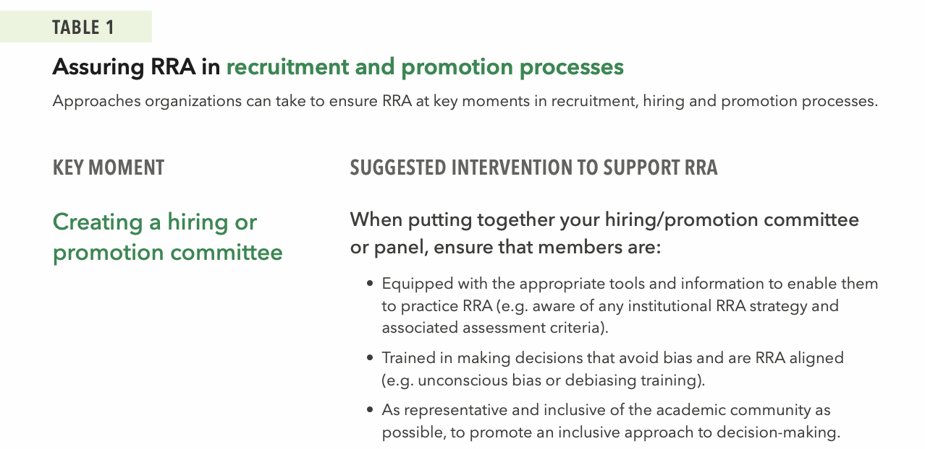
Chapter 3: Key moments in research assessment
Points in time when RRA considerations are important
Recruitment, hiring and promotion
Institutional awards and internal grants
Evaluation of internal research units
Developing corporate communications
Notes:
Chapter 3 provides practical guidance on embedding Responsible Research Assessment (RRA) practices into policies and procedures that significantly impact researchers' careers. Similarly to Chapter 2, this Chapter suggests potential actions from Research Performing Organizations (RPOs), facilitating a ‘choose your own adventure’ or a ‘menu of options’ approach that encourages adaptation to local contexts. The chapter focuses on four crucial points where research and researchers are assessed:
1. Recruitment, hiring, and promotion decisions: This section emphasizes aligning these critical career junctures with RRA principles. This involves recognizing the diverse contributions and talents of researchers, prioritizing qualitative evaluation, moving away from inappropriate metric use, and ensuring a fair and transparent process. Suggested interventions cover creating committees, designing application materials (like transparent forms and clear criteria), writing job adverts, triaging applications, conducting interviews (using standardized protocols), providing post-hire support, and evaluating the entire process (e.g., using feedback forms). It highlights the importance of providing clarity and support throughout the application and assessment process.
2. Institutional awards and internal grants: The chapter offers approaches for applying RRA principles to the assessment and awarding of internal funding and prizes. Key suggestions include ensuring clear, open, and transparent criteria focused on the quality and impact of scholarship in award notices and grant calls. Nomination and application forms should request information relevant to the award/grant and be structured to allow applicants to contextualize their achievements, potentially using narrative formats alongside quantitative data. The process should involve appropriate panels and transparent communication, sensitive to both successful and unsuccessful applicants, and include mechanisms for review and feedback after the award cycle.
3. Evaluating internal research units: This section addresses the assessment of organizational entities like university departments, research centers, and infrastructures. The goal is to align these evaluations with the organization's overall RRA principles, values, and mission. The guide suggests integrating RRA approaches through contractual components in internal budget distribution systems. Recommended actions include developing clear evaluation policies and practices, carefully composing evaluation panels (potentially including external members and providing unconscious bias training), promoting self-evaluation focused on diverse contributions, conducting the evaluation transparently, and establishing mechanisms for post-evaluation feedback and continuous improvement.
4. Developing corporate communications: The final key moment stresses the importance of ensuring that RRA becomes a part of the institution's internal and external narrative and identity. This involves making communication colleagues aware of the RRA strategy and enabling them to share stories and successes that highlight a broader range of contributions. Suggestions include embedding RRA in institutional policies and position statements, leadership updates and newsletters, and communications around key appointments and hires. It specifically addresses how to frame commentary around national and institutional rankings, encouraging a holistic view of the institution and clarifying the limitations of metrics-based rankings while affirming they do not dictate individual assessment criteria.
Chapter 3 also features "Spotlight" sections that delve into considerations relevant to these key moments:
• Narrative CVs: Presented as an alternative to traditional CVs, allowing researchers to describe their achievements, skills, and contributions in a contextualized, descriptive format. They aim to promote diversity, equity, and inclusion by recognizing varied experiences and reducing biases, enabling researchers to "tell their story". The guide mentions evidence suggesting narrative CVs can reduce bias and highlight suboptimal practices. A possible framework for describing contributions via narrative CVs includes knowledge creation, development of individuals/collaborations, supporting the research community, and contributions to broader society.
• Early Career Researchers (ECRs): This spotlight highlights the importance of aligning assessments at key moments like thesis evaluations with RRA principles. It notes ECRs' desire for assessment approaches that value diverse outputs. The Spotlight suggests RPOs can consider training for ECRs covering responsible metrics, open science, research integrity, and how to contextualize their contributions using narrative CVs.
The Chapter references tools like the SPACE Rubric and the SCOPE Framework as aids for monitoring and evaluating the effectiveness of implemented RRA strategies.

Slide 14
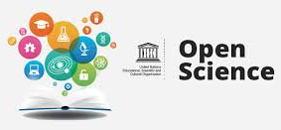


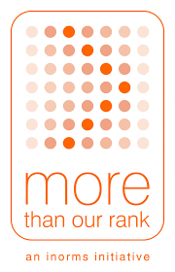

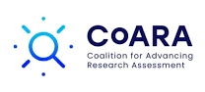


Chapter 4: Global initiatives aligned with RRA
Examples and exemplars
Initiatives that promote and provide leadership around Open Science
Initiatives that promote responsible research assessment and use of research metrics and indicators
Initiatives that enable and encourage a holistic and inclusive view of research
Initiatives that focus on ensuring evidence-based policy and research integrity
Notes:
The main purpose of this final chapter is to introduce a range of global initiatives and frameworks that align with Responsible Research Assessment (RRA) practices and related topics. We suggest that being knowledgeable about and integrating related topics such as open science, societal impact, research integrity, community engagement, interdisciplinarity, and reproducibility – along with others relevant to an organization's context – could be beneficial, as there may be many ongoing efforts to support change in an organization and they can mutually reinforce each other. The list of initiatives is not exhaustive but hopefully provides a helpful starting point.
Chapter 4 is organized into four main sections:
1. Initiatives aiming to provide leadership and guidance on aspects of open science. This section includes initiatives like the UNESCO Recommendation on Open Science, the Higher Education Leadership Initiative for Open Scholarship (HELIOS Open), and the Barcelona Declaration on Open Research Information.
2. Initiatives that focus on driving research assessment reform. Examples covered here include the San Francisco Declaration on Research Assessment (DORA), Foro Latinoamericano sobre Evaluación Científica (FOLEC-CLACSO), the 'More Than Our Rank' (MTOR) initiative, Make Data Count, the Coalition for Advancing Research Assessment (CoARA), and the SCOPE Framework.
3. Initiatives that aim to encourage a holistic and inclusive view of research. This section discusses the Contributor Roles Taxonomy (CRediT) and the EDI Caucus (EDICa).
4. Initiatives that focus on enabling evidence-based policy and research integrity. Initiatives mentioned are The Hong Kong Principles and The Transforming Evidence Funders Network (TEFN).

Slide 15
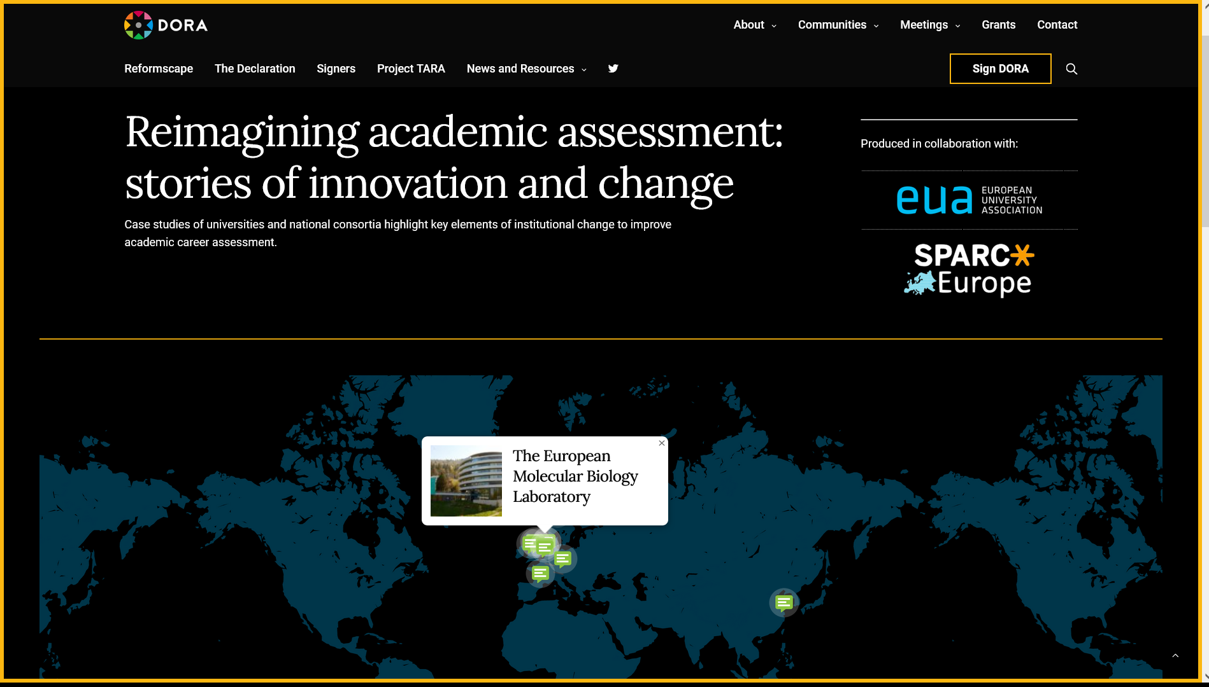
Case studies
Case studies: Describes how single institutions changed their assessment policies
Notes:
The Guide is threaded with examples from organizations across the world to illustrate how they have approached RRA – there are 9 “CASE STUDY” boxes linked throughout the Guide. Most case studies are also available in DORA's online repository.

Slide 16
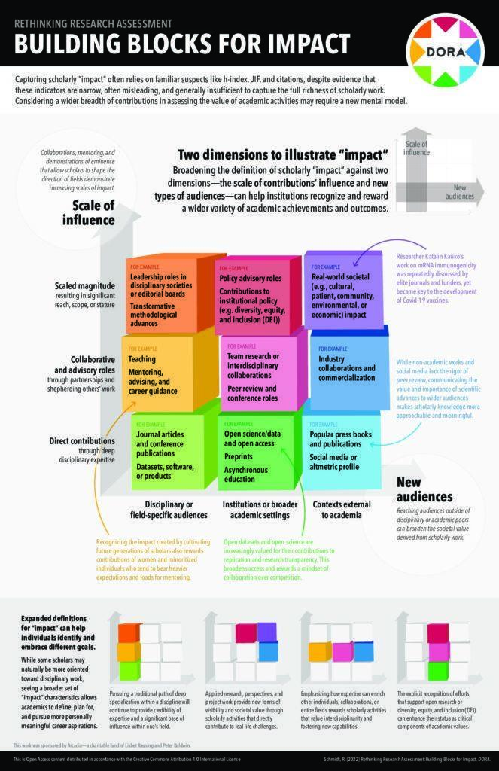
Resource library
Resource library: Tools and articles to support research assessment reform
  Project TARA toolkit
    “Debiasing Committee Composition and Deliberative Processes”
    “Building Blocks for Impact”
Notes:
The Guide lists various types of resources and references to support RPOs in implementing RRA. Within the chapters, specific resources like tools, frameworks, and guides are highlighted with a "RESOURCE" box - there are 11 resources presented this way, most of which are also available on our website.

Slide 17


Reformscape
Reformscape: An observatory of responsible research assessment policies from research institutions
Notes:
Reformscape is an online observatory and digital repository of examples of criteria and standards that RPOs around the world are using for academic career assessment, specifically focusing on hiring, review, promotion, and tenure decisions. It provides a dataset of how institutions are approaching RRA in practice and can help inspire those using the Guide.

Slide 18
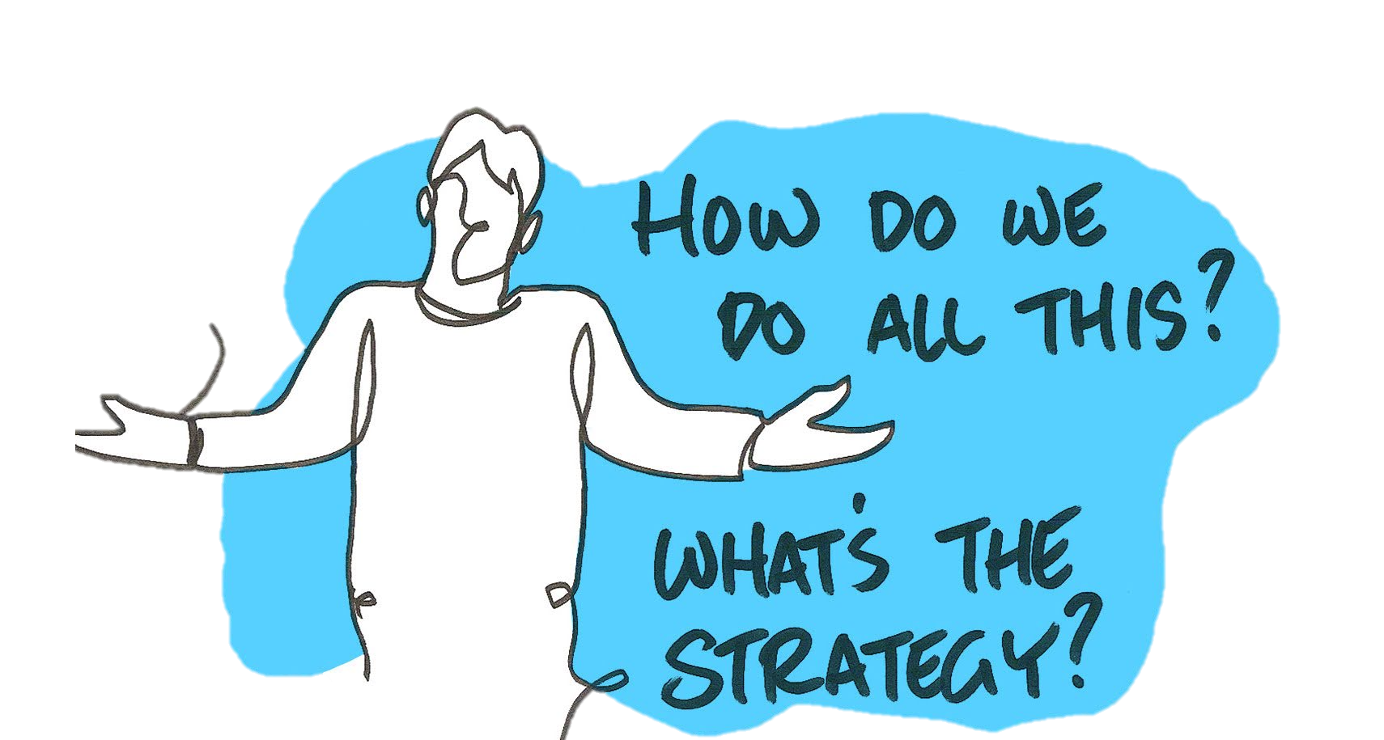
Can DORA help further?
We welcome your feedback on the Guide - indeed, it is intended to be ‘owned’ by the community.
The DORA team is happy to have a dialogue with you. Please stay connected and send invites for meetings, questions and feedback to the DORA team at: info@sfdora.org
Notes:
Please reach out with your ideas and feedback!

Slide 19

Improving research assessment
sfdora.org
Notes:
More information is on our website sfdora.org

