Slide 1

How to use this resource
Additional resources for users can be found on our website and on our zenodo page.
This content is available under a Creative Commons Attribution License (CC BY-SA 4.0), except supporter logos. Logos are trademarks or registered trademarks of their respective organizations and may not be reused or reproduced without permission. The DORA logo may be used provided its visual integrity is maintained and it is not used in any way to suggest endorsement by DORA.
Notes:
Please feel free to use what needed and edit the slides as suitable for your institutional needs.
This content is available under a Creative Commons Attribution License (CC BY-SA 4.0), except supporter logos. Logos are trademarks or registered trademarks of their respective organizations and may not be reused or reproduced without permission. The DORA logo may be used provided its visual integrity is maintained and it is not used in any way to suggest endorsement by DORA.

Slide 2

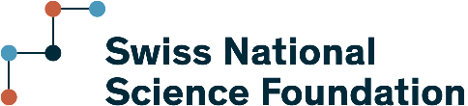















Improving research assessment
Signed by over 26,000 people and organizations
sfdora.org
@DORAssessment on Bluesky and Declaration on Research Assessment on LinkedIn
Supporting organizations
Project
TARA
Visionary
Sustainer
Contributor
Notes:
Journal-based metrics are often misused and ill applied in research and researcher evaluation. This happens at key transition points during a researcher’s career, including hiring, promotion, and tenure. DORA is a global initiative supported by over 15 different organizations including research funders, professional organizations, publishers, and academic institutions. The vision of DORA is to advance practical and robust approaches to research assessment globally and across all scholarly disciplines. Individuals and organizations can sign the declaration pledging to improve culture around research evaluation. DORA empowers the scholarly community through diverse resources and initiatives to foster responsible, transparent, and equitable evaluation practices. Key offerings include:
• Reformscape: An online observatory showcasing responsible assessment policies and practices at academic institutions worldwide.
• A Practical Guide to Implementing Responsible Research Assessment at Research Performing Organizations: Offering concrete strategies and examples for organizational change.
• Tools like the SPACE rubric and Building Blocks for Impact to help institutions analyze conditions and broaden their definition of scholarly impact.
• Fostering communities of practice for knowledge sharing and collective action among funders and other initiatives.
DORA aims to move beyond a narrow focus on quantitative indicators to value the full range of diverse contributions, quality, and impact of research and researchers, driving meaningful culture change in academia. Learn more and join the movement at sfdora.org.

Slide 3
Why DORA exists
Research needs to be assessed and people want to use quantitative evidence to do so.
But many measures now used are flawed or inappropriate.
DORA fosters better ways to assess research.
Notes:
DORA’s was first released to address the widespread misuse and inappropriate application of journal-based metrics, such as Journal Impact Factors, in research and researcher evaluation. This misuse occurs at crucial points in a researcher's career, including hiring, promotion, tenure, and funding decisions. The core problem identified was that these metrics were being used as a surrogate measure of the quality of individual research articles or to assess a scientist’s contributions. DORA also includes several specific recommendations for various stakeholders in the research ecosystem, beyond the general call to move away from journal-based metrics. These recommendations aim to foster more holistic, transparent, and equitable research assessment practices. Over time, DORA evolved from being solely a statement of intent into an active organization campaigning for reform. Its overarching vision is to advance practical and robust approaches to research assessment globally and across all scholarly disciplines
When assessment focuses disproportionately on quantitative indicators, it can lead to:
• Misdirection of research efforts: Researchers may prioritize publishing in high-JIF journals over other meaningful contributions, potentially leading to a "publish or perish" culture that can compromise broader research learnings and experience.
• Reinforcement of biases: Reliance on journal prestige can reinforce existing biases against researchers from less-known institutions or those pursuing non-traditional, but valuable, research paths.
• Reduced investment in diverse contributions: Activities like team science, mentorship, public engagement, data sharing, and policy contributions might be undervalued or neglected because they are not easily "counted" by traditional metrics.
• Negative impact on early career researchers (ECRs): The pressure to publish in specific journals can lead to mental health challenges and a narrow focus that limits the development of a broad range of skills and contributions.
• Lack of alignment with institutional missions: When assessment criteria do not align with an institution's stated values (e.g., fostering interdisciplinarity, open science, societal impact), it creates a disconnect that undermines those goals.

Slide 4
Better assessment improves research
A wider range of scholarly products are valued.
  Datasets, protocols, software, preprints, policy and training can be assessed in addition to peer reviewed journal articles.
Focuses on the merits of specific individual works.
  Reduces reliance on highly selective journals.
  Promotes reproducibility and Open Science.
Notes:
Better assessment encourages a balanced and broad approach, recognizing and valuing a fuller range of contributions beyond traditional publications. Responsible research assessment (RRA) focuses on quality over quantity. It encourages the development of an evaluation system that prioritizes these aspects, emphasizing the importance of rigor and transparency in research practice to preserve research integrity and trust. Practices like open datasets and open science are valued for their contributions to replication and transparency.
By promoting and implementing responsible research assessment (RRA), DORA aims to improve research in several key ways:
Fostering a Holistic and Inclusive View of Research: RRA encourages assessing the full range of diverse contributions, quality, and impact of research and researchers. This includes valuing:
Diverse outputs: Beyond traditional journal articles, this encompasses datasets, software, preprints, protocols, and other scholarly products.
Varied contributions: Such as collaborations, teamwork, mentoring, teaching, leadership roles, and contributions to the research community and broader society.
Quality over quantity: Moving beyond simple counts to emphasize the rigor, transparency, and intrinsic merit of the work
Enhancing Research Integrity and Reproducibility: RRA supports practices that improve the trustworthiness of research. This includes:
Transparency and data sharing: Encouraging researchers to gain credit for work that enhances transparency, such as data sharing, which augments reproducibility and increases public trust.
Rigor in research practice: Emphasizing that the process of doing research, including rigor and transparency, is crucial for preserving integrity.
Promoting Equity, Diversity, and Inclusion (EDI): Better assessment directly addresses systemic inequalities and biases in academia:
Reducing bias in evaluation: Strategies like debiasing training, structured interview protocols, and diverse evaluation panels help ensure fairer decisions in hiring, promotion, and funding.
Equal opportunities: Recognizing diverse experiences and non-typical research paths ensures that individuals from various backgrounds and career stages have equitable opportunities for advancement.
Combating "invisible labor": By providing visibility and recognition for contributions that may have traditionally been overlooked, such as extensive mentoring or community service.
Supporting Early Career Researchers (ECRs): RRA aims to create a more supportive environment for ECRs by:
Valuing diverse career paths: Offering assessment approaches that recognize a variety of outputs and contributions beyond traditional publication metrics.
Providing clarity and support: Graduate programs can include training on RRA principles, helping ECRs understand how to present their work holistically and navigate assessment processes.

Slide 5
DORA’s vision
Advance practical and robust approaches to improve the assessment of research across all scholarly disciplines worldwide.
DORA provides recommendations to stimulate positive action by:
  Research institutions
  Funders
  Publishers
  Metrics providers
  Researchers
Notes:
DORA's overarching vision is to advance practical and robust approaches to research assessment globally and across all scholarly disciplines. This mission is demanding and aims to achieve a significant shift in how research and researchers are evaluated. The ultimate goal is to foster meaningful and lasting improvements in research assessment by ensuring that decisions focus on the diverse qualities of research products and conduct that are highly valued within academia and society, across all actors in the system.
The organization works towards this by recognizing that research assessment reform is a complex "systems challenge" requiring collective action among multiple stakeholders.
DORA's core objectives, which align with its vision, include:
• Raising awareness of the negative impacts of assessment practices that rely too heavily on inappropriate metrics, and highlighting the positive impacts of alternative practices.
• Accelerating the development of clear and concrete measures to reform research assessment.
• Supporting advocates of research assessment reform worldwide.
• Improving equity by advocating for broader representation of researchers in the design of assessment practices that directly address structural inequalities in academia. DORA also recognizes that research assessment reform, open scholarship, and equity/inclusion cannot be treated separately, as they interact in complex ways to create a research culture centered on people and values.
DORA seeks to foster a research system that values the full range of diverse contributions, quality, and impact of research and researchers, leading to a more equitable and impactful future for scholarly work.

Slide 6

Institutional change
“University of Calgary has signed up to DORA and I’m seeing immediate & positive changes. Our academic performance review has moved away from simply publication counting.”
James Wasmuth, 13 July 2023
https://twitter.com/jdwasmuth/status/1679510361719058432
Notes:
DORA has actively worked to spark significant changes in how research performing organizations (RPOs) evaluate research and researchers, with positive results to be shared! Concrete examples of this shift include
Yale Molecular Biophysics and Biochemistry department adopting anonymized applications in faculty searches to eliminate bias from journal names or funding agencies;
The Universitat Oberta de Catalunya, for instance, released an action plan with specific deadlines to implement DORA principles;
The Open University created a new promotion track for researchers doing publicly engaged work, recognizing contributions beyond traditional publications
DORA actively creates and promotes resources to aid RPOs in implementing change:
Reformscape (launched 2024): An interactive online observatory that tracks criteria and standards academic institutions use for hiring, review, promotion, and tenure worldwide. It provides a comprehensive dataset and enables RPOs to learn from existing initiatives.
A Practical Guide to Implementing Responsible Research Assessment at Research Performing Organizations (launched May 2025): This guide offers practical guidance and tips for RPOs to develop, review, or reform their assessment practices. It addresses common challenges and provides activities and examples for engaging leadership, forming working groups, and crafting communication plans.
SPACE to Evolve Academic Assessment rubric (launched 2021): Helps institutions gauge their capacity and progress for RRA reform across five key dimensions (Standards for Scholarship, Process Mechanics and Policies, Accountability, Culture Within Institutions, and Evaluative and Iterative Feedback) and three stages of development.
Briefs and toolkits: DORA has developed resources like "Rethinking Research Assessment: Ideas for Action" and "Unintended Cognitive and Systems Biases" to help RPOs identify obstacles, experiment with new approaches, and counteract biases. The "Building Blocks for Impact" tool helps organizations broaden their understanding of scholarly impact.
Case Studies Repository: Documents real-world examples of institutional change in academic career assessment, providing inspiration and insights into processes and challenges.

Slide 7
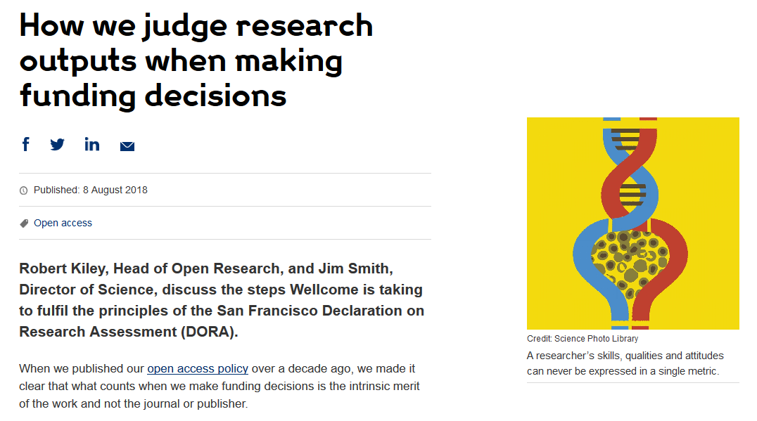
Change from funders: Wellcome
Grant application includes:
  List of research outputs
  Contributions to mentorship
  Output sharing plan to advance potential health benefits
  Plans for public engagement
Guidance provided to advisory panel members.
https://wellcome.org/news/how-we-judge-research-outputs-when-making-funding-decisions
Notes:
Several influential funding organizations have formally signed DORA, committing to its principles. These include 7 UK Research Councils, the Research Council of Norway, ANR, the Australian National Health and Medical Research Council, the Irish Research Council, Science Foundation Ireland, the Academy of Finland and the British Heart Foundation. Funders are moving away from using journal-based metrics, such as the Journal Impact Factor, as a proxy for the quality of individual articles or a scientist's contributions in funding decisions; adopting the use of a narrative CV format in its major funding streams; and encouraging a wider range of research outputs beyond traditional publications, including data, code, and diverse societal impacts.
DORA launched two quarterly communities of practice in 2020 for public and private funders (one for the Asia-Pacific region and another for Africa, the Americas, and Europe). These groups serve as platforms to increase knowledge sharing, discuss new policies and pilot initiatives, and facilitate collective action for fair and responsible research assessment. These groups have grown significantly in participation.
DORA has organized workshops with funder groups, such as with the Funding Organisations for Gender Equality Community of Practice (FORGEN CoP), specifically to explore strategies for optimizing narrative CVs and mitigating bias in their use for grant evaluation. DORA, in collaboration with the Elizabeth Blackwell Institute for Health Research and the MoreBrains Cooperative, has run workshops focused on improving pre-award processes to foster equitable and transparent research assessment.

Slide 8
Change from publishers
PLOS describes how its journals comply with DORA recommendations.
EMBO Press acknowledges DORA signature; shows citation distributions for its journals; presents all available metrics side-by-side and rounded to single digits.
Development (Company of Biologists) uses multiple metrics of journal performance.
Notes:
DORA has sparked significant change within publishing by directly advocating for a reduced reliance on traditional metrics, providing actionable guidance for adopting more holistic assessment practices, actively collaborating on new models for scholarly communication (like preprints and CRediT), and enhancing accountability for publishers through public commitment requirements.
DORA's foundational recommendation is to "not use journal-based metrics, such as Journal Impact Factors, as a surrogate measure of the quality of individual research articles, to assess an individual scientist’s contributions, or in hiring, promotion, or funding decisions". While this may be perceived as directly challenging publishers' traditional reliance on such metrics, numerous major publishers and scholarly societies have voluntarily signed DORA, including Springer Nature, Taylor & Francis, and Redalyc, an organization indexing Latin American journals, which mandated that all 1,360 journals it indexes sign DORA and adhere to its principles.
DORA has actively provided guidance to publishers on how they can support research assessment reform. A feature published by Science Editor, co-authored by DORA staff, offered 10 achievable recommendations for journals and publishers beyond merely abandoning the Impact Factor.

Slide 9
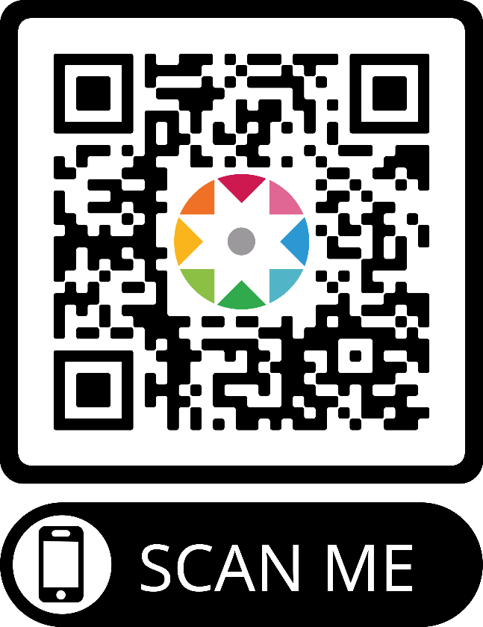
What you can do
Sign DORA! (sfdora.org/sign).
Ask your institution to review assessment and sign DORA.
Use our collection of good practices to implement change.
Tell us how you improved assessment so we can tell others (sfdora.org/contact).
Notes:
Individuals play a crucial role in implementing Responsible Research Assessment (RRA) by actively challenging traditional practices and advocating for change within their spheres of influence! Beyond those actions listed in the slide, there’s much more people can consider doing, as we share below. Thank you for joining us in this movement!
For Researchers (including Early Career Researchers and those on committees):
Base assessments on scientific content rather than journal-based metrics when serving on committees for funding, hiring, tenure, or promotion.
Cite primary literature where observations were first reported instead of reviews, to properly credit the original discoverers.
Use a range of article metrics and indicators in personal or supporting statements to demonstrate the impact of individual published articles and other research outputs.
Challenge inappropriate reliance on quantitative metrics and promote best practices that emphasize the value and influence of specific research outputs.
When compiling CVs, consider using narrative CVs or annotated CVs to contextualize achievements, highlight specific contributions, and showcase a broader range of impacts beyond traditional metrics like publications and grants.
Actively engage in discussions around research assessment, especially as Early Career Researchers (ECRs), bringing fresh perspectives on academic incentives and career progression.
Seek out training on responsible research assessment, including topics like research integrity, ethics, responsible use of metrics, open science, and how to create narrative CVs.
When applying for positions or grants, check for transparent assessment criteria and inquire if they are not readily available. Ask if reviewer training materials are provided.
Be a voice for change from within review panels by asking about bias mitigation training and working to hold colleagues accountable during the review process.
For Staff (Librarians, Research Managers, Administrators, HR Personnel, IT Departments, etc.):
Support bibliometric education for faculty and staff, introducing alternative metrics and advocating for their responsible use, rather than solely focusing on JIF and h-index.
Create online resources and host events on different CV types (e.g., narrative CVs) and why qualitative narratives are beneficial.
Advise and guide researchers and students on "high quality" research, emphasizing RRA principles.
Help shape and implement institutional policies that guide assessment and evaluation frameworks, including criteria and information to be included.
Work with leadership to develop clear guidance for reviewers and applicants, create training materials, and iterate on them as needed.
Ensure existing and new policies align with RRA strategy and are transparent, especially regarding Equity, Diversity, and Inclusion (EDI), hiring, promotion, and open science.
Communicate effectively about RRA, emphasizing its benefits and impacts, and leveraging communication expertise.
For Individuals in Leadership/Policymaking Roles:
Develop clear guidance on the type of information that should and should not be included in CVs, and create training for reviewers on effectively reviewing narrative-style CVs.
Influence panel composition and training by working with HR, Ethics, and other departments to develop clear guidance and training materials.
Foster an active dialogue with staff that engages thoughtfully with their questions and concerns regarding quantitative indicators.
Incorporate narrative elements into applications to optimize assessment processes and mitigate biases.
Promote the use of self-evaluation reports for units, based on textual descriptions of activities, mission, vision, and a diverse set of collaborations, outputs, and staff development, rather than just quantitative data.
Ensure that assessment practices do not disadvantage Early Career Researchers (ECRs) and other under-represented groups.
By taking a few of these actions, individuals can collectively contribute to a more holistic, transparent, and equitable research assessment ecosystem.

