Slide 1

How to use this resource
Notes and additional resources for users are included in the notes section.
This content is available under a Creative Commons Attribution License (CC BY 4.0), except supporter logos. Logos are trademarks or registered trademarks of their respective organizations and may not be reused or reproduced without permission.
https://creativecommons.org/licenses/by/4.0/

Slide 2


















Improving research assessment
Signed by over 24,000 people and organizations
sfdora.org • @DORAssessment on most social media platforms
Supporting organizations
Visionary
Sustainer
Contributor
Notes:
Journal-based metrics are often misused and ill applied in research and researcher evaluation. This happens at key transition points during a researcher’s career, including hiring, promotion, and tenure. DORA is a global initiative supported by over 15 different organizations including research funders, professional organizations, publishers, and academic institutions. The vision of DORA is to advance practical and robust approaches to research assessment globally and across all scholarly disciplines. Individuals and organizations can sign the declaration pledging to improve culture around research evaluation. DORA is collecting best practices to help members of the community learn from each other and create change. More information is on the website: sfdora.org

Slide 3
Why DORA exists
Research needs to be assessed and people want to use quantitative evidence to do so
But many measures now used are flawed or inappropriate
DORA fosters better ways to assess research

Slide 4
Better assessment improves research
A wider range of scholarly products are valued
  Datasets, protocols, software, preprints, policy, training, and policy can be assessed in addition to peer reviewed journal articles
Focuses on the merits of specific individual works
  Reduces reliance on highly selective journals
  Promotes reproducibility and Open Science

Slide 5
DORA’s vision
Advance practical and robust approaches to improve how research globally and across all scholarly disciplines
DORA provides recommendations to stimulate positive action by:
  Funders
  Research institutions
  Publishers
  Metrics providers
  Researchers

Slide 6

Institutional change
“University of Calgary has signed up to DORA and I’m seeing immediate & positive changes. Our academic performance review has moved away from simply publication counting.”
James Wasmuth, 13 July 2023
https://twitter.com/jdwasmuth/status/1679510361719058432

Slide 7
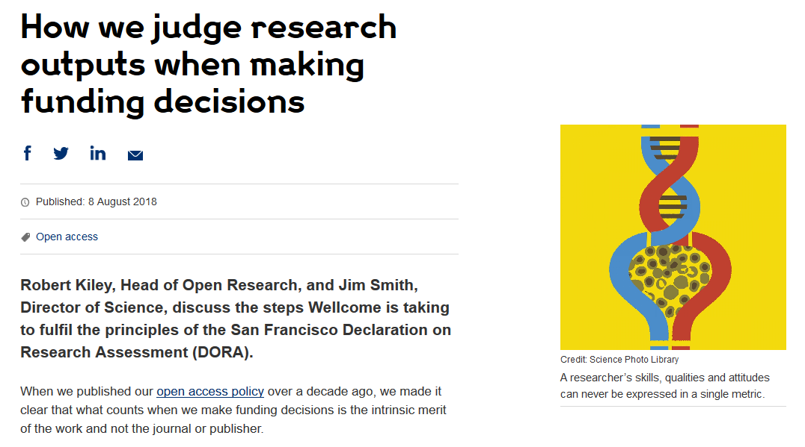
Change from funders: Wellcome
Grant application includes:
  List of research outputs
  Contributions to mentorship
  Output sharing plan to advance potential health benefits
  Plans for public engagement
Guidance provided to advisory panel members
https://wellcome.org/news/how-we-judge-research-outputs-when-making-funding-decisions

Slide 8
Change from publishers
PLOS describes how its journals comply with DORA recommendations
EMBO Press acknowledges DORA signature; shows citation distributions for its journals; presents all available metrics side-by-side and rounded to single digits
Development (Company of Biologists) uses multiple metrics of journal performance

Slide 9
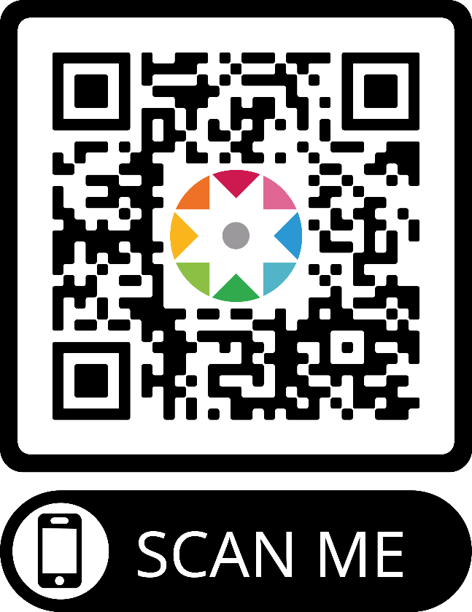
What you can do
Sign DORA! (sfdora.org/sign)
Ask your institution to review assessment and sign DORA
Use our collection of good practices to implement change
Tell us how you improved assessment so we can tell others (sfdora.org/contact)

