Slide 1

How to use this resource
Additional resources for users can be found on our website and on our zenodo page.
This content is available under a Creative Commons Attribution License (CC BY-SA 4.0), except supporter logos. Logos are trademarks or registered trademarks of their respective organizations and may not be reused or reproduced without permission. The DORA logo may be used provided its visual integrity is maintained and it is not used in any way to suggest endorsement by DORA.
Notes:
Please feel free to use what needed and edit the slides as suitable for your institutional needs.
This content is available under a Creative Commons Attribution License (CC BY-SA 4.0), except supporter logos. Logos are trademarks or registered trademarks of their respective organizations and may not be reused or reproduced without permission. The DORA logo may be used provided its visual integrity is maintained and it is not used in any way to suggest endorsement by DORA.

Slide 2

Improving research assessment
sfdora.org
@DORAssessment on Bluesky
Declaration on Research Assessment on LinkedIn
Notes:
Journal-based metrics are often misused and ill applied in research and researcher evaluation. This happens at key transition points during a researcher’s career, including hiring, promotion, and tenure. DORA is a global initiative supported by over 15 different organizations including research funders, professional organizations, publishers, and academic institutions. The vision of DORA is to advance practical and robust approaches to research assessment globally and across all scholarly disciplines. Individuals and organizations can sign the declaration pledging to improve culture around research evaluation. DORA empowers the scholarly community through diverse resources and initiatives to foster responsible, transparent, and equitable evaluation practices. Key offerings include:
• Reformscape: An online observatory showcasing responsible assessment policies and practices at academic institutions worldwide.
• A Practical Guide to Implementing Responsible Research Assessment at Research Performing Organizations: Offering concrete strategies and examples for organizational change.
• Tools like the SPACE rubric and Building Blocks for Impact to help institutions analyze conditions and broaden their definition of scholarly impact.
• Fostering communities of practice for knowledge sharing and collective action among funders and other initiatives.
DORA aims to move beyond a narrow focus on quantitative indicators to value the full range of diverse contributions, quality, and impact of research and researchers, driving meaningful culture change in academia. Learn more and join the movement at sfdora.org.

Slide 3
Why DORA exists
Research needs to be assessed and people want to use quantitative evidence to do so.
But many measures now used are flawed or inappropriate.
DORA fosters better ways to assess research.
Notes:
DORA’s was first released to address the widespread misuse and inappropriate application of journal-based metrics, such as Journal Impact Factors, in research and researcher evaluation. This misuse occurs at crucial points in a researcher's career, including hiring, promotion, tenure, and funding decisions. The core problem identified was that these metrics were being used as a surrogate measure of the quality of individual research articles or to assess a scientist’s contributions. DORA also includes several specific recommendations for various stakeholders in the research ecosystem, beyond the general call to move away from journal-based metrics. These recommendations aim to foster more holistic, transparent, and equitable research assessment practices. Over time, DORA evolved from being solely a statement of intent into an active organization campaigning for reform. Its overarching vision is to advance practical and robust approaches to research assessment globally and across all scholarly disciplines
When assessment focuses disproportionately on quantitative indicators, it can lead to:
• Misdirection of research efforts: Researchers may prioritize publishing in high-JIF journals over other meaningful contributions, potentially leading to a "publish or perish" culture that can compromise broader research learnings and experience.
• Reinforcement of biases: Reliance on journal prestige can reinforce existing biases against researchers from less-known institutions or those pursuing non-traditional, but valuable, research paths.
• Reduced investment in diverse contributions: Activities like team science, mentorship, public engagement, data sharing, and policy contributions might be undervalued or neglected because they are not easily "counted" by traditional metrics.
• Negative impact on early career researchers (ECRs): The pressure to publish in specific journals can lead to mental health challenges and a narrow focus that limits the development of a broad range of skills and contributions.
• Lack of alignment with institutional missions: When assessment criteria do not align with an institution's stated values (e.g., fostering interdisciplinarity, open science, societal impact), it creates a disconnect that undermines those goals.

Slide 4
Long standing problems
1997: Why the impact factor of journals should not be used for evaluating research
2001: Some misuses of journal impact factor in research evaluation
2018: What’s wrong with the journal impact factor in 5 graphs
Notes:
The Journal Impact Factor (JIF) and other traditional metrics have several long-standing problems that lead to their misuse and negative impacts on research assessment. The JIF has a number of well-documented deficiencies as a tool for research assessment:
Highly skewed citation distributions: Citation distributions within journals are highly skewed, meaning a few highly cited articles can disproportionately inflate a journal's impact factor.
Field-specific properties: The properties of the JIF are field-specific. It is a composite of multiple, highly diverse article types, including primary research papers and reviews, making it unsuitable for direct comparison across different scientific disciplines.
Manipulation by editorial policy: Journal Impact Factors can be manipulated, or "gamed," by editorial policies.
Lack of transparency: The data used to calculate Journal Impact Factors are neither transparent nor openly available to the public.
Not a measure of individual article quality: It is a measure of the "average citation performance" of papers in a particular journal over the past two years, not a direct measure of the value or quality of an individual paper or researcher. Claims that JIF signifies the value or quality of individual papers are not supported by evidence.
Poor predictor of citation performance: JIF provides no indication of the wide variation in the distribution of citations among articles within a journal. Evidence shows that JIFs are poor predictors of the citation performance of individual articles.
No evidence for peer review quality: There is no good evidence to support claims that peer review quality is significantly better in higher JIF journals.
Reservations apply to other journal-based indicators: These reservations about the JIF apply equally to other journal-based indicators like the Citescore, Eigenfactor Score, and Source Normalized Impact per Paper (SNIP).

Slide 5
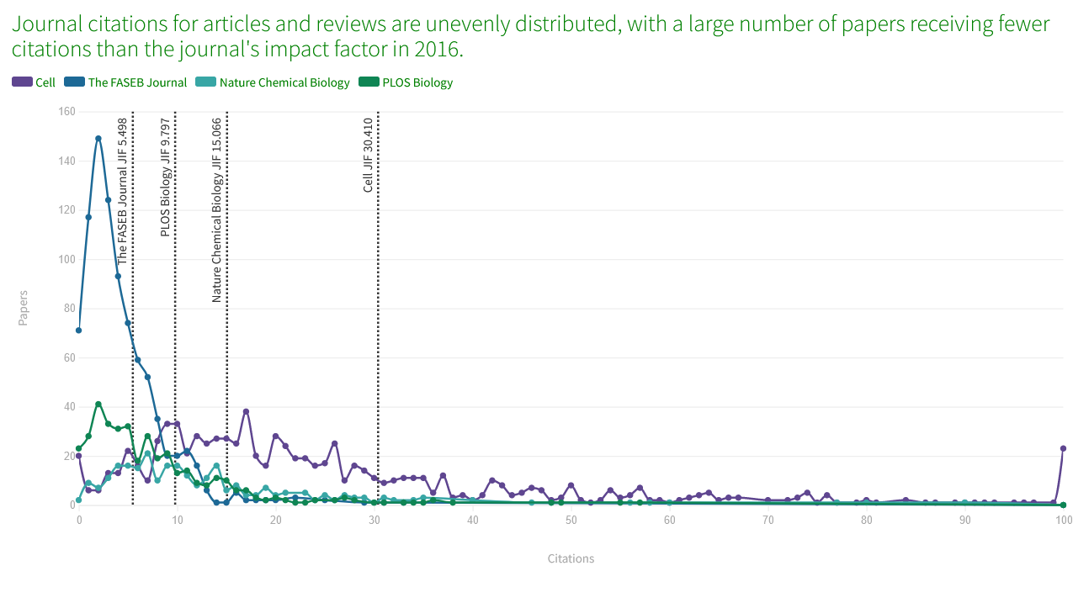
Skewed distributions (often driven by a few papers) make it practically impossible to predict success of individual papers
https://www.nature.com/nature-index/news/whats-wrong-with-the-jif-in-five-graphs
Notes:
Problems with the JIF (from the preamble to the declaration):
citation distributions within journals are highly skewed
the properties of the Journal Impact Factor are field-specific: it is a composite of multiple, highly diverse article types, including primary research papers and reviews
Journal Impact Factors can be manipulated (or “gamed”) by editorial policy
data used to calculate the Journal Impact Factors are neither transparent nor openly available to the public

Slide 6
Long standing problems
“there are no explicit incentives or structures to assess contributions to public scholarship”
“current structures of faculty assessment have yet to recognize the value of non-traditional scholarly outputs”
“there is still pressure to publish in high-JIF venues, which limits the adoption of open access publishing”
Rethinking Research Assessment For The Greater Good: Findings From The Rpt Project
Notes:
The pervasive reliance on inappropriate proxy measures like the JIF and h-index feeds into a "publish or perish" culture that devalues important scholarly contributions, such as:
Engagement with local communities.
Rigor, transparency, and reproducibility in research.
Creation of intellectual property and software.
Mentorship.
Academic service.
This emphasis on quantity and prestige can mask and devalue important scholarly contributions, lead to undesirable behaviors that hinder scientific progress (e.g., false reporting, aversion to negative data, lack of transparency), and perpetuate existing inequities by favoring established researchers or those from prestigious institutions.
DORA advocates for moving beyond these narrow quantitative indicators to embrace a more holistic, transparent, and equitable assessment that values the quality, broad range of contributions, and impacts of research.

Slide 7
DORA Declaration
Launched in 2012
Themes of the declaration
Do not use journal-based metrics as a surrogate measure of quality
Consider the value and impact of a broad range of research outputs
Be explicit about the criteria used in hiring, promotion, and tenure decisions
Facilitate openness by encouraging reuse of reference lists, responsible referencing and authorship
Currently signed by ~22,000 individuals + ~3,500 organizations across 166 countries

Slide 8
Better assessment promotes better research
A wider range of scholarly products are valued.
  Datasets, protocols, software, preprints, policy and training can be assessed in addition to peer reviewed journal articles.
Focuses on the merits of specific individual works.
  Reduces reliance on heavily competitive journals.
  Promotes reproducibility and Open Science.
Notes:
Better assessment encourages a balanced and broad approach, recognizing and valuing a fuller range of contributions beyond traditional publications. Responsible research assessment (RRA) focuses on quality over quantity. It encourages the development of an evaluation system that prioritizes these aspects, emphasizing the importance of rigor and transparency in research practice to preserve research integrity and trust. Practices like open datasets and open science are valued for their contributions to replication and transparency.
By promoting and implementing responsible research assessment (RRA), DORA aims to improve research in several key ways:
Fostering a Holistic and Inclusive View of Research: RRA encourages assessing the full range of diverse contributions, quality, and impact of research and researchers. This includes valuing:
Diverse outputs: Beyond traditional journal articles, this encompasses datasets, software, preprints, protocols, and other scholarly products.
Varied contributions: Such as collaborations, teamwork, mentoring, teaching, leadership roles, and contributions to the research community and broader society.
Quality over quantity: Moving beyond simple counts to emphasize the rigor, transparency, and intrinsic merit of the work
Enhancing Research Integrity and Reproducibility: RRA supports practices that improve the trustworthiness of research. This includes:
Transparency and data sharing: Encouraging researchers to gain credit for work that enhances transparency, such as data sharing, which augments reproducibility and increases public trust.
Rigor in research practice: Emphasizing that the process of doing research, including rigor and transparency, is crucial for preserving integrity.
Promoting Equity, Diversity, and Inclusion (EDI): Better assessment directly addresses systemic inequalities and biases in academia:
Reducing bias in evaluation: Strategies like debiasing training, structured interview protocols, and diverse evaluation panels help ensure fairer decisions in hiring, promotion, and funding.
Equal opportunities: Recognizing diverse experiences and non-typical research paths ensures that individuals from various backgrounds and career stages have equitable opportunities for advancement.
Combating "invisible labor": By providing visibility and recognition for contributions that may have traditionally been overlooked, such as extensive mentoring or community service.
Supporting Early Career Researchers (ECRs): RRA aims to create a more supportive environment for ECRs by:
Valuing diverse career paths: Offering assessment approaches that recognize a variety of outputs and contributions beyond traditional publication metrics.
Providing clarity and support: Graduate programs can include training on RRA principles, helping ECRs understand how to present their work holistically and navigate assessment processes.

Slide 9
DORA as an Organization
Advance practical and robust approaches to improve the assessment of research across all scholarly disciplines worldwide.
Notes:
DORA's overarching vision is to advance practical and robust approaches to research assessment globally and across all scholarly disciplines. This mission is demanding and aims to achieve a significant shift in how research and researchers are evaluated. The ultimate goal is to foster meaningful and lasting improvements in research assessment by ensuring that decisions focus on the diverse qualities of research products and conduct that are highly valued within academia and society, across all actors in the system.
The organization works towards this by recognizing that research assessment reform is a complex "systems challenge" requiring collective action among multiple stakeholders.

Slide 10
DORA’s approaches
Joséphine
Increase awareness of the negative impacts of current assessment practices through
Events and communications
Research projects
Develop measures for assessment reform through
Advice and training materials
Curated resources and case studies
Partnerships
Support advocates of research assessment reform through
Communities of practice
Community grants
Ambassadors program
https://sfdora.org/2023/03/29/towards-the-future-of-responsible-research-assessment-announcing-doras-new-three-year-strategic-plan/
Notes:
DORA's core objectives, which align with its vision, include:
• Raising awareness of the negative impacts of assessment practices that rely too heavily on inappropriate metrics, and highlighting the positive impacts of alternative practices.
• Accelerating the development of clear and concrete measures to reform research assessment.
• Supporting advocates of research assessment reform worldwide.
• Improving equity by advocating for broader representation of researchers in the design of assessment practices that directly address structural inequalities in academia. DORA also recognizes that research assessment reform, open scholarship, and equity/inclusion cannot be treated separately, as they interact in complex ways to create a research culture centered on people and values.
DORA seeks to foster a research system that values the full range of diverse contributions, quality, and impact of research and researchers, leading to a more equitable and impactful future for scholarly work.

Slide 11
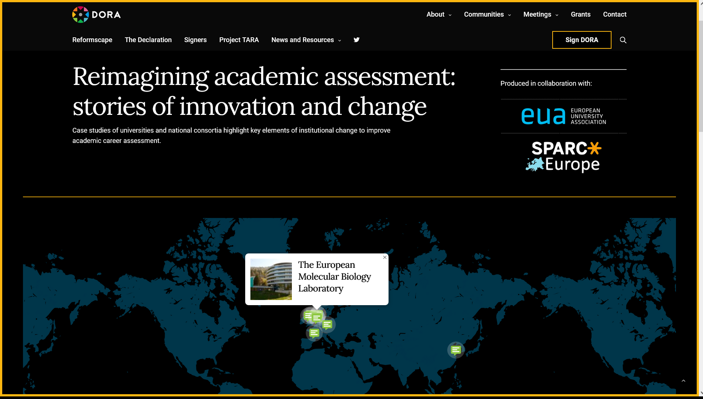
DORA resources
Case studies: Describes how single institutions changed their assessment policies
Notes:
DORA case studies are documented examples of innovation and change in research assessment policies and practices within various organizations, primarily academic institutions and national consortia, that aim to support and inspire the global research community in implementing responsible research assessment. It provides concrete, real-world examples that other individuals and organizations can draw upon as they develop new policies and approaches to assessment. They serve as a "library of examples" to learn from. Each case study typically documents key elements of institutional change, including: motivations for change, processes undertaken, timelines, new policies implemented, and the types of people involved.

Slide 12



Resources
Reformscape: An observatory of responsible research assessment policies from research institutions
Notes:
Reformscape is DORA's interactive online observatory, launched in 2024, which tracks criteria and standards academic institutions use for hiring, review, promotion, and tenure globally. It serves as a library of examples to inspire and guide institutions looking to improve their academic career assessment practices. It evolved from DORA's earlier "Reimagining Academic Assessment: Stories of innovation and change" repository of case studies.
A system of meta tags was created to allow users to sort and explore source material using descriptive criteria such as geographic location, type of institution, and academic discipline.

Slide 13
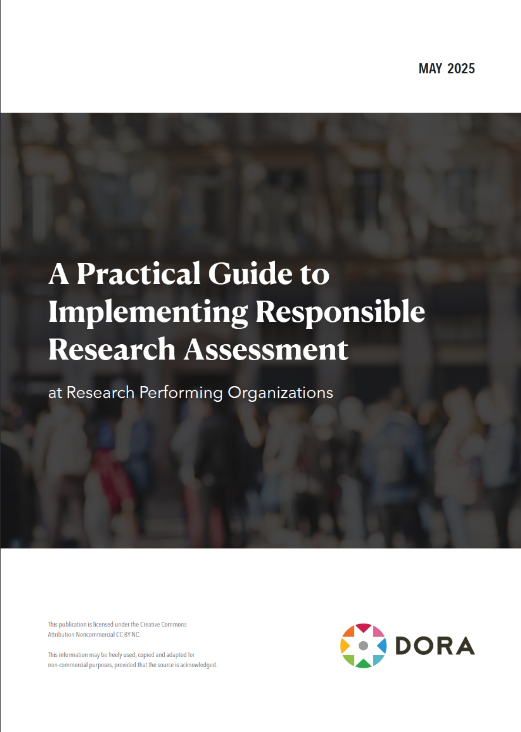

Practical guide
The Guide: action-oriented guidance, resources, and illustrative examples for organisations looking to shape and deliver responsible research assessment practices.
Download from Zenodo
bit.ly/DORA-Guide
Notes:
“A Practical Guide to Implementing Responsible Research Assessment at Research Performing Organizations” provides action-oriented guidance, resources, and illustrative examples, for research performing organizations (RPOs) who are looking to shape and deliver responsible research assessment (RRA) practices. This includes RPOs who are looking to create an RRA strategy, organizations wanting to reform existing practices, and organizations simply wanting to take steps towards more holistic and inclusive approaches to research assessment.
One approach to research assessment certainly does not fit all, so the Guide is intended to be an inspirational tool. It is discipline-agnostic, flexible, and is intended to be adaptable to diverse organizational and disciplinary contexts by users. We envision the Practical Guide being modified and updated over time – and especially being enriched with real examples and through feedback from research performing organizations as they start to use it.
Alongside the Guide, we have also produced two slides decks to support its implementation: one providing a structured overview of the Guide, and another to foster discussions around the Guide. The slides are freely available here.
The Practical Guide has been created as part of Project TARA and, alongside Reformscape, the Building Blocks for Impact, and the Debiasing Committee Composition, forms a suite of tools designed to help organizations who are seeking to reform research assessment practices. Project TARA is supported by Arcadia, a family charitable foundation that helps people to record cultural heritage, to conserve and restore nature, and to promote open access to knowledge, whom we thank. Since 2002 Arcadia has awarded more than $1.2 billion to organizations around the world.

Slide 14
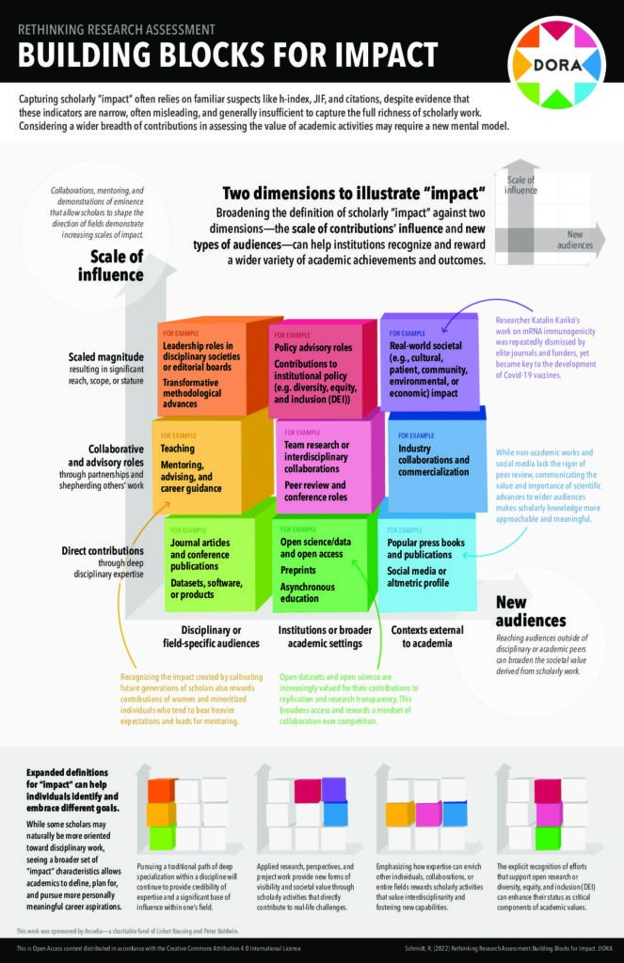
DORA resource library
Resource library: Tools and articles to support research assessment reform
  Project TARA toolkit
    “Debiasing Committee Composition and Deliberative Processes”
    “Building Blocks for Impact”
Notes:
DORA's Resource Library is an interactive, searchable collection of materials designed to facilitate the development and implementation of RRA policies and practices globally. The Resource Library combines and expands on DORA’s existing collection of good practices and other resources. It is organized based on type and intended audience, and includes a diverse range of materials such as:
Policies and guidance: Formal documents and recommendations related to research assessment.
Good practices: Examples of how organizations are successfully implementing RRA.
Tools: Practical instruments to aid in assessment, such as the SPACE rubric (for analyzing institutional conditions and progress indicators), the Rethinking Research Assessment Brief, and the Cognitive and Systems Biases Brief. Recently, short educational videos on concepts like the h-index have also been added.
Journal articles: Scholarly publications relevant to research assessment.
Position papers: Formal statements outlining DORA's stance or that of other organizations on RRA topics.
Advocacy materials: Resources to support individuals and organizations in advocating for change.

Slide 15
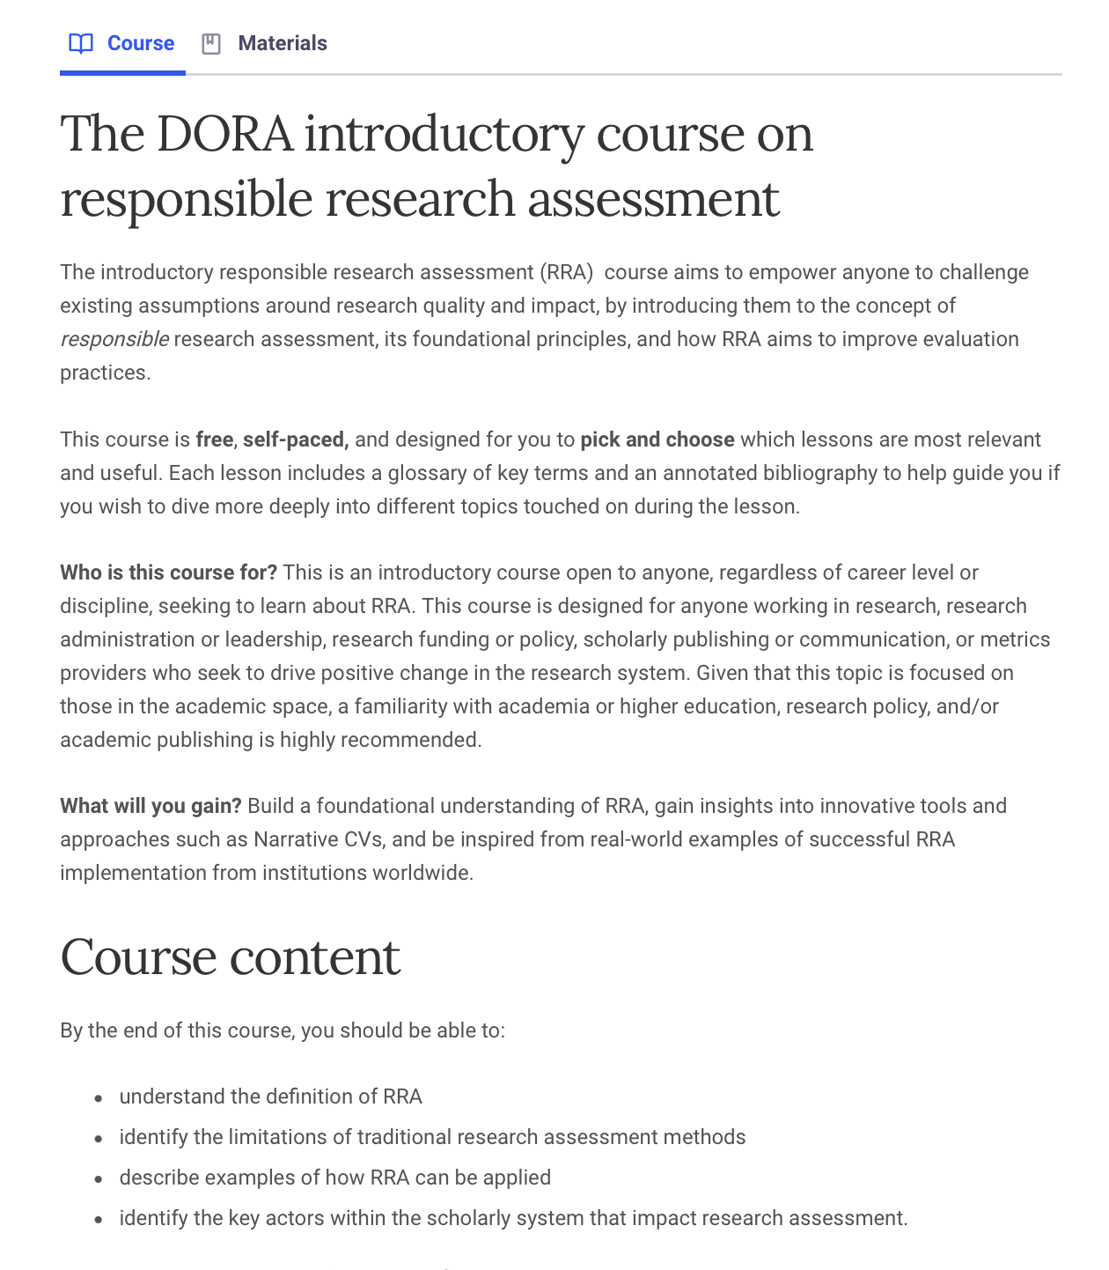
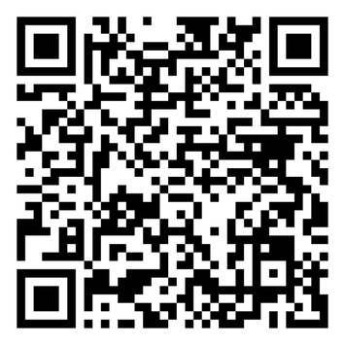

Introductory Course for Research Assessment
bit.ly/DORA-Intro-Course
Notes:
The introductory responsible research assessment (RRA) course aims to empower anyone to challenge existing assumptions around research quality and impact, by introducing them to the concept of responsible research assessment, its foundational principles, and how RRA aims to improve evaluation practices.
This course is free, self-paced, and designed for you to pick and choose which lessons are most relevant and useful. Each lesson includes a glossary of key terms and an annotated bibliography to help guide you if you wish to dive more deeply into different topics touched on during the lesson.
Who is this course for? This is an introductory course open to anyone, regardless of career level or discipline, seeking to learn about RRA. This course is designed for anyone working in research, research administration or leadership, research funding or policy, scholarly publishing or communication, or metrics providers who seek to drive positive change in the research system. Given that this topic is focused on those in the academic space, a familiarity with academia or higher education, research policy, and/or academic publishing is highly recommended.
What will you gain? Build a foundational understanding of RRA, gain insights into innovative tools and approaches such as Narrative CVs, and be inspired from real-world examples of successful RRA implementation from institutions worldwide.
Course content
By the end of this course, you should be able to:
understand the definition of RRA
identify the limitations of traditional research assessment methods
describe examples of how RRA can be applied
identify the key actors within the scholarly system that impact research assessment.

Slide 16
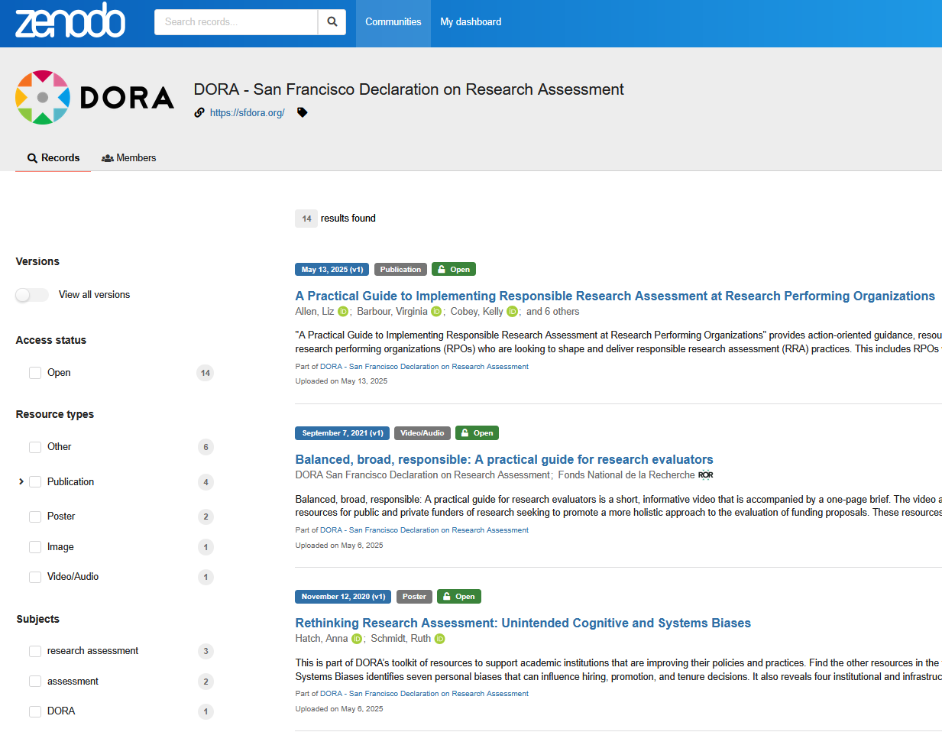
DORA on Zenodo
DORA Zenodo community
DORA’s resources are freely available to access and download
Notes:
DORA’s resources are available on our website, but also in a Zenodo community, to ensure that our resources are findable and secure.

Slide 17
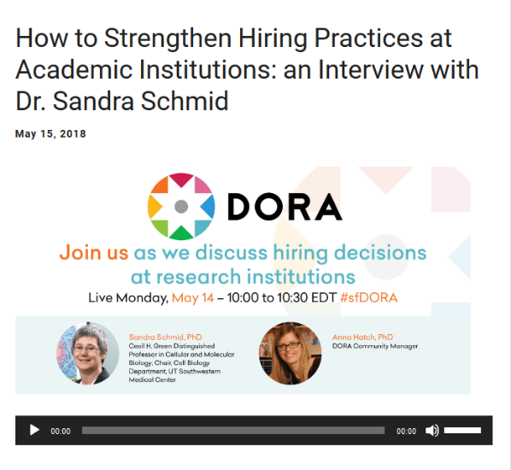
Institutional change
U. Texas Southwestern Medical Center (USA)
Candidates receive questions before Skype interviews, so they have time to reflect.
The goal is to identify thoughtful individuals, not only candidates who process information quickly.
https://sfdora.org/2018/05/15/how-to-strengthen-hiring-practices-at-academic-institutions-an-interview-with-dr-sandra-schmid/
Notes:
DORA has actively worked to spark significant changes in how research performing organizations (RPOs) evaluate research and researchers, with positive results to be shared! Concrete examples of this shift include
Yale Molecular Biophysics and Biochemistry department adopting anonymized applications in faculty searches to eliminate bias from journal names or funding agencies;
The Universitat Oberta de Catalunya, for instance, released an action plan with specific deadlines to implement DORA principles;
The Open University created a new promotion track for researchers doing publicly engaged work, recognizing contributions beyond traditional publications

Slide 18
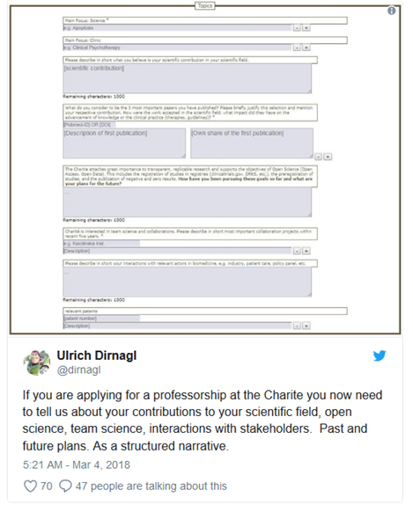
More institutional change
Charité University Hospital (Germany) application includes:
  Contribution to research field.
  Open Science.
  Team science.
  Interactions with stakeholders.
Staff member sits on hiring meetings as a neutral party to promote balanced discussions.
https://twitter.com/dirnagl/status/970227847943114752
Notes:
DORA actively creates and promotes resources to aid RPOs in implementing change:
Reformscape (launched 2024): An interactive online observatory that tracks criteria and standards academic institutions use for hiring, review, promotion, and tenure worldwide. It provides a comprehensive dataset and enables RPOs to learn from existing initiatives.
A Practical Guide to Implementing Responsible Research Assessment at Research Performing Organizations (launched May 2025): This guide offers practical guidance and tips for RPOs to develop, review, or reform their assessment practices. It addresses common challenges and provides activities and examples for engaging leadership, forming working groups, and crafting communication plans.
SPACE to Evolve Academic Assessment rubric (launched 2021): Helps institutions gauge their capacity and progress for RRA reform across five key dimensions (Standards for Scholarship, Process Mechanics and Policies, Accountability, Culture Within Institutions, and Evaluative and Iterative Feedback) and three stages of development.
Briefs and toolkits: DORA has developed resources like "Rethinking Research Assessment: Ideas for Action" and "Unintended Cognitive and Systems Biases" to help RPOs identify obstacles, experiment with new approaches, and counteract biases. The "Building Blocks for Impact" tool helps organizations broaden their understanding of scholarly impact.
Case Studies Repository: Documents real-world examples of institutional change in academic career assessment, providing inspiration and insights into processes and challenges.

Slide 19

Responses to change
“University of Calgary has signed up to DORA and I’m seeing immediate & positive changes. Our academic performance review has moved away from simply publication counting.”
James Wasmuth, 13 July 2023
https://twitter.com/jdwasmuth/status/1679510361719058432

Slide 20
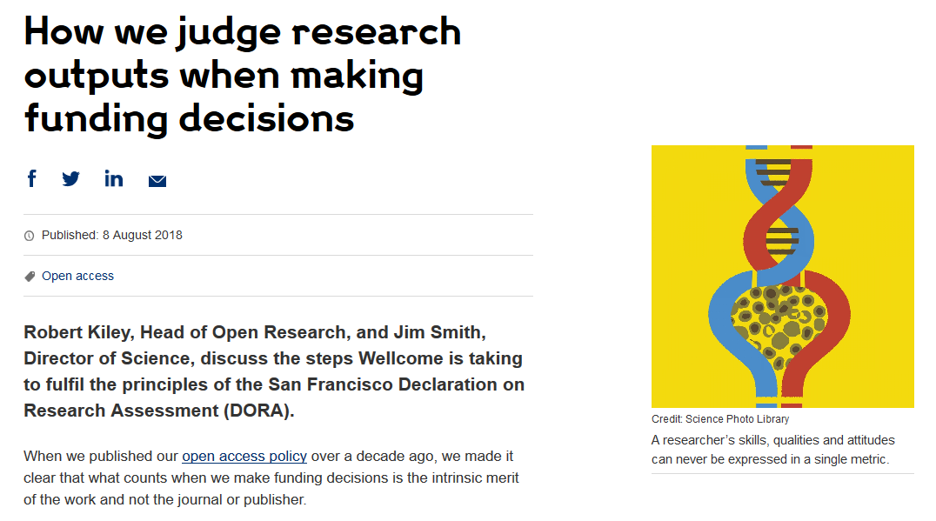
Change from funders: Wellcome
Grant application includes:
List of research outputs.
Contributions to mentorship.
Output sharing plan to advance. potential health benefits.
Plans for public engagement.
Guidance provided to advisory panel members.
https://wellcome.org/news/how-we-judge-research-outputs-when-making-funding-decisions
Notes:
Several influential funding organizations have formally signed DORA, committing to its principles. These include 7 UK Research Councils, the Research Council of Norway, ANR, the Australian National Health and Medical Research Council, the Irish Research Council, Science Foundation Ireland, the Academy of Finland and the British Heart Foundation. Funders are moving away from using journal-based metrics, such as the Journal Impact Factor, as a proxy for the quality of individual articles or a scientist's contributions in funding decisions; adopting the use of a narrative CV format in its major funding streams; and encouraging a wider range of research outputs beyond traditional publications, including data, code, and diverse societal impacts.

Slide 21
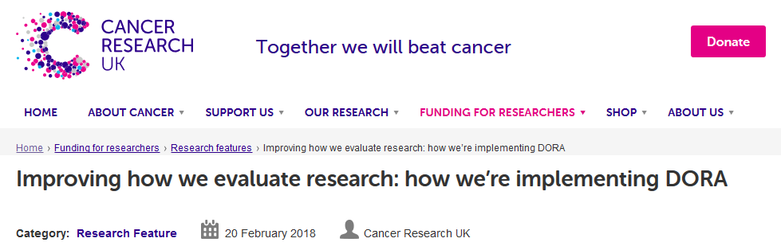
Change from funders: Cancer Research UK
Grant application includes:
List of research outputs
Summary of 3-5 achievements
Space to describe other measures of impact
Reminds peer reviewers and committee members of DORA principles throughout funding process
https://news.cancerresearchuk.org/2018/02/20/improving-research-evaluation-dora/
Notes:
DORA launched two quarterly communities of practice in 2020 for public and private funders (one for the Asia-Pacific region and another for Africa, the Americas, and Europe). These groups serve as platforms to increase knowledge sharing, discuss new policies and pilot initiatives, and facilitate collective action for fair and responsible research assessment. These groups have grown significantly in participation.
DORA has organized workshops with funder groups, such as with the Funding Organisations for Gender Equality Community of Practice (FORGEN CoP), specifically to explore strategies for optimizing narrative CVs and mitigating bias in their use for grant evaluation. DORA, in collaboration with the Elizabeth Blackwell Institute for Health Research and the MoreBrains Cooperative, has run workshops focused on improving pre-award processes to foster equitable and transparent research assessment.

Slide 22
Change from publishers
PLOS describes how its journals comply with DORA recommendations.
EMBO Press shows citation distributions for its journals; presents all available metrics side-by-side, rounded to single digits.
Development (Company of Biologists) uses multiple metrics of journal performance.
Notes:
DORA has sparked significant change within publishing by directly advocating for a reduced reliance on traditional metrics, providing actionable guidance for adopting more holistic assessment practices, actively collaborating on new models for scholarly communication (like preprints and CRediT), and enhancing accountability for publishers through public commitment requirements.
DORA's foundational recommendation is to "not use journal-based metrics, such as Journal Impact Factors, as a surrogate measure of the quality of individual research articles, to assess an individual scientist’s contributions, or in hiring, promotion, or funding decisions". While this may be perceived as directly challenging publishers' traditional reliance on such metrics, numerous major publishers and scholarly societies have voluntarily signed DORA, including Springer Nature, Taylor & Francis, and Redalyc, an organization indexing Latin American journals, which mandated that all 1,360 journals it indexes sign DORA and adhere to its principles.
DORA has actively provided guidance to publishers on how they can support research assessment reform. A feature published by Science Editor, co-authored by DORA staff, offered 10 achievable recommendations for journals and publishers beyond merely abandoning the Impact Factor.

Slide 23
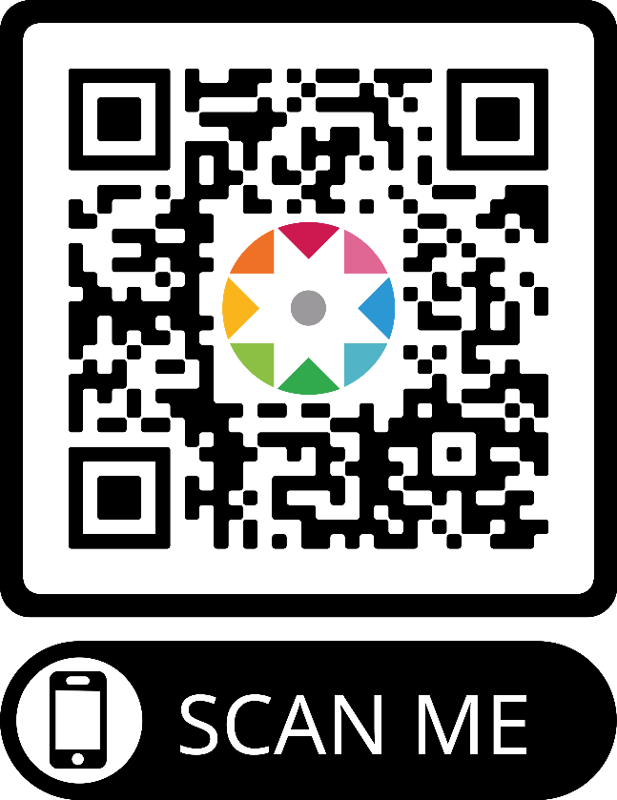
What you can do
Sign DORA! (sfdora.org/sign)
Ask your institution to review assessment and sign DORA.
Use our collection of good practices to implement change.
Tell us how you improved assessment so we can tell others (sfdora.org/contact).
Notes:
Individuals play a crucial role in implementing Responsible Research Assessment (RRA) by actively challenging traditional practices and advocating for change within their spheres of influence! Beyond those actions listed in the slide, there’s much more people can consider doing, as we share below. Thank you for joining us in this movement!
For Researchers (including Early Career Researchers and those on committees):
Base assessments on scientific content rather than journal-based metrics when serving on committees for funding, hiring, tenure, or promotion.
Cite primary literature where observations were first reported instead of reviews, to properly credit the original discoverers.
Use a range of article metrics and indicators in personal or supporting statements to demonstrate the impact of individual published articles and other research outputs.
Challenge inappropriate reliance on quantitative metrics and promote best practices that emphasize the value and influence of specific research outputs.
When compiling CVs, consider using narrative CVs or annotated CVs to contextualize achievements, highlight specific contributions, and showcase a broader range of impacts beyond traditional metrics like publications and grants.
Actively engage in discussions around research assessment, especially as Early Career Researchers (ECRs), bringing fresh perspectives on academic incentives and career progression.
Seek out training on responsible research assessment, including topics like research integrity, ethics, responsible use of metrics, open science, and how to create narrative CVs.
When applying for positions or grants, check for transparent assessment criteria and inquire if they are not readily available. Ask if reviewer training materials are provided.
Be a voice for change from within review panels by asking about bias mitigation training and working to hold colleagues accountable during the review process.
For Staff (Librarians, Research Managers, Administrators, HR Personnel, IT Departments, etc.):
Support bibliometric education for faculty and staff, introducing alternative metrics and advocating for their responsible use, rather than solely focusing on JIF and h-index.
Create online resources and host events on different CV types (e.g., narrative CVs) and why qualitative narratives are beneficial.
Advise and guide researchers and students on "high quality" research, emphasizing RRA principles.
Help shape and implement institutional policies that guide assessment and evaluation frameworks, including criteria and information to be included.
Work with leadership to develop clear guidance for reviewers and applicants, create training materials, and iterate on them as needed.
Ensure existing and new policies align with RRA strategy and are transparent, especially regarding Equity, Diversity, and Inclusion (EDI), hiring, promotion, and open science.
Communicate effectively about RRA, emphasizing its benefits and impacts, and leveraging communication expertise.
For Individuals in Leadership/Policymaking Roles:
Develop clear guidance on the type of information that should and should not be included in CVs, and create training for reviewers on effectively reviewing narrative-style CVs.
Influence panel composition and training by working with HR, Ethics, and other departments to develop clear guidance and training materials.
Foster an active dialogue with staff that engages thoughtfully with their questions and concerns regarding quantitative indicators.
Incorporate narrative elements into applications to optimize assessment processes and mitigate biases.
Promote the use of self-evaluation reports for units, based on textual descriptions of activities, mission, vision, and a diverse set of collaborations, outputs, and staff development, rather than just quantitative data.
Ensure that assessment practices do not disadvantage Early Career Researchers (ECRs) and other under-represented groups.
By taking a few of these actions, individuals can collectively contribute to a more holistic, transparent, and equitable research assessment ecosystem.

Slide 24















Supporting organizations
Additional Support
Visionary
Sustainer
Contributor
Notes:
DORA is a global initiative supported by over 15 different organizations including research funders, professional organizations, publishers, and academic institutions. DORA categorizes its supporting organizations into different tiers based on their annual contribution levels. DORA has procedures for adjusted membership fees for organizations in developing or transitional economies and may also accept "in-kind" support. You can join us as a funding organization – email administrator@sfdora.org to join this distinct group of leaders in RRA.

Slide 25
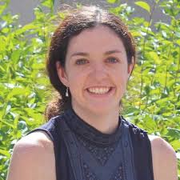

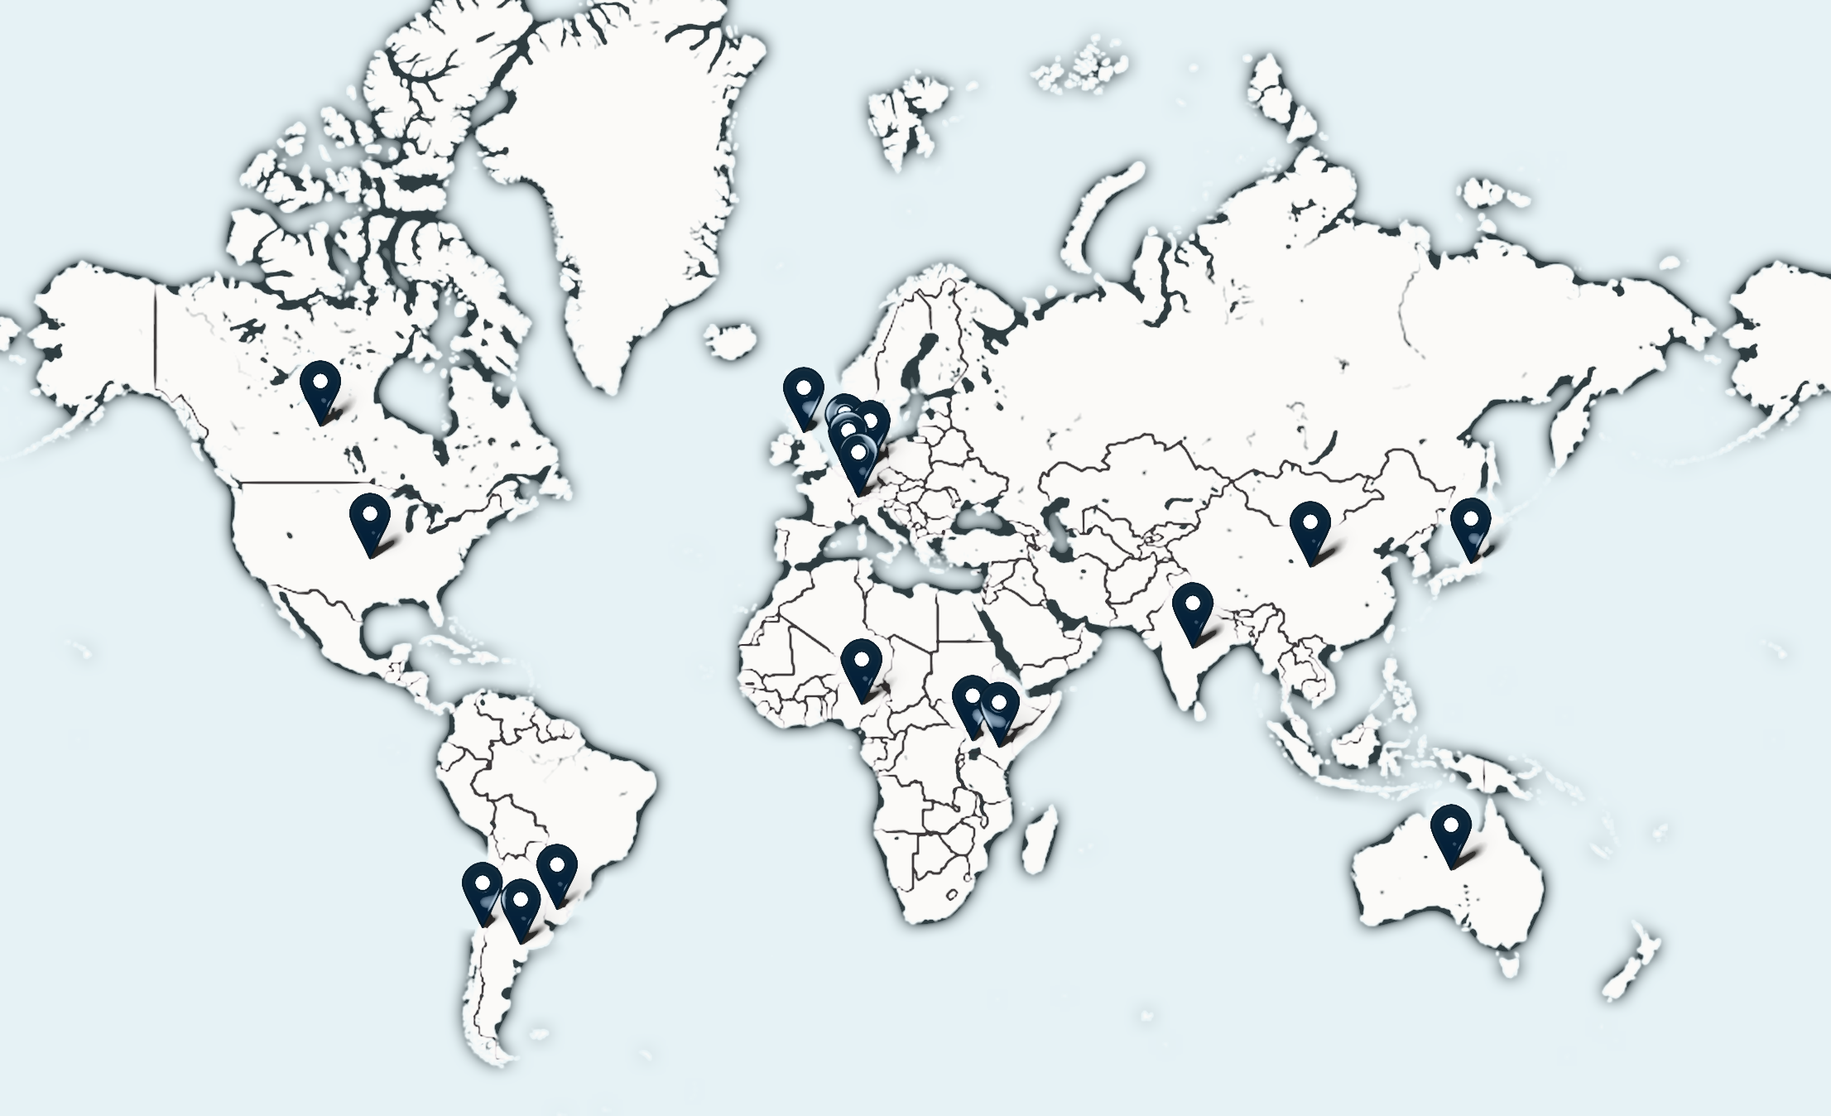
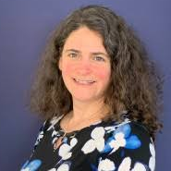

The DORA team
A global Steering Committee powered by a flexible team
Kelly Cobey
(DORA Co-Chair
University of Ottawa)
Ginny Barbour
(DORA Co-Chair
QUT)
Rebecca Lawrence
(DORA Vice-Chair
Taylor & Francis)
Giovanna Lima
(DORA Program Manager)
Notes:
DORA's team is comprised of its leadership, various committees, and staff, supported by an administrative entity and key collaborators.
The Steering Committee provides governance, steers strategic priorities, approves supporting organizations and policies, and raises awareness within their respective communities. Membership is designed to reflect diverse geographic regions and stakeholder groups. DORA operates under the sponsorship of ASCB, which manages DORA's data, website, and handles the hiring and management of DORA staff. This relationship ensures DORA's operational support and financial management.
This diverse team structure, with both volunteers, paid staff, and external collaborators, enables DORA to pursue its strategic objectives effectively.
Here's a breakdown of DORA’s core team:
Co-Chairs and Vice-Chair
Co-Chairs: Ginny Barbour (Queensland University of Technology, Australia) and Kelly Cobey (University of Ottawa Heart Institute, Canada).
Vice-Chair: Rebecca Lawrence (F1000, UK).
Roles: They provide leadership and guide DORA's strategic direction.
Program Director / Program Manager (Staff)
Giovanna Lima: Started as DORA’s new Program Manager in January 2025.
Role: Responsible for day-to-day operations, program management, community engagement, resource development, and supporting strategic objectives.

