Slide 1
How to use this resource
Notes and additional resources for users are included in the notes section.
This content is available under a Creative Commons Attribution License (CC BY 4.0), except supporter logos. Logos are trademarks or registered trademarks of their respective organizations and may not be reused or reproduced without permission.

Slide 2
Improving research assessment
sfdora.org
@DORAssessment on most social media platforms
Notes:
Journal-based metrics are often misused and ill applied in research and researcher evaluation. This happens at key transition points during a researcher’s career, including hiring, promotion, and tenure. DORA is a global initiative supported by over 15 different organizations including research funders, professional organizations, publishers, and academic institutions. The vision of DORA is to advance practical and robust approaches to research assessment globally and across all scholarly disciplines. Individuals and organizations can sign the declaration pledging to improve culture around research evaluation. DORA is collecting best practices to help members of the community learn from each other and create change. More information is on the website: sfdora.org

Slide 3
Why DORA exists
Research needs to be assessed and people want to use quantitative evidence to do so
But many measures now used are flawed or inappropriate
DORA fosters better ways to assess research

Slide 4
Long standing problems
1997: Why the impact factor of journals should not be used for evaluating research
2001: Some misuses of journal impact factor in research evaluation
2018: What’s wrong with the journal impact factor in 5 graphs

Slide 5
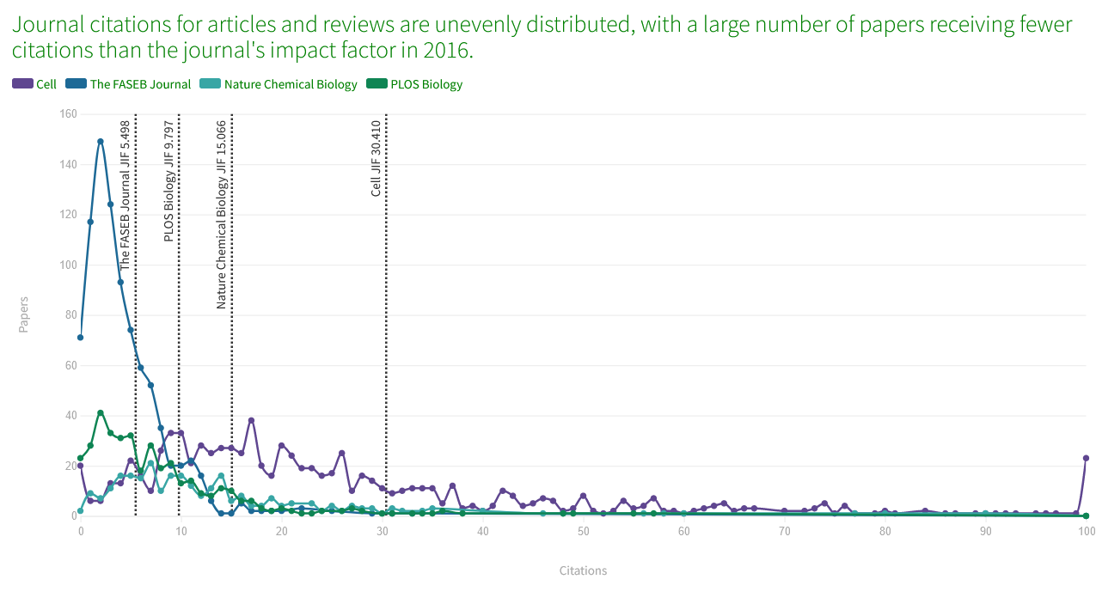
Skewed distributions (often driven by a few papers) make it practically impossible to predict success of individual papers
https://www.nature.com/nature-index/news/whats-wrong-with-the-jif-in-five-graphs

Slide 6
The declaration
Draws attention to potential problems of journal-based metrics in hiring, promotion, and funding decisions
Demonstrates community support for change
Currently signed by over 24,000 individuals and organizations

Slide 7
Meaningful assessment improves research
Focuses on the merits of specific individual works
Reduces reliance on heavily competitive journals
Promotes reproducibility and Open Science
A wider range of scholarly products are valued
Datasets, protocols, software, preprints, policy, training, and policy can be assessed in addition to peer reviewed journal articles

Slide 8
DORA’s mission
Advance practical and robust approaches to improve how research is assessed across all scholarly disciplines globally

Slide 9
DORA’s objectives
Increase awareness of the negative impacts of research assessment practices
Develop measures of research assessment reform
Support advocates of research assessment reform
Secure funding to deliver DORA’s mission
https://sfdora.org/2023/03/29/towards-the-future-of-responsible-research-assessment-announcing-doras-new-three-year-strategic-plan/

Slide 10
DORA’s approaches
Community engagement
Resource development
Partnership
Advising
Convening

Slide 11
Ideas for action
Instill standard and structure into research assessment processes
Foster a sense of personal accountability
Prioritize equity and transparency of research assessment processes
Take a portfolio view toward researcher contributions
Refine research assessment processes through iterative feedback
One page
summary
resource
https://sfdora.org/resource/rethinking-research-assessment/
Notes:
https://sfdora.org/2020/05/19/rethinking-research-assessment-ideas-for-action/

Slide 12
Institutional change
U. Texas Southwestern Medical Center (USA)
Candidates receive questions before Skype interviews, so they have time to reflect
The goal is to identify thoughtful individuals, not only candidates who process information quickly
https://sfdora.org/2018/05/15/how-to-strengthen-hiring-practices-at-academic-institutions-an-interview-with-dr-sandra-schmid/

Slide 13
Institutional change
Charité University Hospital (Germany) application includes:
Contribution to research field
Open Science
Team science
Interactions with stakeholders
Staff member sits on hiring meetings as a neutral party to promote balanced discussions
https://twitter.com/dirnagl/status/970227847943114752

Slide 14
Institutional change
“University of Calgary has signed up to DORA and I’m seeing immediate & positive changes. Our academic performance review has moved away from simply publication counting.”
James Wasmuth, 13 July 2023
https://twitter.com/jdwasmuth/status/1679510361719058432

Slide 15
Change from funders: Wellcome
Grant application includes:
List of research outputs
Contributions to mentorship
Output sharing plan to advance potential health benefits
Plans for public engagement
Guidance provided to advisory panel members
https://wellcome.org/news/how-we-judge-research-outputs-when-making-funding-decisions

Slide 16
Change from funders: Cancer Research UK
Grant application includes:
List of research outputs
Summary of 3-5 achievements
Space to describe other measures of impact
Reminds peer reviewers and committee members of DORA principles throughout funding process
https://news.cancerresearchuk.org/2018/02/20/improving-research-evaluation-dora/

Slide 17
Change from publishers
PLOS describes how its journals comply with DORA recommendations
EMBO Press shows citation distributions for its journals; presents all available metrics side-by-side, rounded to single digits
Development (Company of Biologists) uses multiple metrics of journal performance

Slide 18
What you can do
Sign DORA! (sfdora.org/sign)
Ask your institution to review assessment and sign DORA
Use our collection of good practices to implement change
Tell us how you improved assessment so we can tell others (sfdora.org/contact)

Slide 19
Supporting organizations
Visionary
Sustainer
Contributor
Notes:
Journal-based metrics are often misused and ill applied in research and researcher evaluation. This happens at key transition points during a researcher’s career, including hiring, promotion, and tenure. DORA is a global initiative supported by over 15 different organizations including research funders, professional organizations, publishers, and academic institutions. The vision of DORA is to advance practical and robust approaches to research assessment globally and across all scholarly disciplines. Individuals and organizations can sign the declaration pledging to improve culture around research evaluation. DORA is collecting best practices to help members of the community learn from each other and create change. More information is on the website: sfdora.org

Slide 20
The DORA team
Many people volunteer to serve on DORA’s Executive Board and Steering Committee!
sfdora.org/team

