Slide 1
Notes and additional resources for users are included in the notes section.
This content is available under a Creative Commons Attribution License. Logos are trademarks or registered trademarks of their respective organizations and may not be reused or reproduced without permission.

Slide 2
Declaration On Research Assessment Improving how research is assessed
sfdora.org
@DORAssessment
Notes:
DORA is an initiative to push for real change in research assessment. The vision of DORA is to advance practical and robust approaches to research assessment globally and across all scholarly disciplines. Individuals and organizations can sign the declaration pledging to improve culture around research evaluation. DORA is collecting best practices to help members of the community learn from each other and create change. More information is on the website: sfdora.org
Journal-based metrics are often misused and ill applied in research and researcher evaluation. This is happens at key transition points during a researcher’s career, including hiring, promotion, and tenure.

Slide 3
Why a Declaration?
Addresses misuse of journal-based metrics in hiring, promotion and funding decisions
Draws attention to the problem and fosters progressive solutions
Demonstrates community support for change
July 2020:
Signed by >19,75 organizations and >16,000 individuals
Notes:
Problems with the JIF (from the preamble to the declaration):
citation distributions within journals are highly skewed
the properties of the Journal Impact Factor are field-specific: it is a composite of multiple, highly diverse article types, including primary research papers and reviews
Journal Impact Factors can be manipulated (or “gamed”) by editorial policy
data used to calculate the Journal Impact Factors are neither transparent nor openly available to the public

Slide 4
Meaningful Assessment Improves Research
Promotes value of all scholarly outputs
Focuses on the merits of the work
Journal articles
Preprints
Datasets
Software
Protocols
Research materials
Well-trained researchers
Societal outcomes and policy changes
Reduces JIF-chasing
Facilitates Open Science practices
Improves rigor and reliability
Enhances collaboration

Slide 5
DORA’s vision
Advance practical and robust approaches to improve how research is assessed globally and across all scholarly disciplines
The declaration provides recommendations to stimulate positive action by:
Funders
Research institutions
Publishers
Metrics providers
Researchers
Notes:
People may associate DORA with negative thinking, assuming that all the declaration says is “Don’t use JIFs”. But from the beginning DORA has been a positive enterprise, seeking to foster innovation and responsible practice in research assessment. JIFs (and journal names) are frequently misused as a shortcut because they can quickly be applied to sort large volumes of applications. It is important that alternatives to the JIF are time efficient and intuitive.

Slide 6
DORA’s Objectives
Raise awareness
Call attention to new tools and processes in research assessment and the responsible use of metrics the align with core academic values and promote consistency and transparency in decision making.
Facilitate implementation
Aid development of new policies and practices for hiring, promotion, and funding decisions.
Catalyze change
Spread research assessment reform broadly by working across scholarly disciplines and globally.
Improve equity
Call for broader representation of researchers in the design of research assessment practices that directly address the structural inequalities in academia.

Slide 7
DORA’s Approaches
Community engagement
Publish blogs, organize community interviews, and give presentations on research assessment.
Resource development
Curate collections of good practices, create slide presentation to help individuals initiate local conversations about change, and publish commentaries to provide additional guidance for stakeholders.
Partnership
Work with other organizations that share our desire to reform research assessment.
Advising
Advise academic institutions and funders seeking to review and revise their research assessment policies and practices.
Convening
Gather diverse stakeholders at conference sessions, workshops, and meetings to work towards system change.

Slide 8
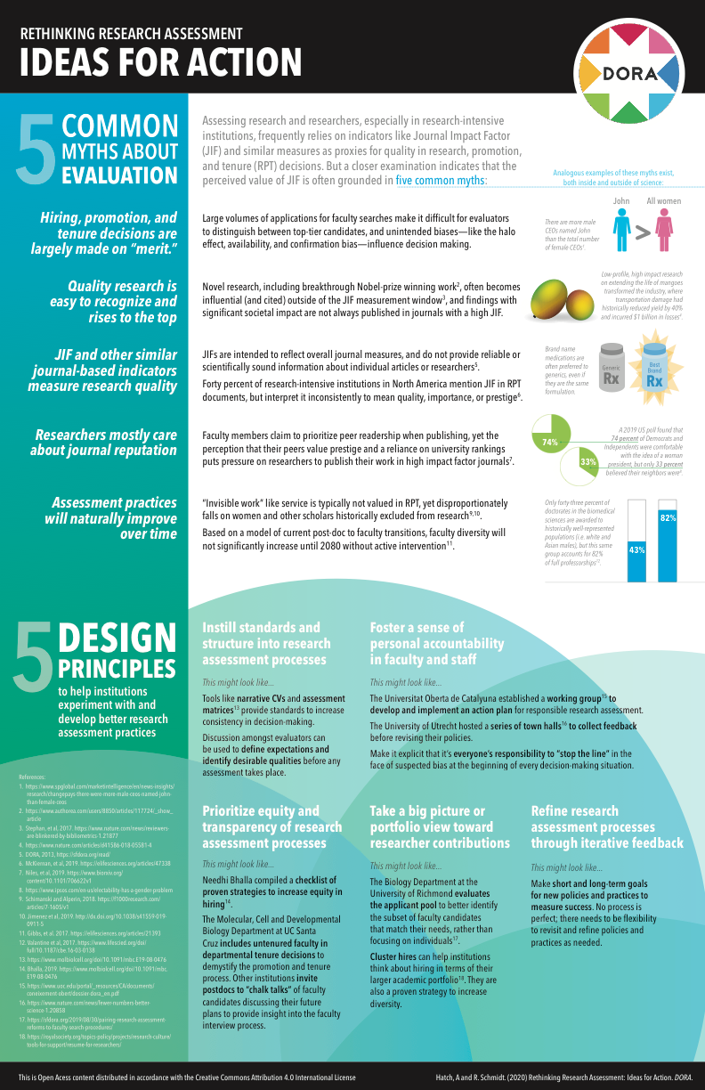
DORA Ideas for Action
Five design principles for institutions
Instill standard and structure into research assessment processes
Foster a sense of personal accountability
Prioritize equity and transparency of research assessment processes
Take a portfolio view toward researcher contributions
Refine research assessment processes through iterative feedback
Notes:
https://sfdora.org/2020/05/19/rethinking-research-assessment-ideas-for-action/

Slide 9
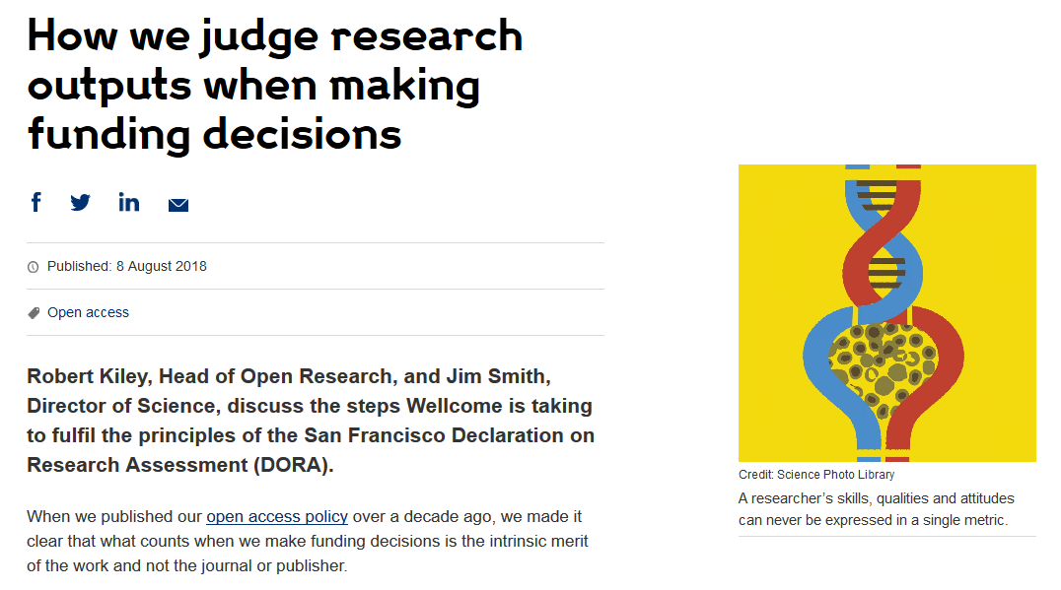
Change is happening: Funders
Cancer Research UK
London, UK
Application includes:
List of research outputs
Summary of 3-5 achievements
Space to describe other measures of impact
Reminds peer reviewers and committee members of DORA principles throughout funding process
Wellcome
London, United Kingdom
Application includes:
List of research outputs
Contributions to mentorship
Output sharing plan to advance potential health benefits
Plans for public engagement
Guidance provided to advisory panel members
Notes:
Wellcome example: https://wellcome.ac.uk/news/how-we-judge-research-outputs-when-making-funding-decisions
Cancer Research UK example: https://www.cancerresearchuk.org/funding-for-researchers/research-features/2018-02-20-improving-research-evaluation-dora

Slide 10
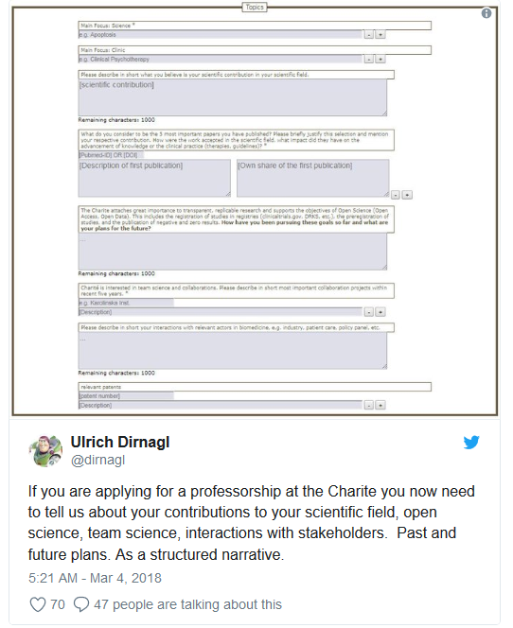
Change is happening: Research Institutes
Application includes:
Contribution to research field
Open Science
Team Science
Interactions with stakeholders
Staff member sits on hiring deliberation meetings as a neutral party to promote balanced discussions
UT Southwestern Medical Center
Dallas, Texas
Candidates receive questions before Skype interviews, so they have time to reflect. The goal is to identify thoughtful individuals, in addition to candidates who process information quickly.
Charité University Hospital
Berlin, Germany
Notes:
UT Southwestern example: https://sfdora.org/2018/05/15/how-to-strengthen-hiring-practices-at-academic-institutions-an-interview-with-dr-sandra-schmid/
Charité University Hospital: https://sfdora.org/2018/07/06/simple-questions-big-insights-charite-uses-bio-sketch-questions-to-recruit-faculty/

Slide 11
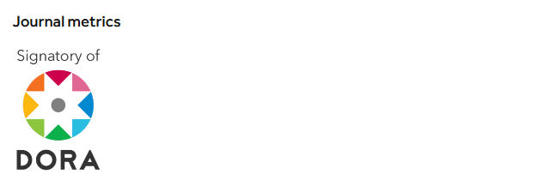
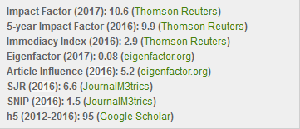
Change is happening: Publishers
PLOS
San Francisco, California
Dedicated page on website describing how its journals comply with DORA recommendations
The Company of Biologists
Cambridge, UK
EMBO Press
Heidelberg, Germany
“Development uses a number of metrics that together provide a rich view of the journal’s performance”
Acknowledges DORA signature
Shows citation distributions for its journals
Presents all available metrics side-by-side and rounded to single digits
Notes:
PLOS example: https://www.plos.org/dora
Company of Biologists example: http://dev.biologists.org/content/about
EMBO examples: http://emboj.embopress.org/about#bibliometrics; http://emboj.embopress.org/content/34/12/1601

Slide 12
What can you do?
Sign DORA
Ask your institution/employer to review assessment practices
Use our collection of good practices to implement change
Tell us about how you improved assessment so we can share your ideas with others
sfdora.org/contact
@DORAssessment #AssessingResearch

Slide 13
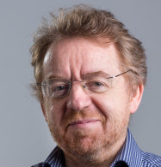
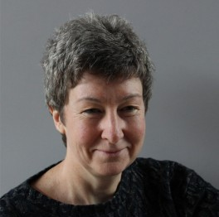
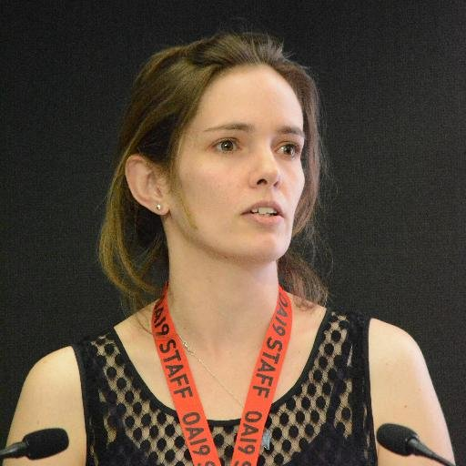
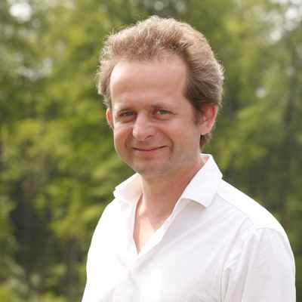
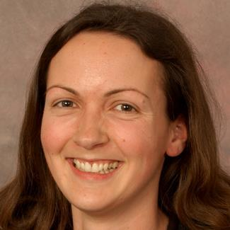
Member organizations, Steering Committee and Staff
Stephen Curry, Chair
Imperial College London
David Carr
Wellcome
Michael Hill
Swiss National Science Foundation
Stuart King
eLife
Anna Hatch
Program Director
Boyana Konforti
Howard Hughes Medical Institute
Catriona MacCallum
Hindawi
Erin McKiernan
National Autonomous University of Mexico
Dan Morgan
PLOS
Helen Sitar
Community Coordinator
Claire Moulton
Company of Biologists
Bernd Pulverer
EMBO
Fiona Reddington
Cancer Research UK
Erika Shugart
American Society for Cell Biology

Slide 14
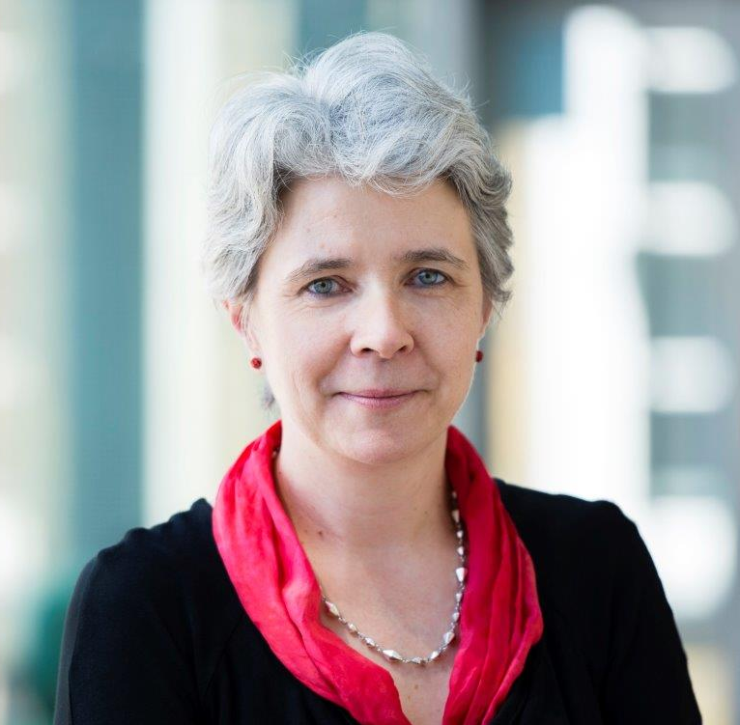
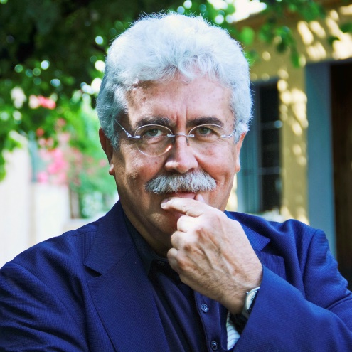
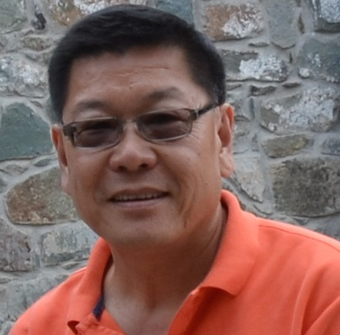
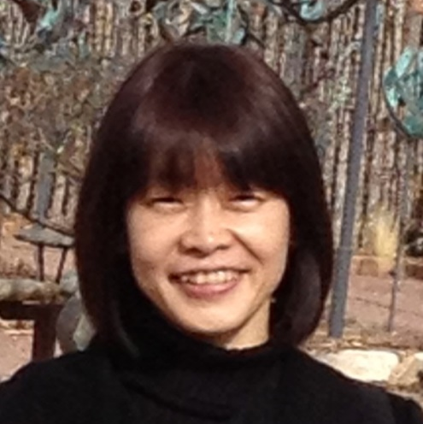
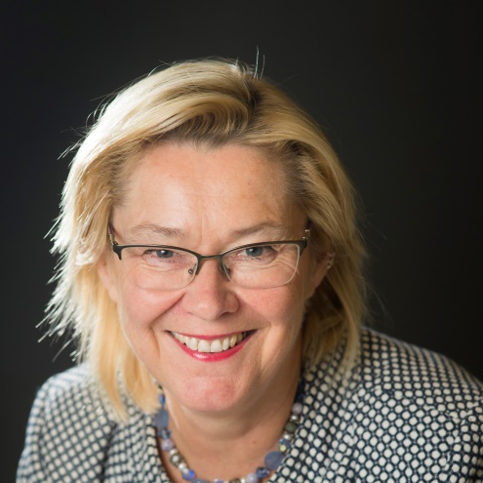
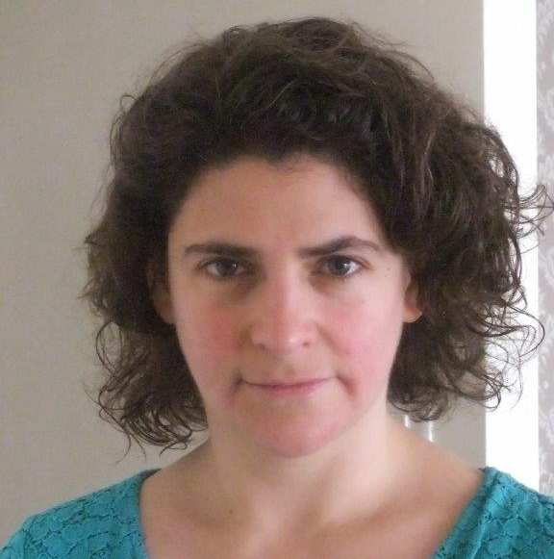
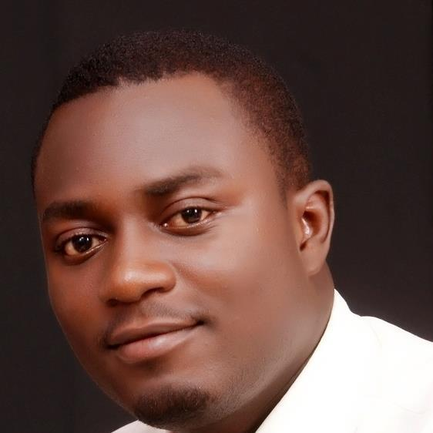
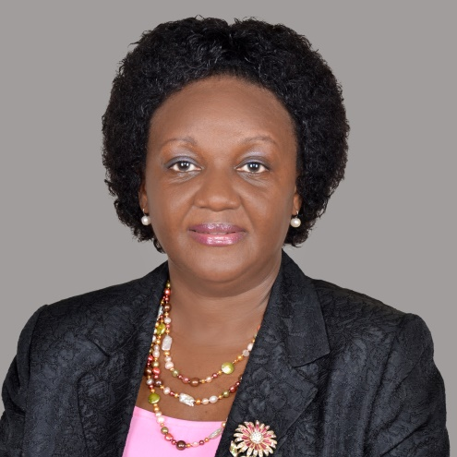
Advisory Board
Ginny Barbour, Chair
Queensland University of Technology
Australia
José Pío Beltrán
CSIC
Spain
Needhi Bhalla
University of California, Santa Cruz
United States
Leslie Chan
University of Toronto Scarborough
Canada
Christian Gonzalez-Billaut
Universidad de Chile
Chile
Yukiko Gotoh
The University of Tokyo
Japan
Kristiina Hormia-Poutanen
National Library of Finland
Finland
Rebecca Lawrence
F1000
United Kingdom
Xiaoxuan Li
Chinese Academy of Sciences
China
Satyajit Mayor
National Centre for
Biological
Science (TIFR)
India
Valerie Mizrahi
University of Capetown
South Africa
Ahmed Ogunlaja
Open Access Nigeria
Nigeria
Laura Rovelli
El Consejo Latinoamericano de Ciencias Sociales (CLACSO)
Argentina
Rhoda Wanyenze
Makerere University School
of Public Health
Uganda

