Slide 1
NIH Office of Portfolio Analysis (OPA)
Developing artificial intelligence (AI) to assist with
decision-making and research assessment
  Track and parameterize decision-making at NIH and other funders
  Capture and make accurate predictions about the resulting impact
George Santangelo, PhD
OPA Director
DPCPSI / NIH

Slide 2
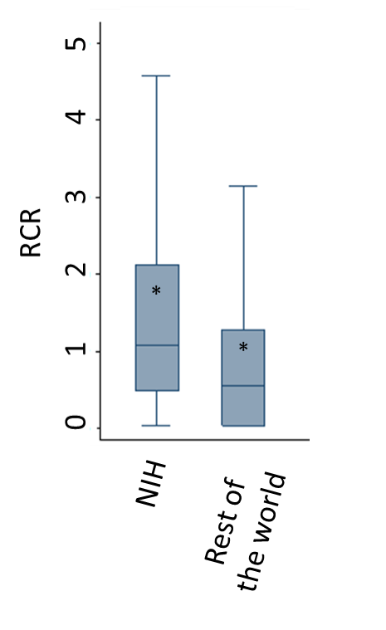
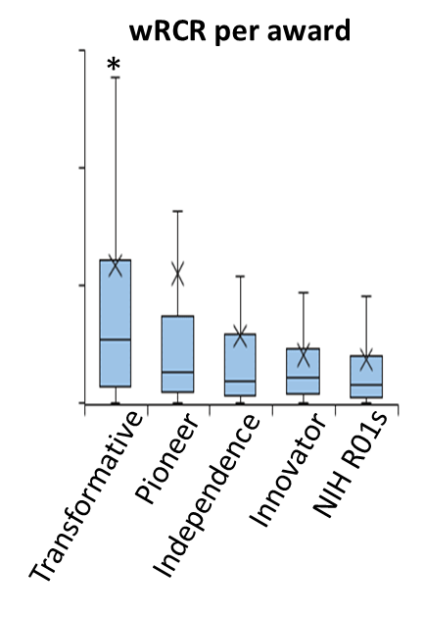

OPA AI to track and predict the impact of NIH decision-making
Track and parameterize:
Influence using bibliometric data
The Relative Citation Ratio (RCR)
        Hutchins BI et al. PLoS Biology 2016 14:e1002541
        Hutchins BI et al. PLoS Biology 2017 15:e2003552
        Santangelo GM Mol. Biol. Cell 2017 28:1401-1408
Office of Portfolio Analysis
Notes:
The People module of iCite is currently under development (see slides below)

Slide 3
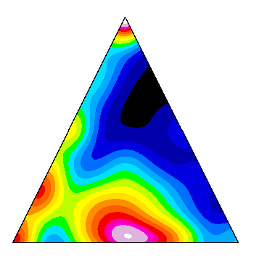
OPA AI to track and predict the impact of NIH decision-making
Track and parameterize:
Influence using bibliometric data
The Relative Citation Ratio (RCR)
        Hutchins BI et al. PLoS Biology 2016 14:e1002541
        Hutchins BI et al. PLoS Biology 2017 15:e2003552
        Santangelo GM Mol. Biol. Cell 2017 28:1401-1408
Translational progress / clinical trials (CTs) and tech transfer / patents
The triangle of biomedicine, APT scores
    Hutchins BI et al. PLoS Biology 2019 17(10):e3000416
Office of Portfolio Analysis
Notes:
The People module of iCite is currently under development (see slides below)

Slide 4

OPA AI to track and predict the impact of NIH decision-making
Track and parameterize:
The publicly available OPA tool
Influence using bibliometric data
The Relative Citation Ratio (RCR)
        Hutchins BI et al. PLoS Biology 2016 14:e1002541
        Hutchins BI et al. PLoS Biology 2017 15:e2003552
        Santangelo GM Mol. Biol. Cell 2017 28:1401-1408
2.0
Influence module
Translation module
Open Citation Collection
Hutchins et al. PLOS Biology 2019
17:e3000385
Translational progress / clinical trials (CTs) and tech transfer / patents
The triangle of biomedicine, APT scores
    Hutchins BI et al. PLoS Biology 2019 17(10):e3000416
Office of Portfolio Analysis
Notes:
The People module of iCite is currently under development (see slides below)

Slide 5
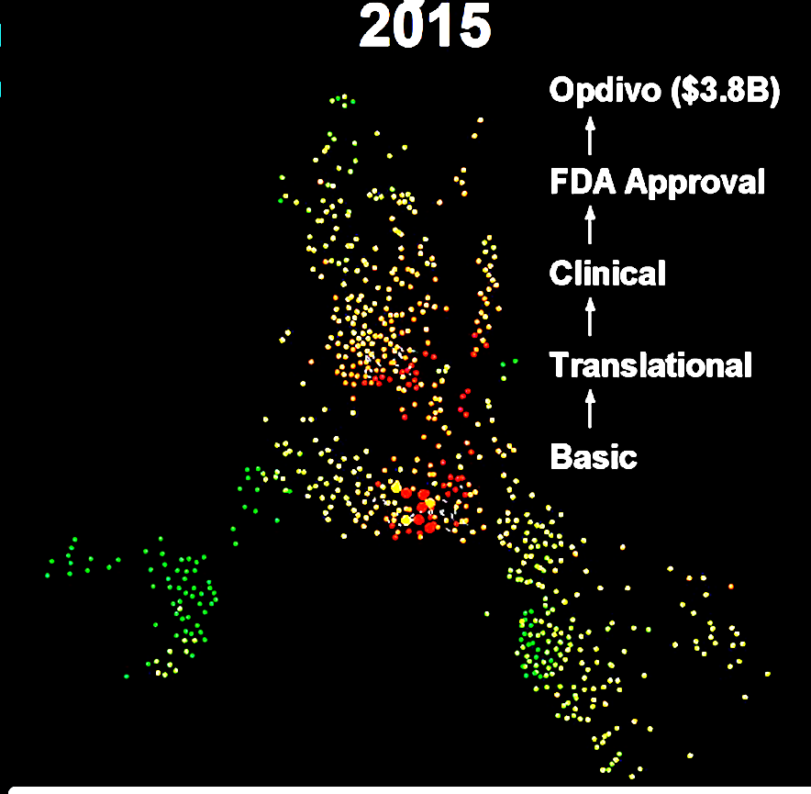
OPA AI to track and predict the impact of NIH decision-making
Track and parameterize:
The publicly available OPA tool
Influence using bibliometric data
The Relative Citation Ratio (RCR)
        Hutchins BI et al. PLoS Biology 2016 14:e1002541
        Hutchins BI et al. PLoS Biology 2017 15:e2003552
        Santangelo GM Mol. Biol. Cell 2017 28:1401-1408
2.0
Influence module
Translation module
Open Citation Collection
Hutchins et al. PLOS Biology 2019
17:e3000385
Translational progress / clinical trials (CTs) and tech transfer / patents
The triangle of biomedicine, APT scores
    Hutchins BI et al. PLoS Biology 2019 17(10):e3000416
Development of drugs and devices
  Disambiguated drug and lead compound name, FDA data
Office of Portfolio Analysis
Notes:
The People module of iCite is currently under development (see slides below)

Slide 6
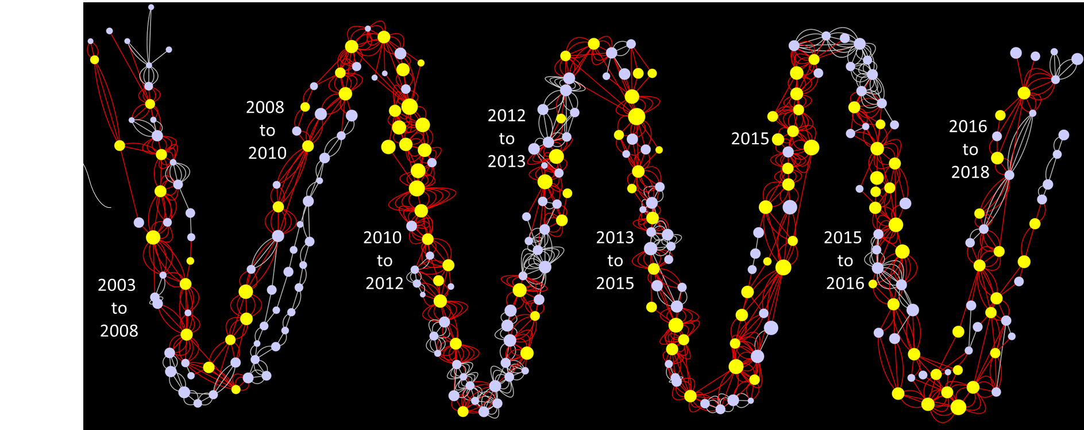
OPA AI to track and predict the impact of NIH decision-making
Track and parameterize:
The publicly available OPA tool
Influence using bibliometric data
The Relative Citation Ratio (RCR)
        Hutchins BI et al. PLoS Biology 2016 14:e1002541
        Hutchins BI et al. PLoS Biology 2017 15:e2003552
        Santangelo GM Mol. Biol. Cell 2017 28:1401-1408
2.0
Influence module
Translation module
Open Citation Collection
Hutchins et al. PLOS Biology 2019
17:e3000385
Translational progress / clinical trials (CTs) and tech transfer / patents
The triangle of biomedicine, APT scores
    Hutchins BI et al. PLoS Biology 2019 17(10):e3000416
Development of drugs and devices
  Disambiguated drug and lead compound name, FDA data
Rate of scientific progress and emergence
Office of Portfolio Analysis
Notes:
The People module of iCite is currently under development (see slides below)

Slide 7
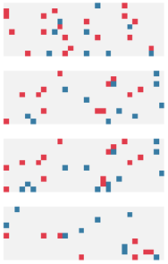
OPA AI to track and predict the impact of NIH decision-making
Track and parameterize:
The publicly available OPA tool
Influence using bibliometric data
The Relative Citation Ratio (RCR)
        Hutchins BI et al. PLoS Biology 2016 14:e1002541
        Hutchins BI et al. PLoS Biology 2017 15:e2003552
        Santangelo GM Mol. Biol. Cell 2017 28:1401-1408
2.0
Influence module
Translation module
Open Citation Collection
Hutchins et al. PLOS Biology 2019
17:e3000385
Translational progress / clinical trials (CTs) and tech transfer / patents
The triangle of biomedicine, APT scores
    Hutchins BI et al. PLoS Biology 2019 17(10):e3000416
Development of drugs and devices
  Disambiguated drug and lead compound name, FDA data
Rate of scientific progress and emergence
Detection of overlapping proposals submitted to different funders
Hoppe et al. Science Advances 2019 5:eaaw7238
Office of Portfolio Analysis
Notes:
The People module of iCite is currently under development (see slides below)

Slide 8
Publicly available web tool: iCite 2.0
Tracking influential publications
Tracking and predicting translational impact

Slide 9









iCite 2.0 development partners
Wellcome Trust
Chonnettia Jones, Director of Insight and Analysis
American Society for Microbiology
Stefano Bertuzzi, CEO
Cornell University
Elizabeth Wood, Director of Clinical Research Information
New York University
Alisa Surkis, Vice Chair Research
Northwestern University
Karen Gutzman, Head, Research Assessment and Communications
Medical University of South Carolina
William Morgenweck, Information Technology Manager
Georgia Clinical & Translational Science Alliance
Eric Nehl, Director, Evaluation & Continuous Improvement
International Rare Diseases Research Consortium
Lucia Monaco, Chair
University of Regensburg
Bjorn Brembs, Professor
Office of Portfolio Analysis

Slide 10
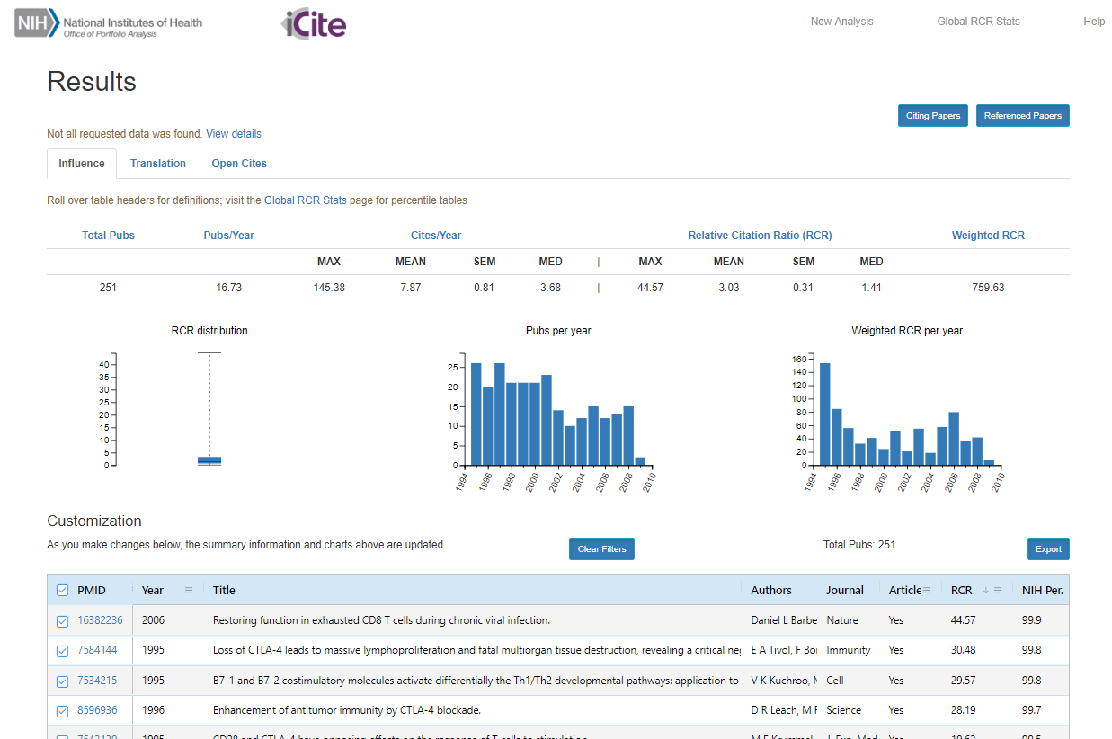

Slide 11
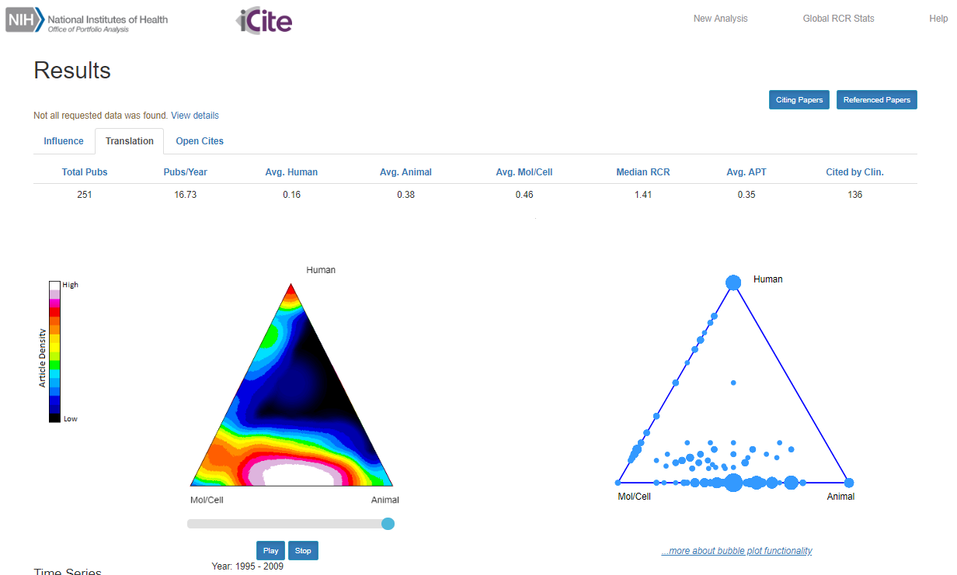

Slide 12
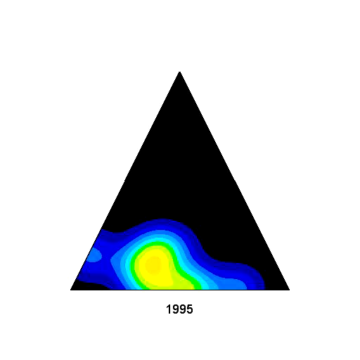
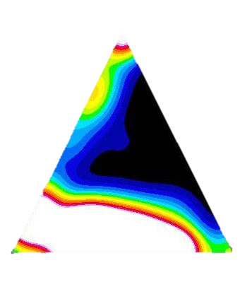
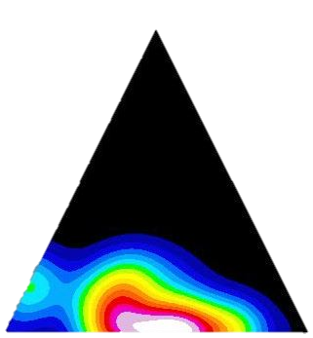
Tracking bench-to-bedside translational progress in biomedical research
Development of cancer immunotherapy
iCite Translation
1996 to 2009
Citation pattern
human
2009
2009
Translational/Clinical
1996
1996
cell &
molecular
animal
Clinical Research
Translational Research
Fundamental Research
Fundamental
Low
Article Density
High
Office of Portfolio Analysis

